Slide 1
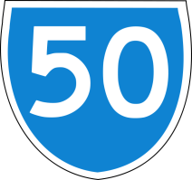
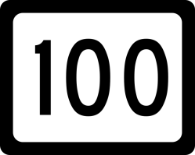
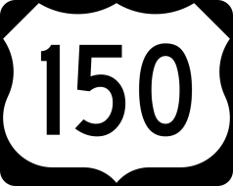
HISTORY | GEOGRAPHY | FAMOUS PEOPLE | POLITICAL SYSTEM | WAY OF LIFE | SURPRISE

Slide 2
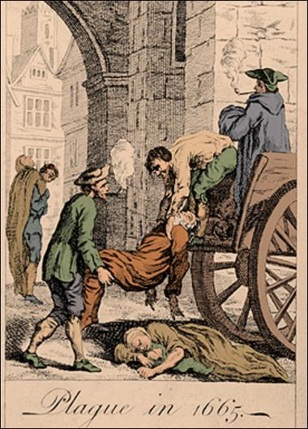
What disaster did the whole England suffer from in 1665?
The Great Plague

Slide 3
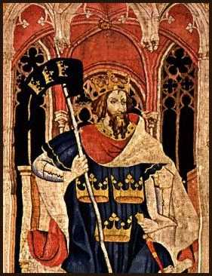
Under what king did the Knights of the Round Table gather together?
King Arthur

Slide 4
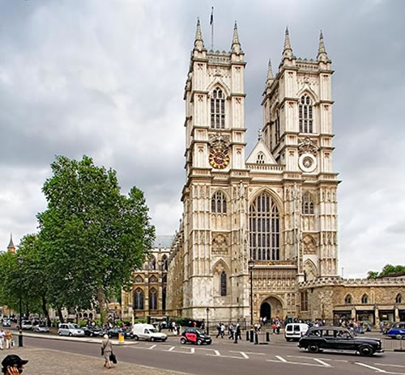
Where are the British kings crowned?
in Westminster Abbey

Slide 5
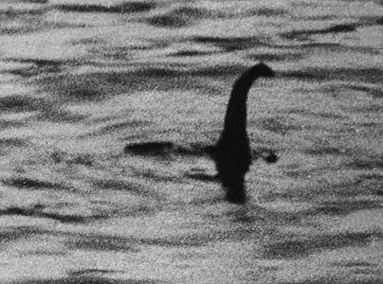
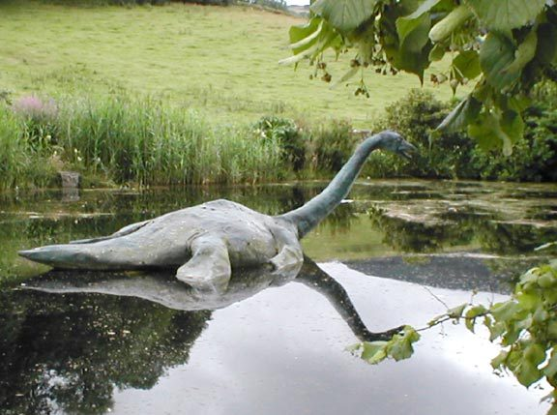
What lake does the famous Scottish monster live in?
Loch Ness

Slide 6
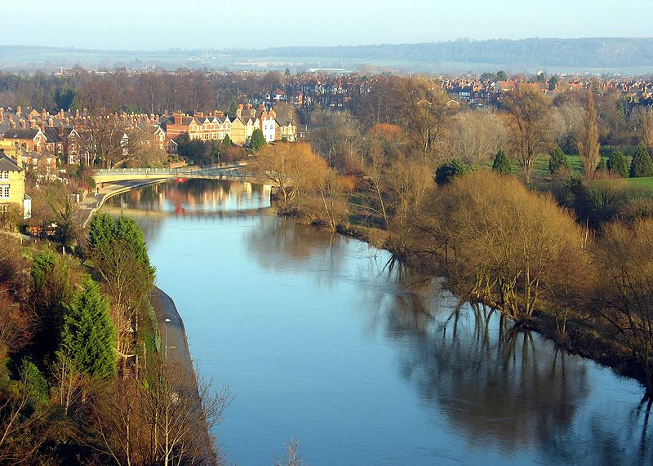
What is the longest river in Great Britain?
the Severn

Slide 7
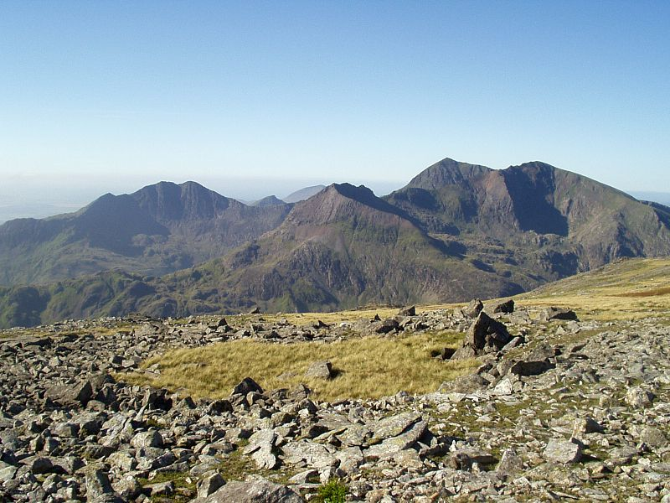
What is the name of the highest mountain in Wales?
Snowdon

Slide 8
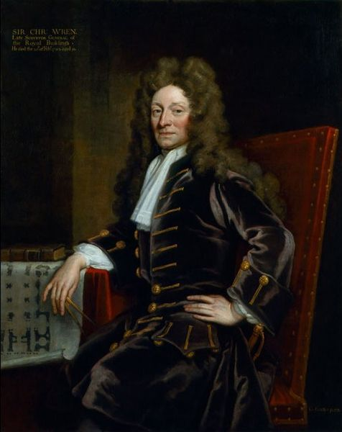
Who is the “Architect of London?”
Christopher Wren

Slide 9
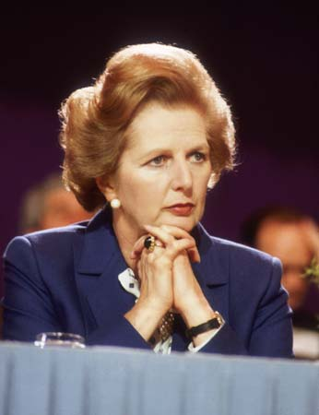
Who was the British Prime Minister in 1979-1996?
Margaret Thatcher

Slide 10
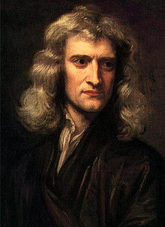
Who wrote the Universal Law of Gravitation?
Sir Isaac Newton

Slide 11
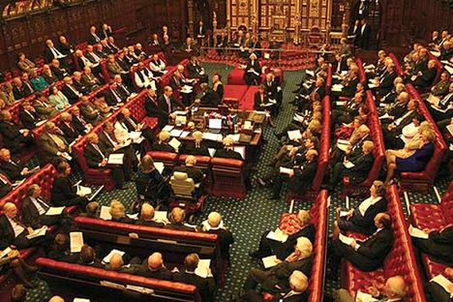
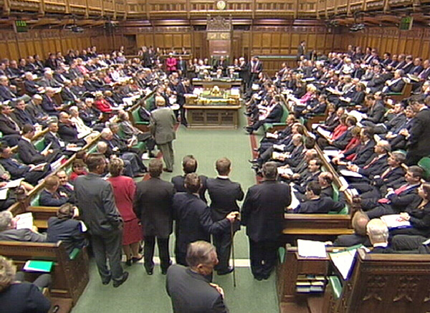
What chambers does the British Parliament consist of?
the House of Lords and the House of Commons

Slide 12
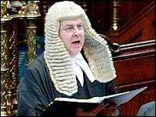
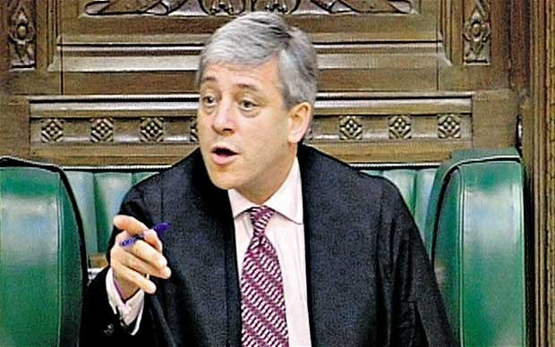
Who presides over the House of Lords and the House of Commons?
the Lord Chancellor
the Speaker

Slide 13
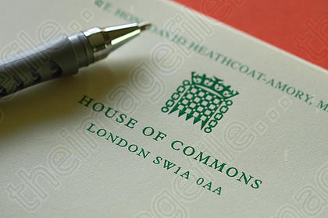
What do the letters MP stand for?
Member of Parliament

Slide 14
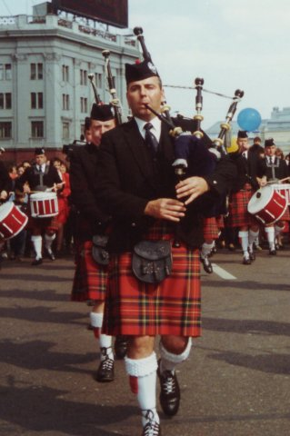
What is the Scottish national costume for men?
the kilt

Slide 15
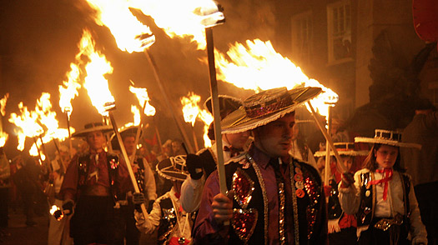
Which holiday is usually celebrated on the 5th of November in the UK?
Guy Fawkes Night or
Guy Fawkes Day

Slide 16
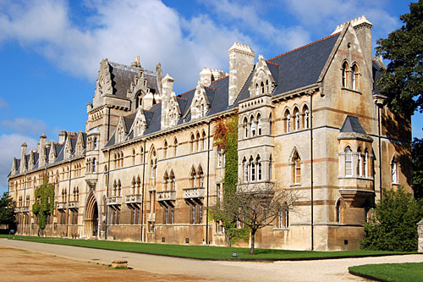
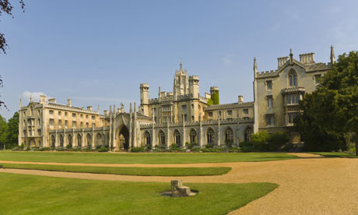
What universities have the highest academic reputation in the UK?
Cambridge University and Oxford University

Slide 17
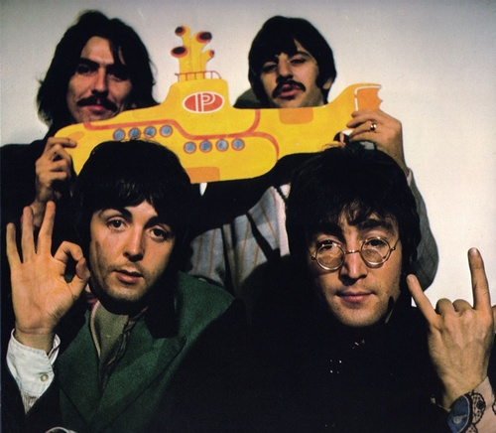
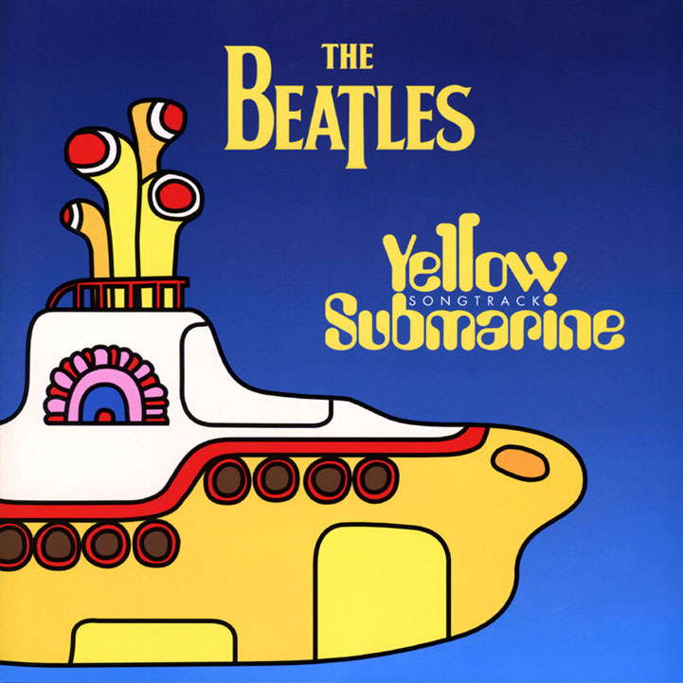
Who sings this song?

Slide 18
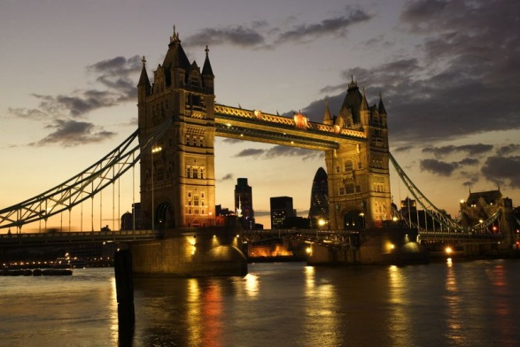
What is this?
Tower Bridge - the most famous bridge in London over the River Thames.

Slide 19
What are these?
The official mascots for the 2012 Summer Olympic and Paralympic Games in London
Талисманы Игр были объявлены 19 мая 2010 года. Ими стали, по заявлениям авторов, две капли стали из Болтона по имени Венлок и Мандевиль. Они названы в честь города Мач-Венлок, в которых прошли первые соревнования наподобие Олимпийских игр, и деревни Сток-Мандевиль, где прошли первые на территории Великобритании Паралимпийские игры. У обоих талисманов по одному глазу, они носят велосипедные шлемы и на них нарисованы логотипы Игр.

