Slide 1
My Family is big

Slide 2
Hi!!! In this presentation I will tell you about the big and cheerful family, I hope my work will be pleasant, follow the links below;)

Slide 3
(Grandfather) Sats Stepan Stepanovich
(Grandmother) Sats Valentina Aleksandrovna
(Aunt) Grigoriev Irina Stepanovna
(The husband of the aunt, the Uncle) Grigoriev Andrey Valerjanovich
(Mum) Sats Veronica Stepanovna
(Uncle) Sats Dmitry Stepanovich
(The son,) Nefedov Roman Aleksandrovich
Grigorieva Valentine Andreevna's (cousin)
Grigorieva Elina Andreevna's (cousin)
Grigorieva Julia Andreevna's (cousin)
The End

Slide 4
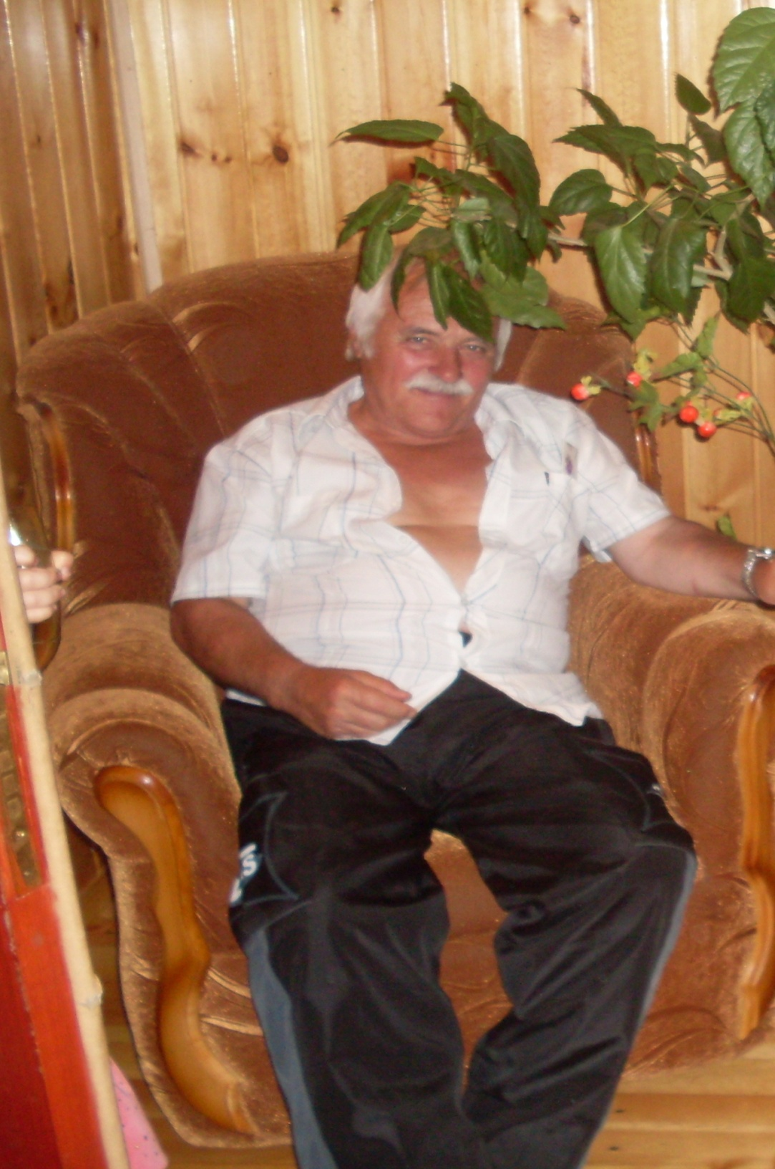
My grandfather is the cheerful
person, likes to joke and to have fun.
His predilection is repairing of clocks, and also he is the magnificent carpenter.

Slide 5
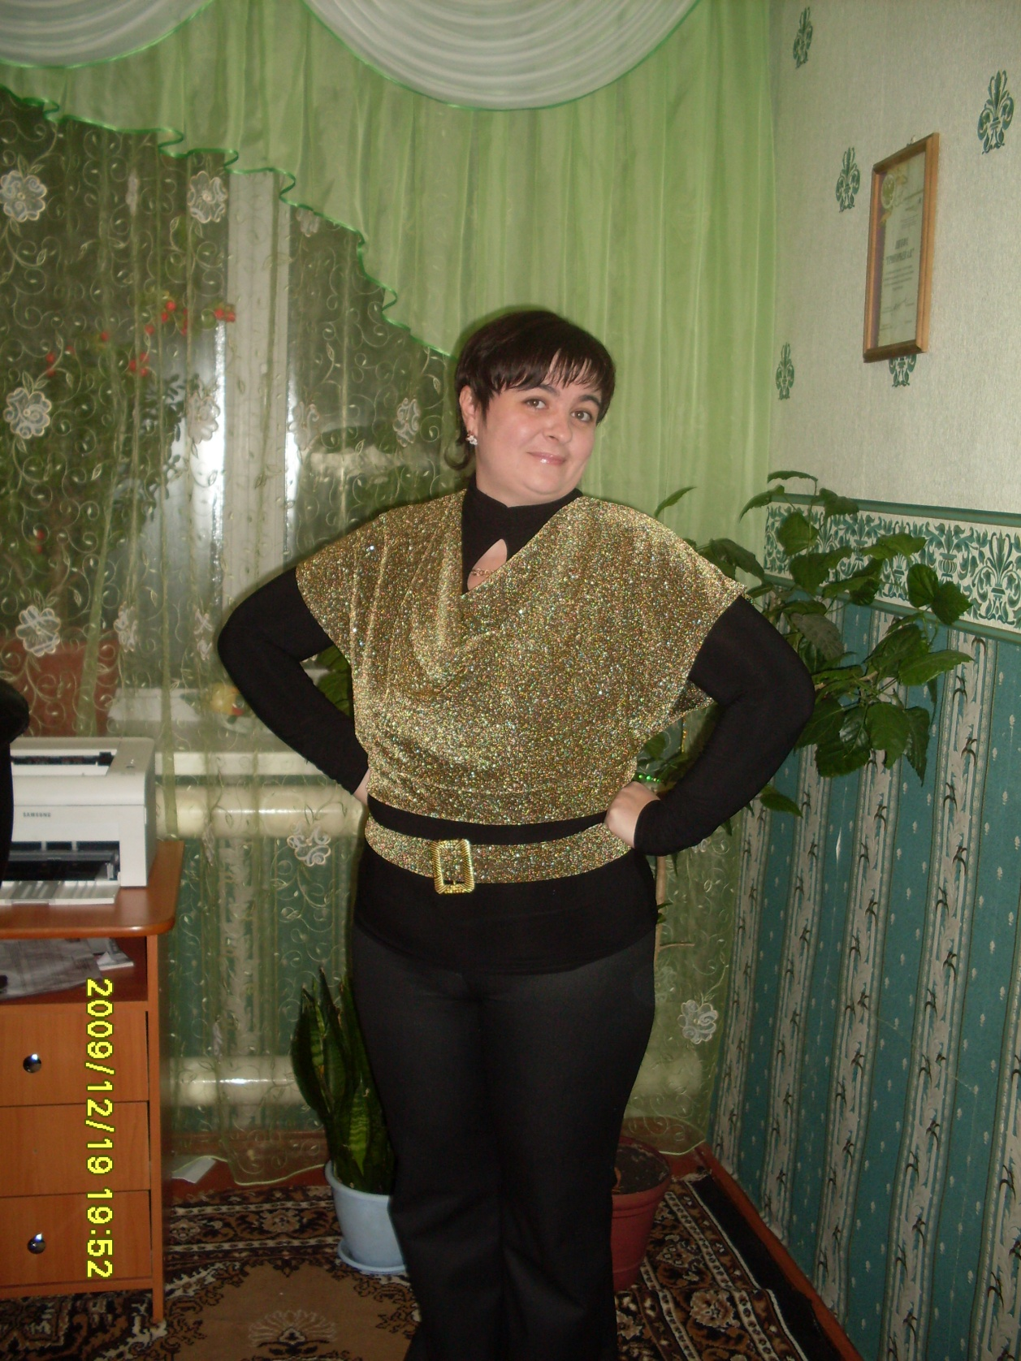
The aunt is many-sided
person with sensible character. about hobbies…I know her as the ardent admirer of plants namely flowers, still she is the excellent cook!

Slide 6
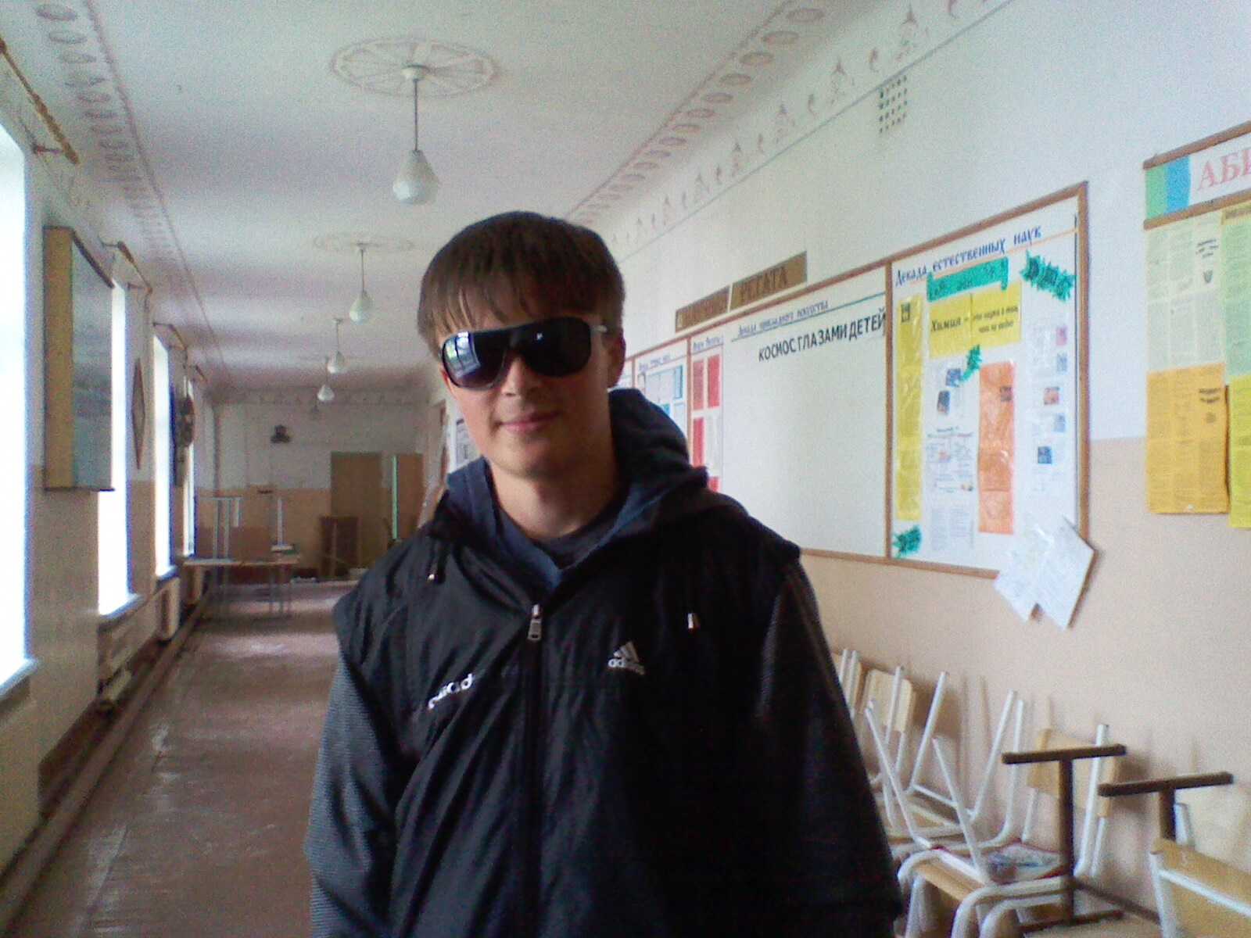
I am the person from the active life
position, I am interested in
different kinds of sports, and as for me,
I like to dig in electronics

Slide 7
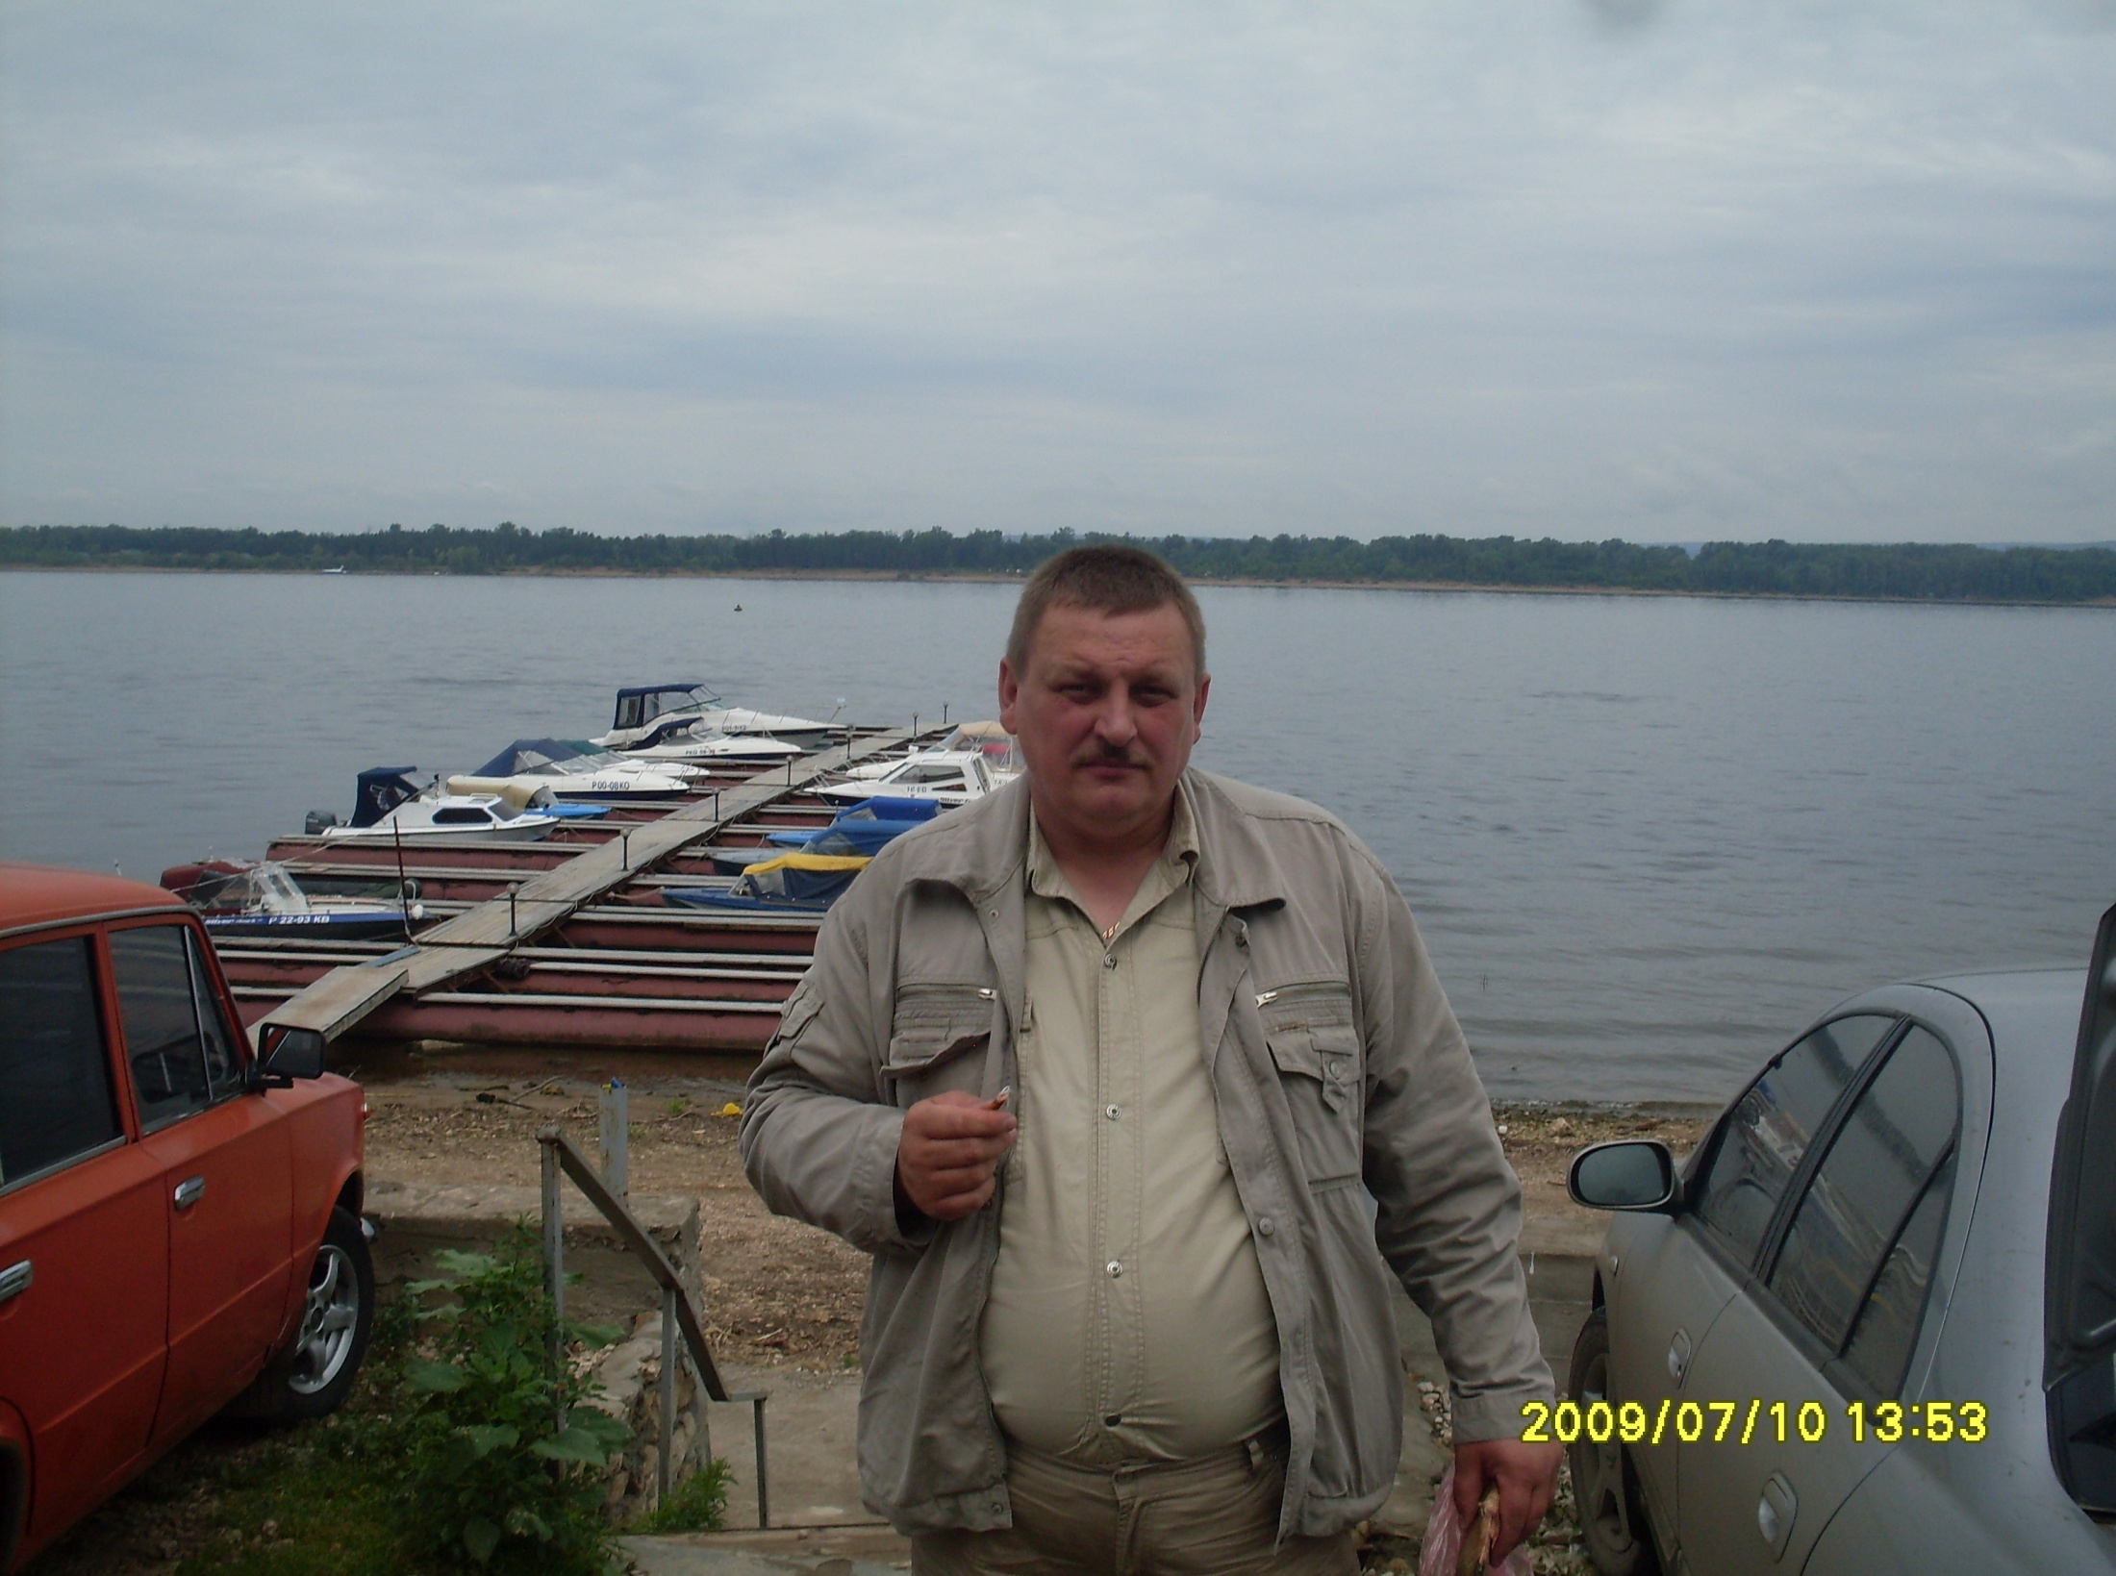
The uncle-fair, widely
developed person, with
Excellent sense of humor, for pleasure
Likes to play in a backgammon,
also is fond of hunting!

Slide 8
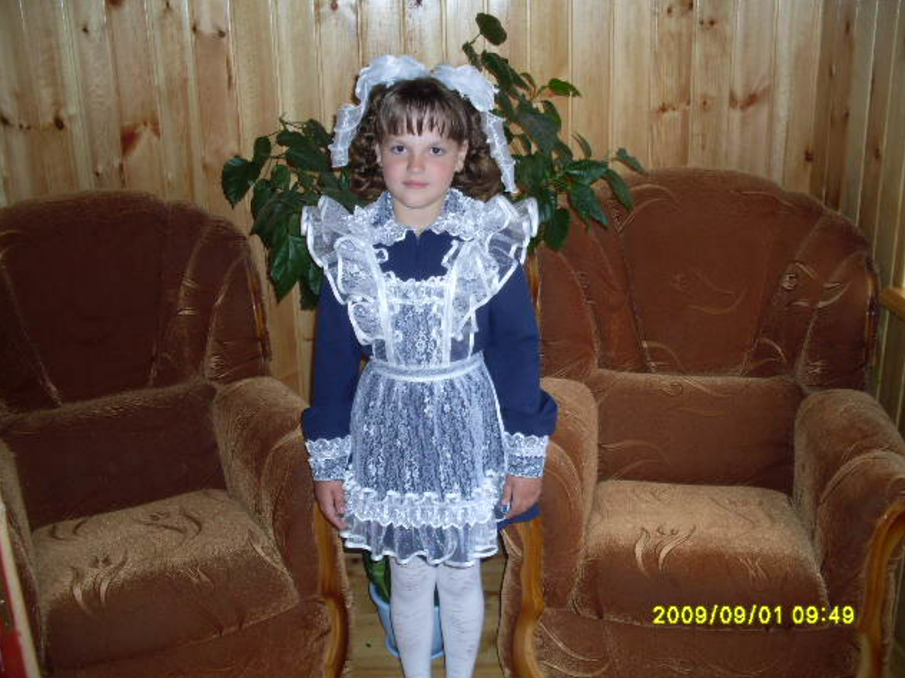
Julia.. My cousin wears fashionable clothes likes
to play "school"
and to communicate with friends =)

Slide 9
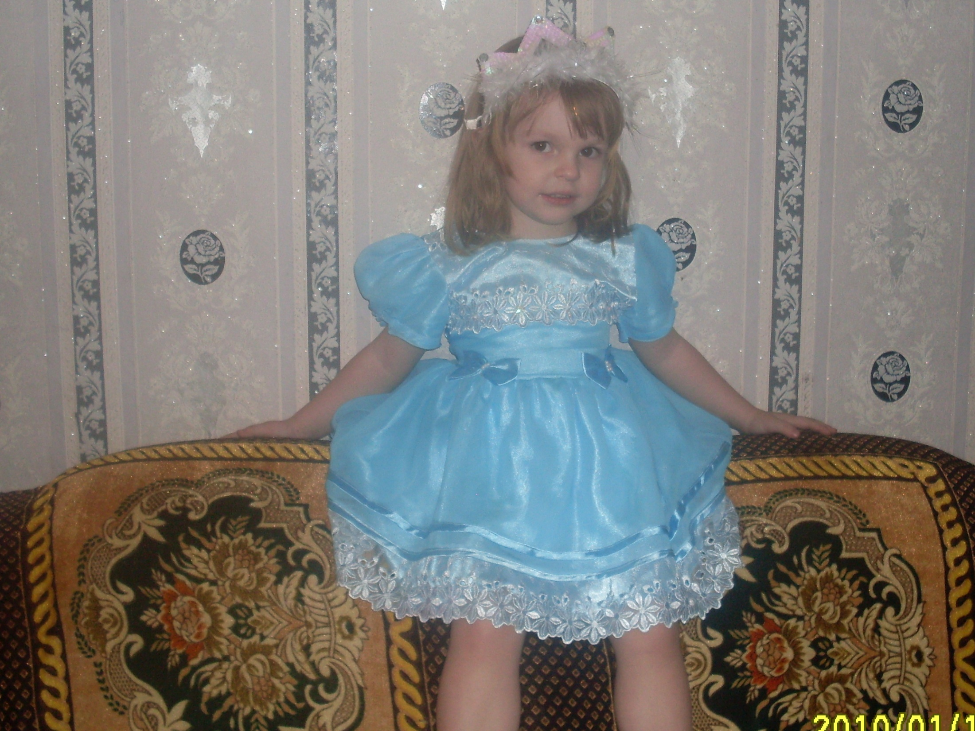
The YOUNGEst OF SISTERS,
THE funniest
AND MYSTERIOUS GIRL.. about HOBBIES:
LIKES TO watch CARTOON FILMS

Slide 10
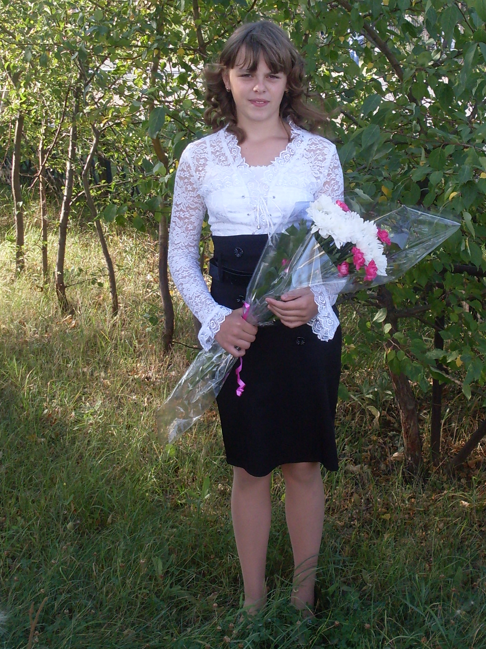
CLEVER AND INCENDIARY! She is my cousin too, THE OPTIMIST,
IS A GOOD JUDGE OF MUSIC AND DANCES,
IS FOND of dancing AND SINGS well!!!

Slide 11
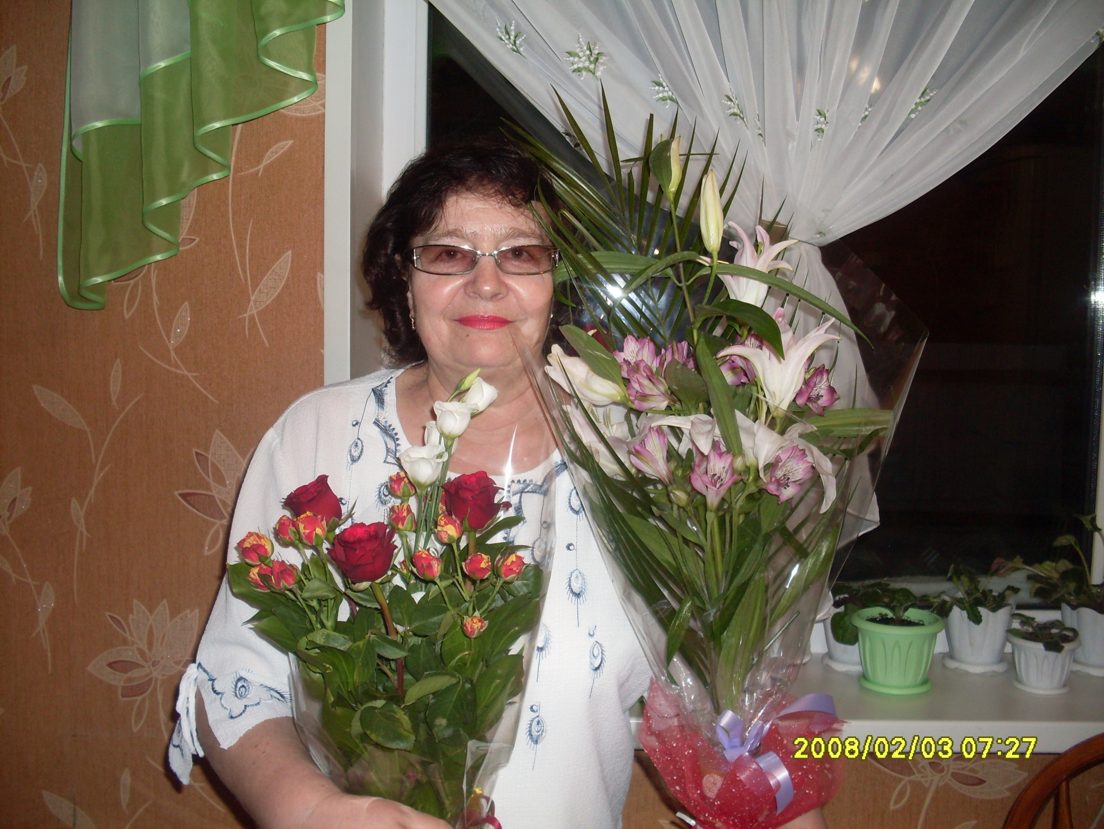
Our GRANDMOTHER is GOOD-NATURED! THE HOUSEWIFE,
She is very responsible person, her HOBBY is
CHORAL SINGING, my Granma takes part at big musical festivals and events!(I am proud of this fact)))))

Slide 12
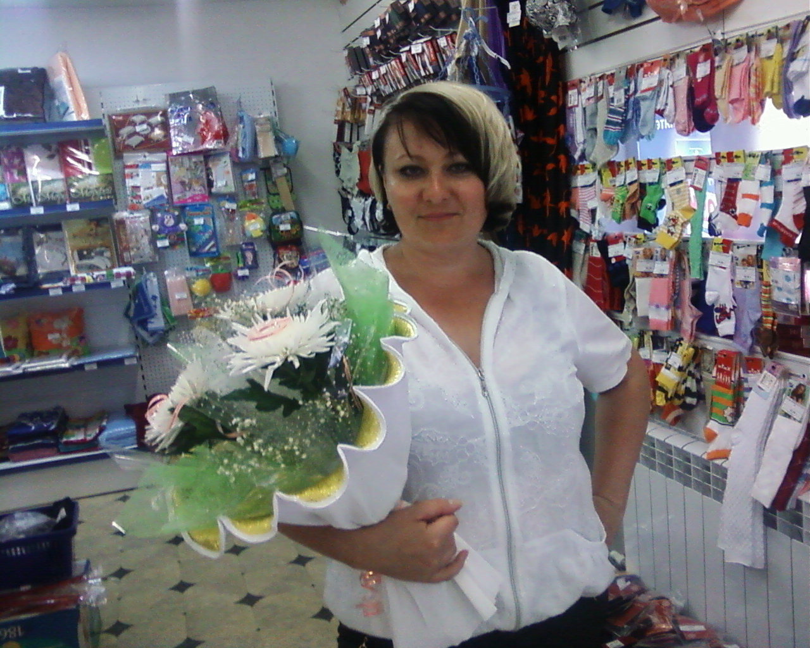
MUM IS THE CREATIVE PERSON,
ALWAYS SHE IS READY
TO HELP WITH ANY BUSINESS,
LIKES TO EMBROIDER AND SKI

Slide 13
Thanks
for
viewing
presentation
of
MY
author:
Nefedov
Roman

Slide 14
Источники:
1.Домашний фото архив
2.Сайт Allday.ru
3.Яндекс.картинки

