Slide 1
Презентация к уроку английского языка по УМК «MILLIE-4» Раздел 4 «In the Castle»
Подготовила презентацию учитель английского языка
МОУ «Средняя общеобразовательная школа №118»
г. Омска
Шаронова Галина Федоровна

Slide 2
УМК «MILLIE-4» Unit 4 «In the Castle»
Unit outcomes:
By the end of the unit pupils should be able to
Create and tell their own story
Complete the picture of a castle by asking about and describing missing details and locations

Slide 3
Nizhniy Novgorod, Koromyslova Tower

Slide 4
The Legend of Koromyslova Tower, Nizhniy Novgorod
Many years ago there was a girl called Alyona. One day she went outside the Kremlin to get some water. But there were Tartars near the Kremlin wall. Alyona had a fight with them and injured them with her yoke. She was so brave and strong! The Tartars scared and ran away. The tower got the name Koromyslova after Alyona’s yoke.
________
Injure- ранить, нанести повреждение
Yoke-коромысло

Slide 5
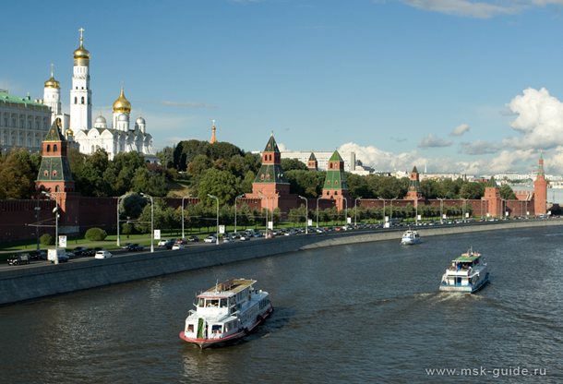
The Moscow Kremlin

Slide 6
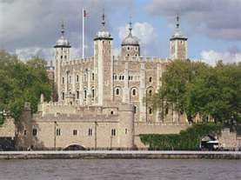
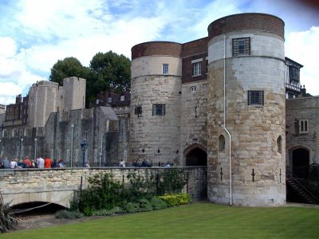
The Tower of London

Slide 7
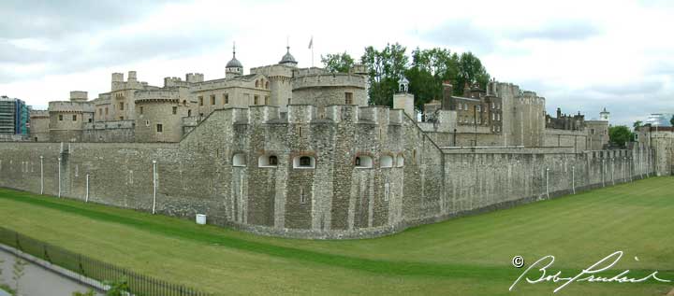
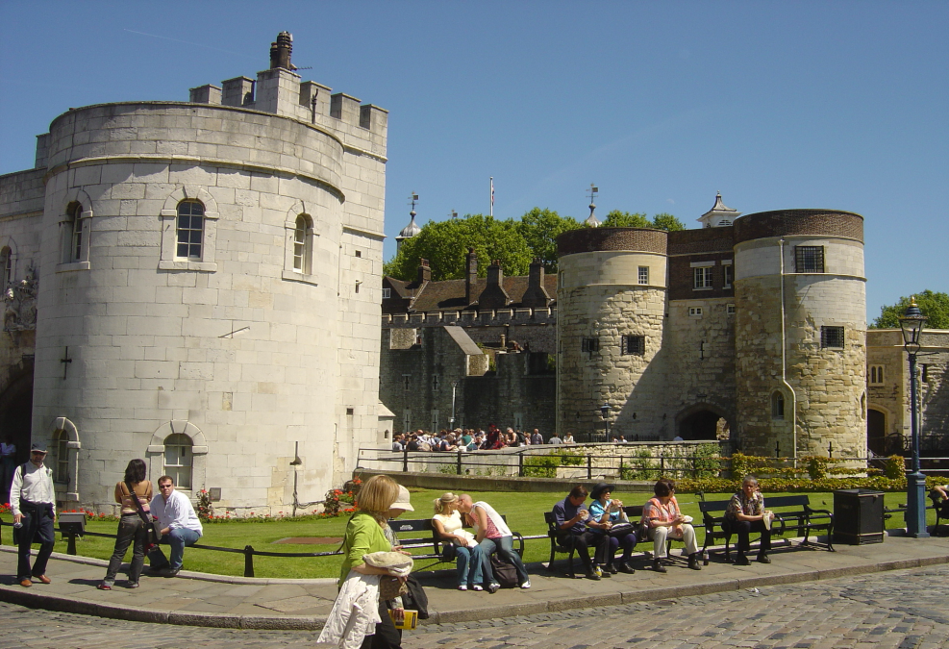
The Tower of London
The Tower of London is an old fortress on the river Thames.
Many tourists from Russia, Japan, the USA, Brazil, China and other countries visit it every day.

Slide 8
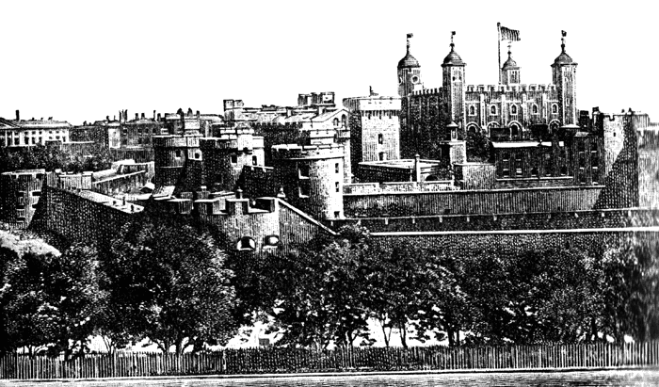
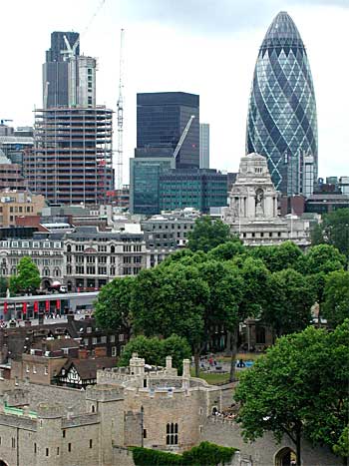
The Tower of London
Many years ago
Now

Slide 9
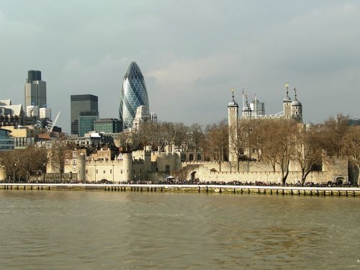
The Tower of London
Now there are many high buildings around the Tower, so it does not look very big.

Slide 10
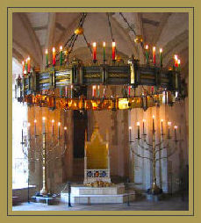
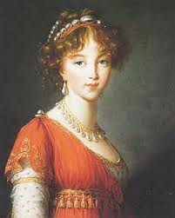
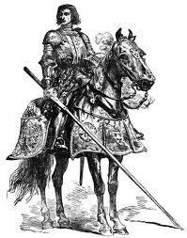
The Tower of London
300 years ago it was one of the king’s palaces. There were a lot of brave knights and princesses in beautiful dresses.

Slide 11
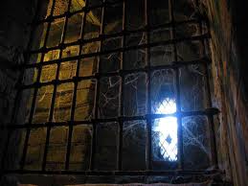
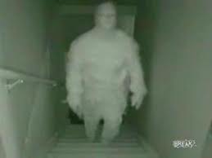
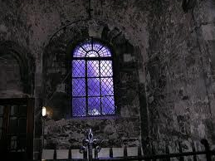
The Tower of London
It was also a prison. Many people were murdered there. Some people say there are ghosts in the Tower.

Slide 12
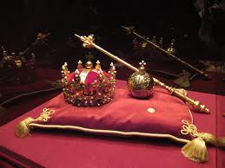
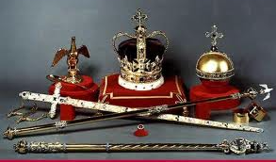
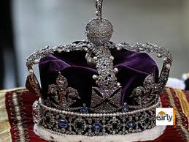
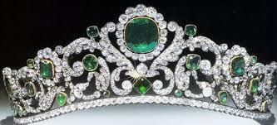
The Tower of London
Today the Tower is a museum. Tourists can see the Crown Jewels of the English kings and queens

Slide 13
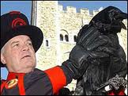
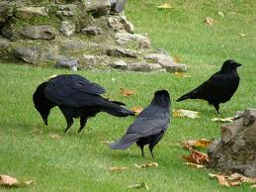
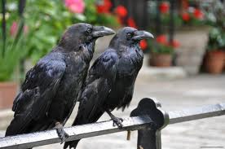
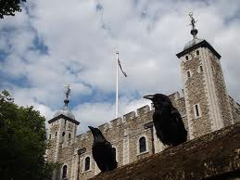
The Tower of London
There are seven ravens in the Tower. Their names are Hardey, Thor, Odin, Gwyllum, Cedric, Hugine and Munin.
Many years ago there were a lot of ravens. People say these birds keep the Tower and the city of London safe.

Slide 14
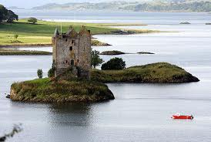
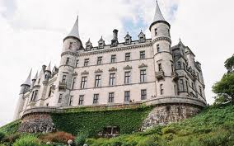
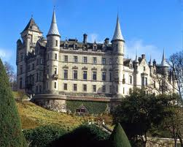
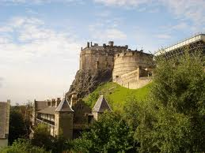
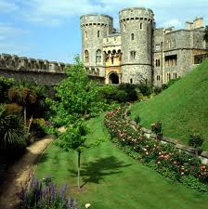
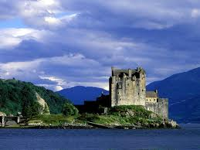
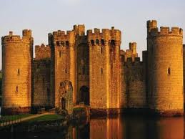
Castles in Great Britain Scotland

Slide 15
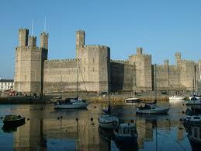
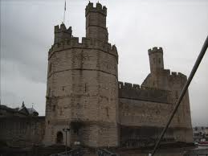
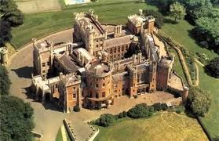
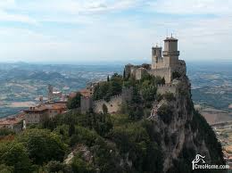
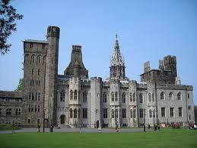
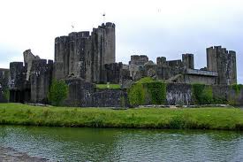
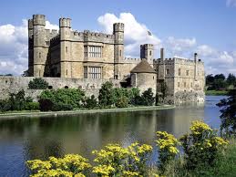
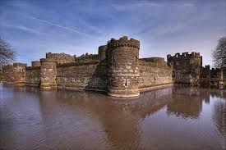
Castles in Great Britain Wales

Slide 16
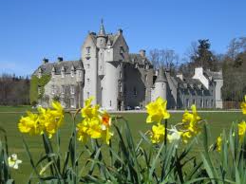
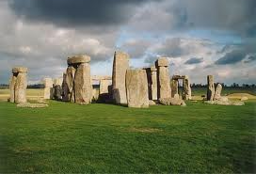
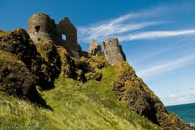
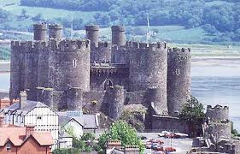
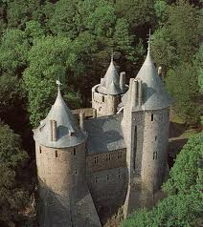
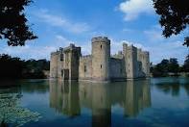
Castles in Great Britain Northern Ireland

Slide 17
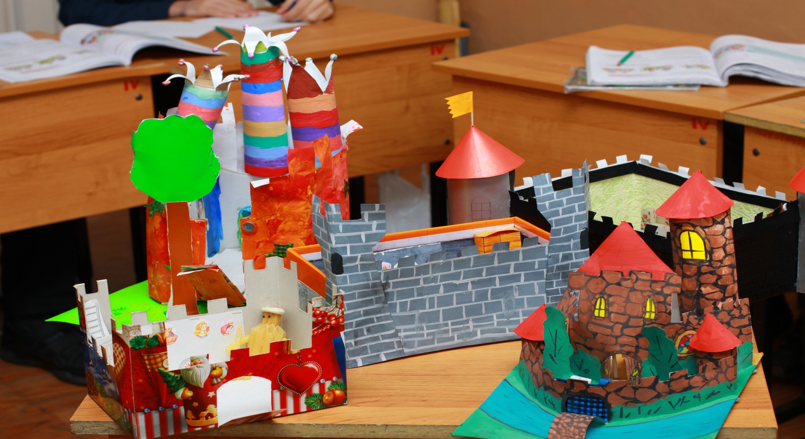
Castles are made by pupils of 4-1 Class School №118 in Omsk

Slide 18
Castles are made by pupils of 4-1 Class School №118 in Omsk

Slide 19
Castles are made by pupils of 4-1 Class School №118 in Omsk

Slide 20
Castles are made by pupils of 4-1 Class School №118 in Omsk

Slide 21
Литература:
Английский язык «Millie-4» С.И.Азарова,Э.Н.Дружинина и др.

