Slide 1
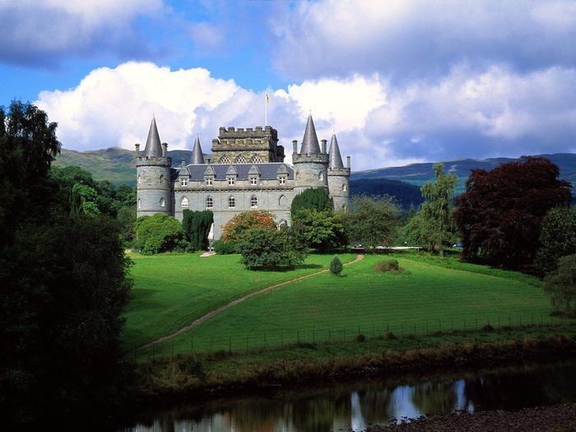
MY HOME IS MY CASTLE
Лозовская Н.Н., учитель, МОУ СОШ № 2, 2011г.

Slide 2
Home or House?
Home is a place where you live.
House is a building where you live in.

Slide 3
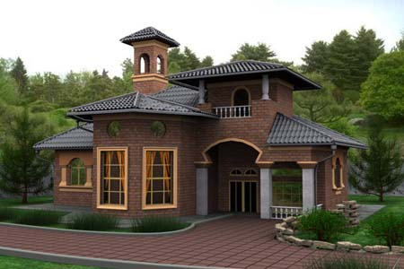
There are different types of houses.
A building for people to live in, often it has more than one level and is used by a single family.
House

Slide 4
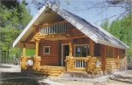
A small house in the country.
cottage
A block of flats
A place for people to live that consists of a set of rooms.

Slide 5
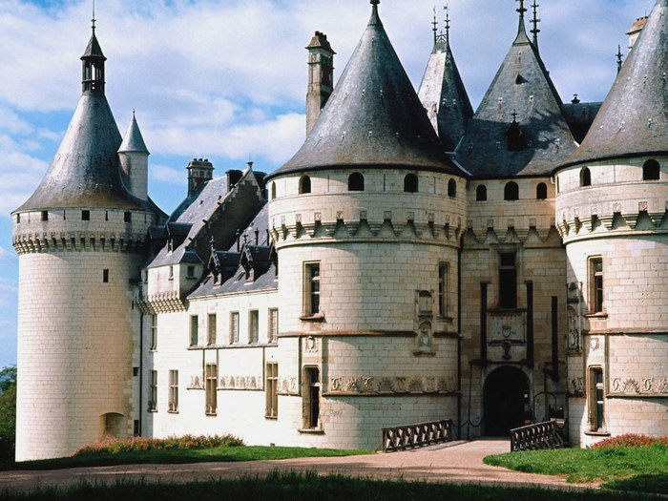
castle
A very large strong building, built in the past as a safe place that could be easily defended against attack.

Slide 6
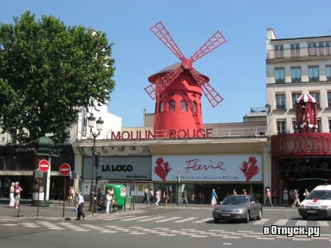
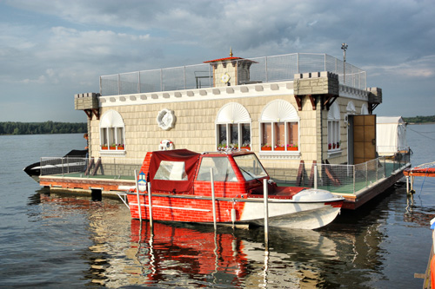
A building with parts that turn around in the wind.
Windmill
Kingfisher
A house on a boat.
Windmill

Slide 7
Answer the questions:
1. Is a house a building where you can live in?
2. What does the word “home” mean?
3. What types of houses do you know?

Slide 8
Используемые ресурсы:
http://fotoart.org.ua/albums/userpics/palace_Inverary_Castle.jpg
http://ru.fishki.net/picsw/062007/07/deti/deti_064.jpg
http://ndo.su/dom/houses/img/index-8.jpg
Http://spb.vizd.ru/var/upload/brus(1).jpg
http://foto.spbland.ru/data/media/12/29853_Suharevo3.jpg
http://desktop.kazansoft.ru/bigimages/world/castle/img-cffa6.jpg
http://www.votpusk.ru/gallery/large/10195.jpg
http://www.domnavode.ru/images/foto/dom-na-vode-3.jpg
Деревянко Н.Н. и др., «Английский язык нового тысячелетия»
5 класс, четвертый год обучения, «Титул», 2008.
Longman Dictionary of English Language and Culture, Longman 1992.
Dictionary of Contemporary English, Longman 1997.

