Slide 1
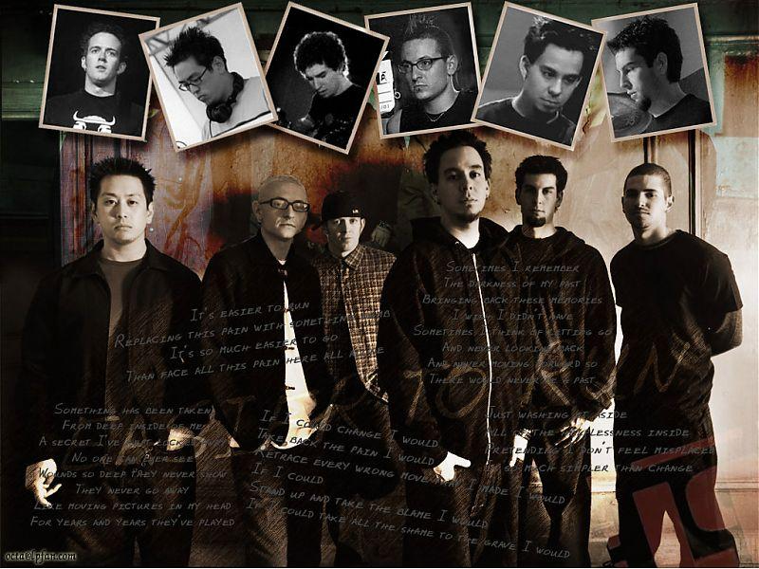
Linkin Park
Made by Maria Kinibaeva 11 class 2012

Slide 2
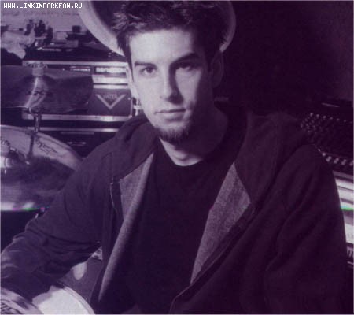
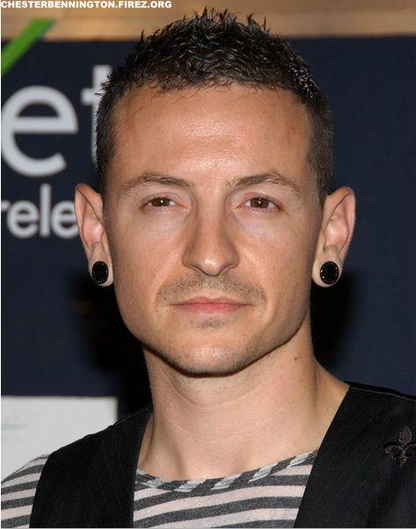
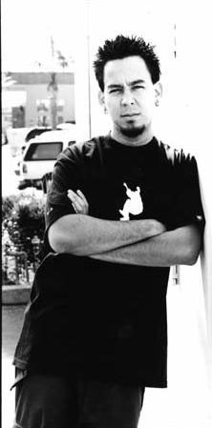
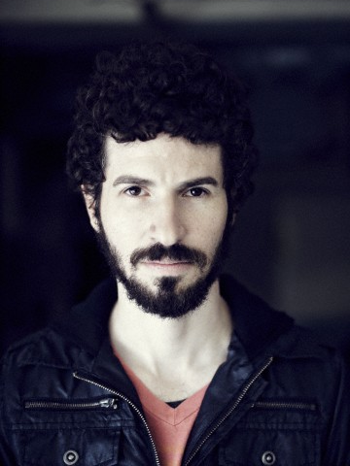
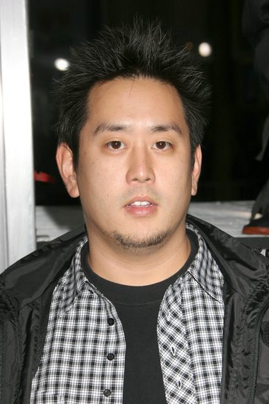
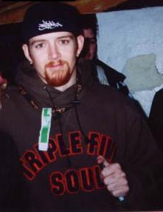
Rob Bourdon – drums (1996–present)
Chester Bennington – lead vocals (1998–present)
Mike Shinoda – vocals, rhythm guitar, keyboards (1996–present)
Joe Hahn – turntables, keyboard, samples, backing vocals (1996–present)
Brad Delson – lead guitar, backing vocals (1996–present)
Dave "Phoenix" Farrell – bass, backing vocals (1996–1998, 2000–present)

Slide 3
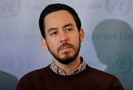
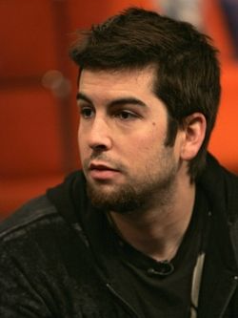
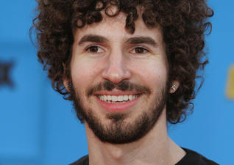
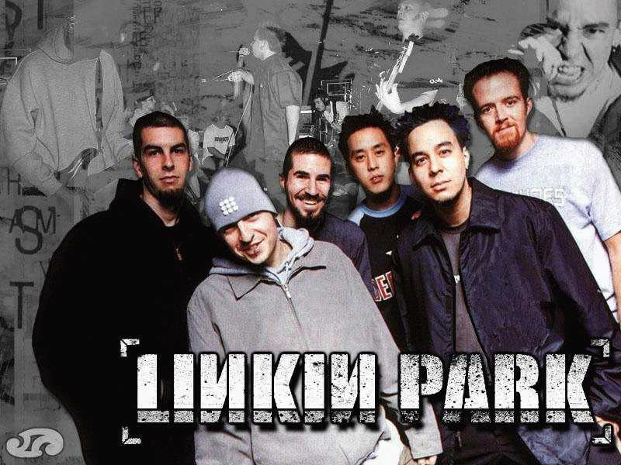
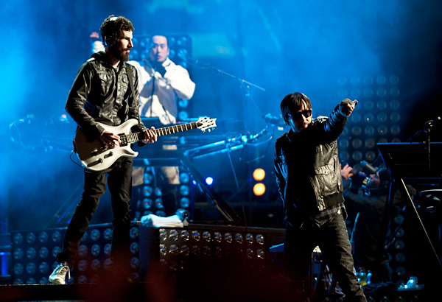
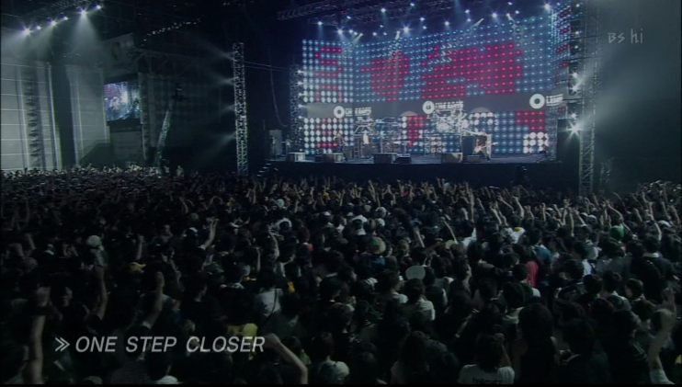
Foundation history
The founding of Linkin Park began with three high school friends; Mike Shinoda, Rob Bourdon, and Brad Delson.After graduating from high school, the three began to take their musical interests more seriously, recruiting Joe Hahn, Dave "Phoenix" Farrell, and Mark Wakefield to perform in their band, Xero. Though limited in resources, the band began recording and producing songs within Shinoda’s makeshift bedroom studio in 1996.The lack of success and stalemate in progress prompted the band's vocalist to leave the band in search of other projects.Farrell also left to tour with Tasty Snax and other bands.
After spending a considerable time searching for vocalist’s replacement, Xero recruited Arizona vocalist, Chester Bennington. Bennington became a standout among applicants because of the dynamic in his singing style.[The band then agreed on changing its name from Xero to Hybrid Theory. The newborn vocal chemistry between Shinoda and Bennington helped revive the band, inciting them to work on new material.The band’s renaissance culminated with a change in name; from Hybrid Theory, the band once again changed its name, this time to Linkin Park, a play on and homage to Santa Monica’s Lincoln Park.[However, despite these changes, the band still struggled to sign a record deal. After facing numerous rejections from several major record labels, Linkin Park turned to Jeff Blue for additional help. After failing to catch Warner Bros. Records on three previous reviews, Jeff Blue, now the vice president of Warner Bros. Records, helped the band sign a deal with the company in 1999. The band released its breakthrough album, Hybrid Theory, the following year.

Slide 4


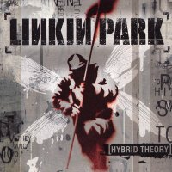
Linkin Park is an American rock band from Agoura Hills, California. Formed in 1996, the band rose to international fame with their debut album, Hybrid Theory, which was certified Diamond by the RIAA(Recording Industry Association of America) in 2005 and multi-platinum in several other countries.
Hybrid Theory

Slide 5
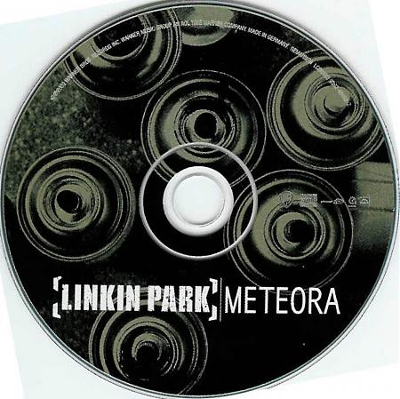
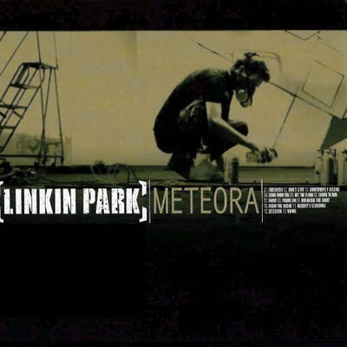
Meteora
Linkin Park's second album debuted on March 25, 2003 and instantly earned worldwide recognition. Meteora sold more than 800,000 copies during its first week, and it ranked as the best selling album on the Billboard charts at the time.The album's singles, including "Somewhere I Belong", "Breaking the Habit", "Faint", and "Numb", received significant radio attention.

Slide 6
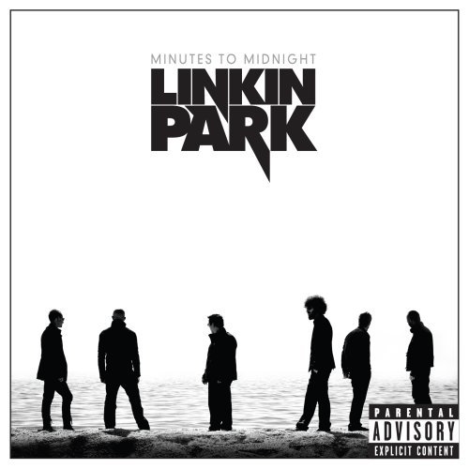
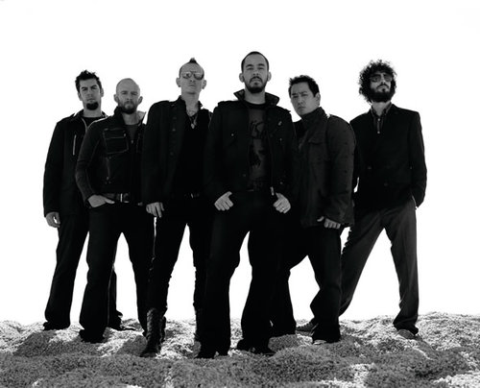
Minutes to midnight
Minutes to Midnight is the third studio album released on May 14, 2007, through Warner Bros. Records. This album includes What I’ve Done» April 2 2007,«Bleed It Out» August 20 2007.«Shadow of the Day» October 16 2007.«Given Up» March13 2008,«Leave Out All the Rest» June 1 2008

Slide 7
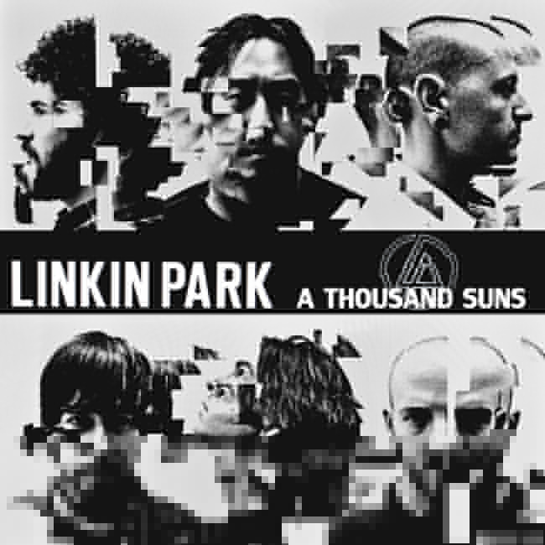
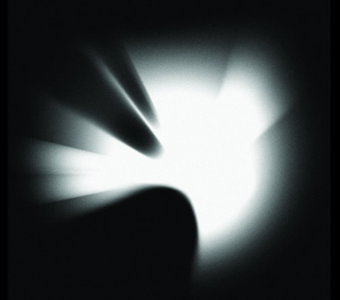
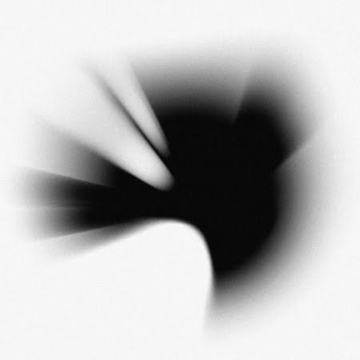
A Thousand Suns
A Thousand Suns is the fourth studio album. It was released on September 14, 2010. A Thousand Suns is a multi-concept album dealing with human fears such as nuclear warfare. "On this record, the concepts blend human ideas with technology [...] Human fears, your fear of what's going to happen in the world, the music kind of references that", said Mike Shinoda on an interview with MTV.

Slide 8
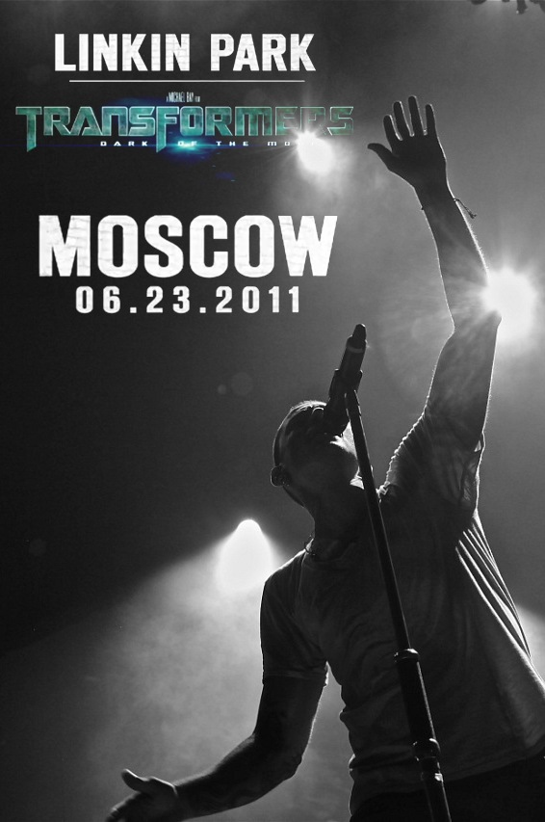

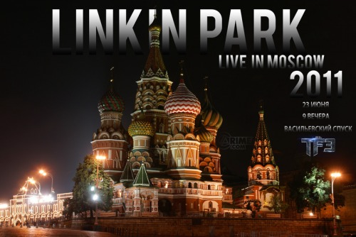
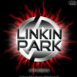


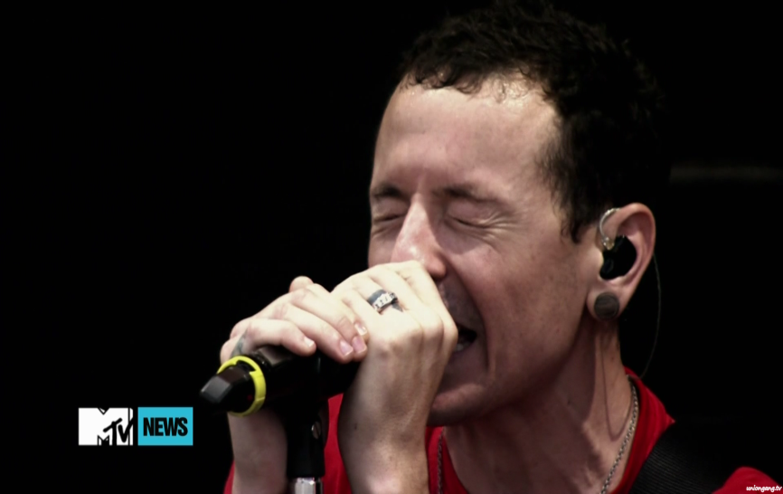
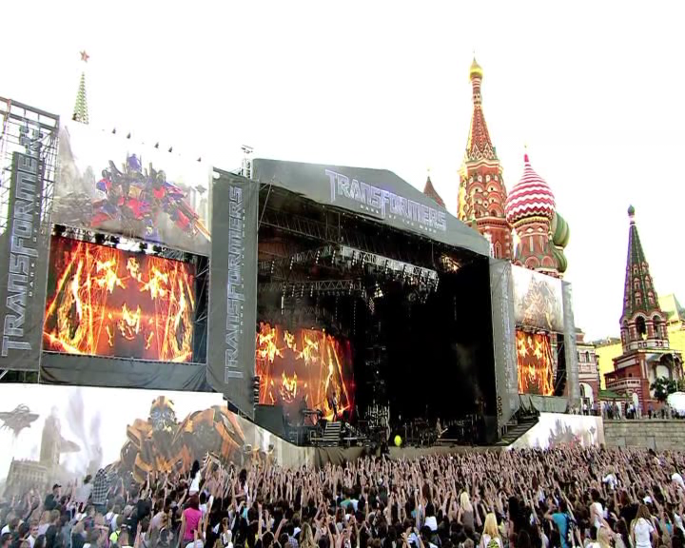

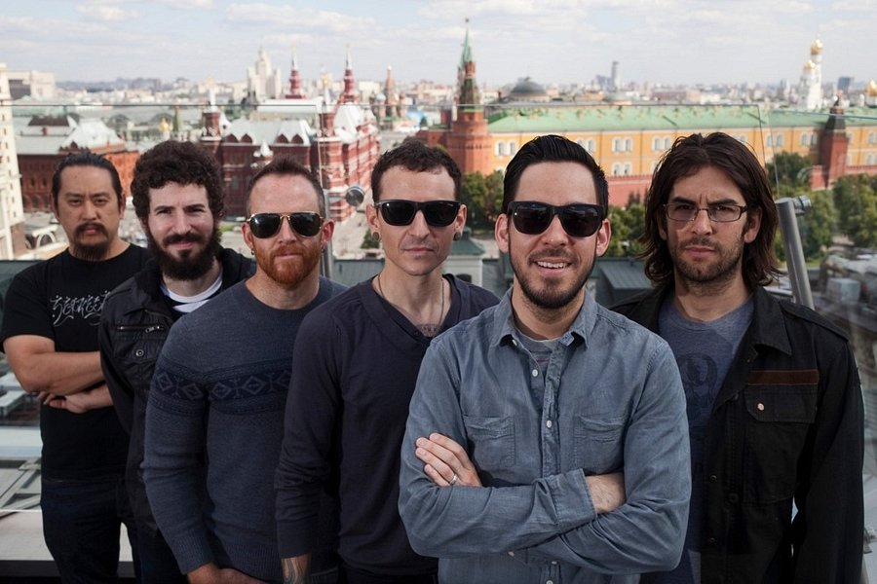

In June the 6th 2011 Linkin park performed in Moscow

Slide 9
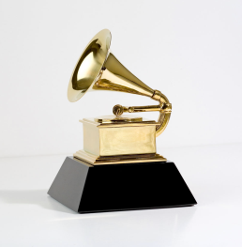
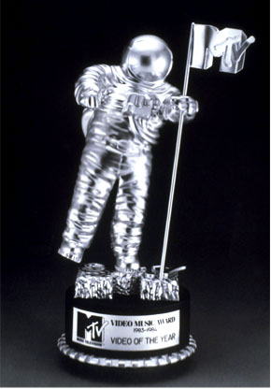
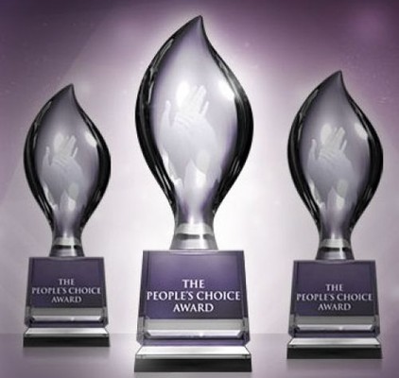


Several Linkin Park Awards
«Grammy Awards» (2 times)
«Crawling» (2002)
«Numb/Encore» (2006)
MTV Video Music Awards (4times)
« Shadow of the Day» (2008)
«Somewhere I Belong» (2003)
«Breaking the Habit» (2004)
«In the End» (2002)
American Music Awards (3 раза) — (2003, 2004, 2007)
People's Choice Awards, USA
2012- Got nomination for People's Choice Award
category Favorite Band
2011- Got nomination for People's Choice Award
category Favorite Rock Band
2008- Got nomination for People's Choice Award
category Favorite Song from a Soundtrack (from Transformers (2007)) for "What I've Done“
World Music Awards
2007- Won World Music Award
category World's Best Selling Rock Group
2003- Won World Music Award
category Best Rock Group
2002- Won World Music Award
category World's Best-Selling Rock Group

Slide 10
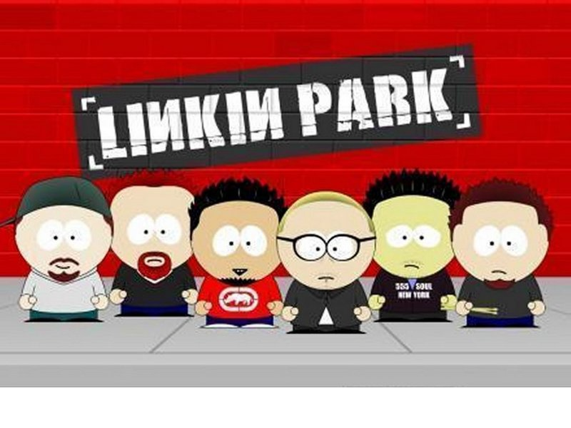
Thank you for attention

