Slide 1
We want to be famous!!!
МОУ Каргасокская Средняя Общеоброзавательная школа №2
Lakonkina Kate
Skirnevskay Lisa
Form 6
Teacher:Fateeva T.A.
Kargasok
2011

Slide 2
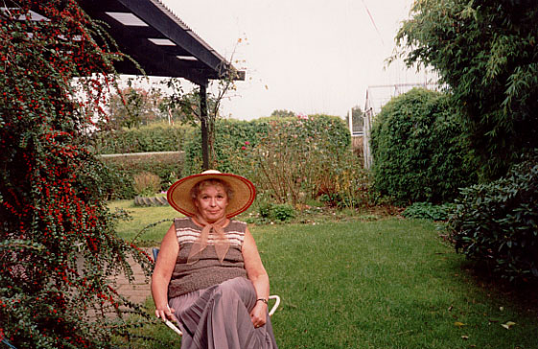
Joanna Khmelevskaya (April 2, 1932)

Slide 3
Goal of the project
We want to talk about an interesting writer.
And people interested in.

Slide 4
Plan
1. project Title
2. The aim of the project
3. Hero of the project
4. Information on Hero
5. Childhood hero
6. Family Hero
7. conclusion
8. links

Slide 5
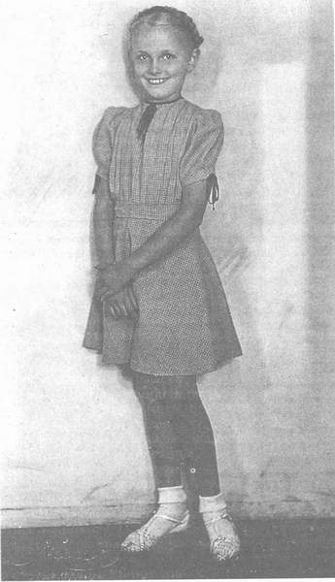
Childhood
Khmelevskaya was born in Warsaw in the family of bank director.
Joanna education was done by women - mother, grandmother and two aunts, Teresa and Lucyna.

Slide 6
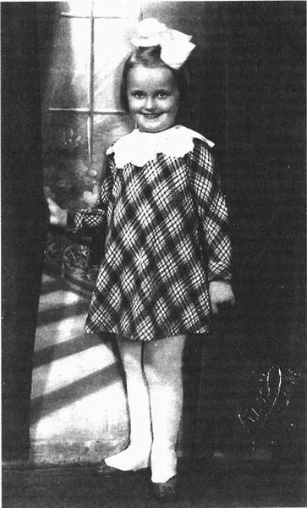
Childhood
Because of the war, John had to quit school.
First worked with her aunt Lucyna, and then, in 1943, was sent to boarding school Chmielewski at Resurrection Monastery in Warsaw.

Slide 7
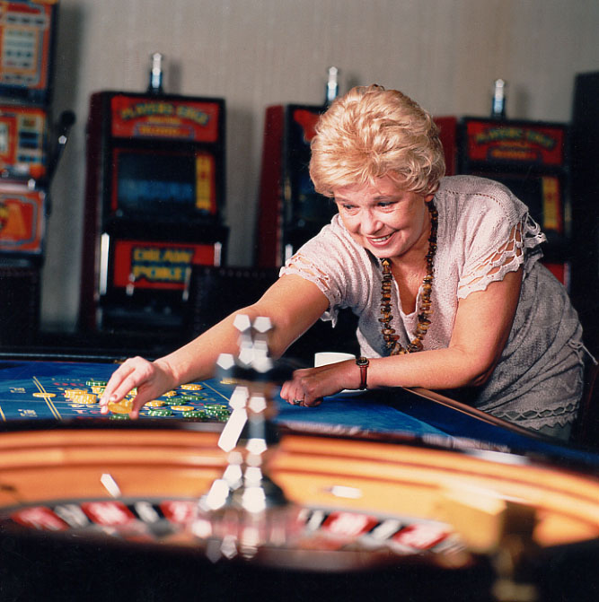
HOBBY
Khmelevskaya well plays in cards. Her hobby - bridge, running, collecting amber and brands, making beads made ​​of shells, tarot cards, compiling tracks from the dry grass.

Slide 8
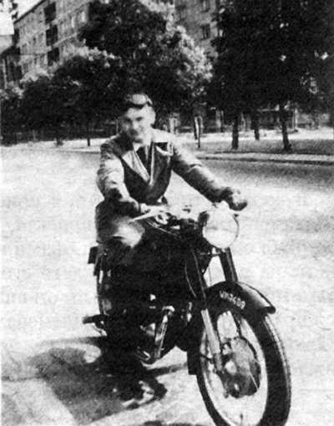
Famely
her husband

Slide 9
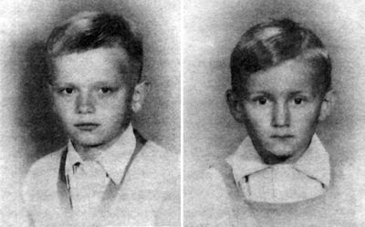
Famely
In this marriage she had two sons - Jerzy (born in 1951) and Robert (born in 1956).

Slide 10
Works
2 heads and one leg Les back roads blind luck The endless band A large piece of light What did the deceased wild squirrels aliens in Garwolin fight fire Crocodile from the country of Charlotte We are all under suspicion century novel mystery all Red pandemonium The book is about food Joke and say I started at the same time (autobiography)

Slide 11
Conclusion
We would like to tell about an interesting person and interested people.

Slide 12
Links
http://translate.google.ru
http://www.google.ru/search?q=иоанна+хмелевская&
http://nnm.ru/blogs/wxyzz/ioanna_hmelevskaya_-_sobranie_sochineniy/
http://modernlib.ru/books/hmelevskaya_ioanna/opasniy_vozrast/read_20/
http://ru.wikipedia.org/wiki/%D0%A5%D0%BC%D0%B5%D0%BB%D0%B5%D0%B2%D1%81%D0%BA%D0%B0%D1%8F,_%D0%98%D0%BE%D0%B0%D0%BD%D0%BD%D0%B0
http://chmelevska.sitecity.ru/album_3008224204.phtml?pix=11

Slide 13
Thank you for attention!
Good Lack!!!

