Slide 1
“We want to be famous”
http://tea4er.ru/contest/-we-want-to-be-famous
Are James Bond
and Jan Fleming alike?
Project by the 6th form pupils of Yakimansko-Slobodskaya school
from the town of Murom Vladimirskaya region;
Remizova Alina, Schmelyova Alexandra.
Teacher: T.L. Barinova

Slide 2
Reading about Jan Fleming we found out that the author and his character James Bond have much in common.
Plan
James Bond
Jan Fleming
They are alike
Actors starred as James Bond
Conclusion
Links

Slide 3
James Bond
James Bond was created by author Ian Fleming and is one of the most famous secret agents in modern fiction. Bond is a cool, handsome, dangerous agent for British Intelligence; his code number, 007, indicates that he has a "license to kill" in the line of duty. Bond travels the globe and uses his wits, fighting skills and a grab-bag of high-tech gadgets to battle super-villains.

Slide 4
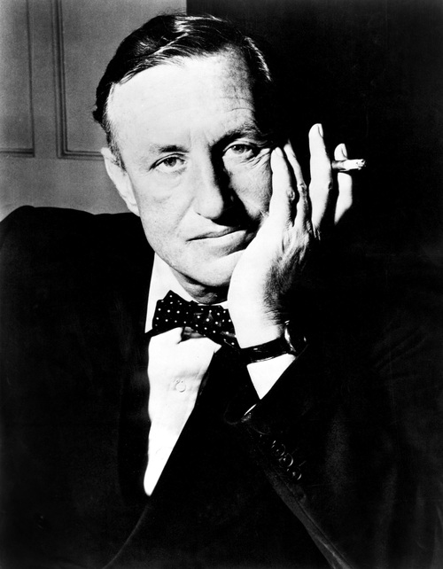
Jan Fleming
Before Fleming started writing the James Bond stories, he worked for British Naval Intelligence. He even had a code name. It was not 007, however, but 17F.
After publishing his first Bond adventure, Casino Royale, in 1953, Fleming wrote one Bond book each year until his death.
Fleming wrote about Bond in a series of novels that ran from 1953 to 1964, including Casino Royale (1953), From Russia With Love (1957) and Goldfinger (1959)

Slide 5
Mr Bond
Jan Fleming
secret agents
The were very attractive to woman and even had the same hairstyle.
They were educated at Eaton and were very good at sports.
They liked adventure, gambling, fast cars, fine wine and good food.
They were secret agents.

Slide 6
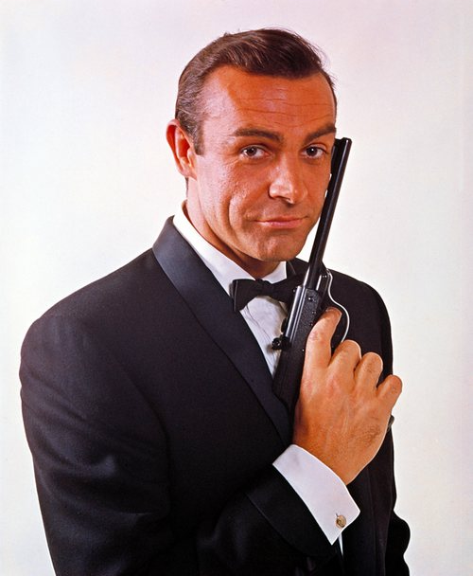

Slide 7
Actors who have starred as James Bond
Sean Connery
Sean Connery was the first actor to play superspy James Bond in feature films. In 1962 he starred as James Bond in Dr. No, and by 1971 he played in five more Bond movies

Slide 8
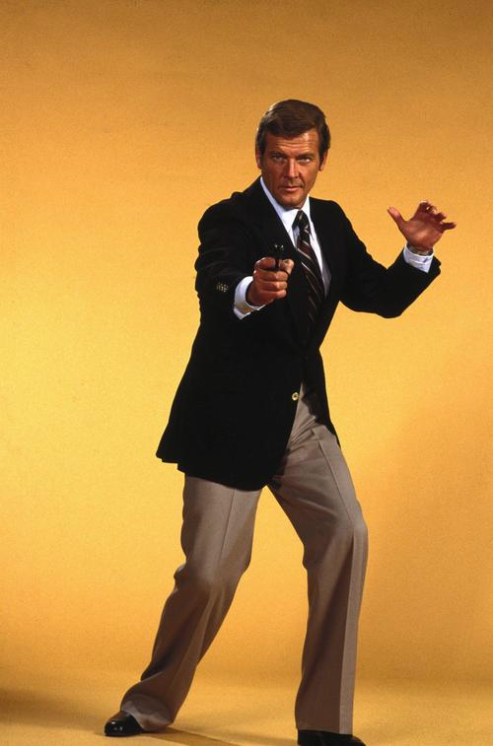
Roger Moore
Roger Moore took over from Sean Connery as James Bond in 1972 and starred in seven Bond movies.

Slide 9
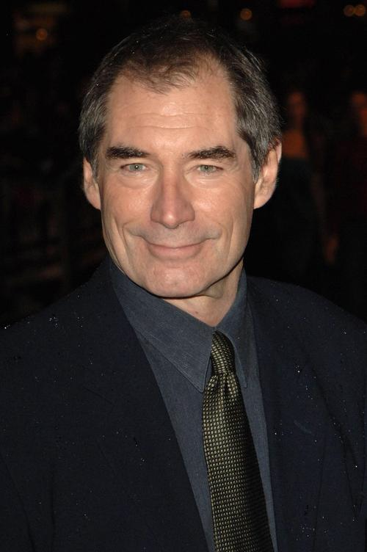
Timothy Dalton
TIMOTHY DALTON then became Bond for two films, The Living Daylights (1987) and License to Kill (1989).

Slide 10
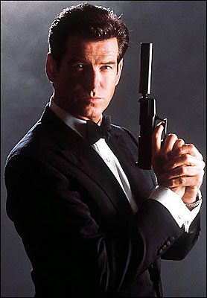
Pierce Brosman
PIERCE BROSNAN, born in Ireland, became the fifth movie Bond. Brosnan played 007 in Goldeneye (1995), Tomorrow Never Dies (1997) and The World Is Not Enough (1999). Brosnan's fourth film as Bond, Die Another Day, was released in 2002 and co-starred Halle Berry

Slide 11
Daniel Craig
DANIEL CRAIG became the sixth movie Bond in the 2006 film Casino Royale. The movie was a modernized version of the original Bond novel, and Craig represented a return to the basics of a younger, tougher bond. (At age 38, he was the first man under 40 to play Bond since George Lazenby.) Craig is blonde and blue-eyed, which earned him initial resistance from fans of a traditional darkly-handsome Bond. He is from England, like Roger Moore, making Craig the first Bond actor not from a fresh country: previous Bond actors were born in Scotland (Connery), Australia (Lazenby), England (Moore), Wales (Dalton), and Ireland (Brosnan).

Slide 12
Conclusion
Reading about Jan Fleming we found out that the author and his character James Bond have much in common.
1. Jan Fleming was a secret agent himself.
2. He worked for British Naval Intelligence.
3. His code name was 17F
4. He promised his friend to write a spy story and he did it.

Slide 13
Links
Speak out 4/2005
http://img1.liveinternet.ru/images/attach/b/3/4/5/4005399_5_pirs_brosnan.jpg
http://f.foto.radikal.ru/0610/7feca794ad40.jpg
http://www.img-box.ru/repository/films/www.img-box.ru_5276.jpg
http://star-gaming.ru/_nw/0/38943814.jpg
http://www.who2.com/jamesbond.html
http://photo.who2.com/photos/ianfleming/2_500.jpg
http://photo.who2.com/photos/seanconnery/65_500.jpg
http://photo.who2.com/photos/jamesbond/31_500.jpgRoger
http://photo.who2.com/photos/timothydalton/9_500.jpg

