Slide 1
Harry Potter
“We want to be famous”
http://tea4er.ru/contest/-we-want-to-be-famous
Project by the 6th form pupils of Yakimansko-Slobodskaya school
from the town of Murom Vladimirskaya region;
Chumichyova Anastasiya, Kolotukhina Sofia Teacher: T.L. Barinova
2011

Slide 2
The aim of our project is to answer the question:
What is common between J.K. Rowling and Daniel Radcliffe?
Plan of the project
J.K. Rowling and her ambition to be a writer;
What is Harry Potter?
Seven Harry Potter books;
Daniel Radcliffe and his fame;
Our classmates’ opinion;
Conclusion;
Links.

Slide 3
J.K Rowling
It was in 1990, that J.K.Rowling first conceived of the idea about Harry Potter.

Slide 4
J.K Rowling
J.K Rowling was born in Chipping Sodury, July 31st 1965. From an early age, J.K. Rowling had an ambition to be a writer. She often tried her hand at writing. After finishing school, her parents encouraged her to study French at the University of Essex.
After having spent a year in Paris, J.K.Rowling graduated from university and took various jobs in London. One of her favourite jobs was working for Amnesty International; the charity, which campaigns against human rights abuses throughout the world.
As she recalls, it was on a long train journey from London to Manchester when she began forming in her mind, the characters of the series.

Slide 5
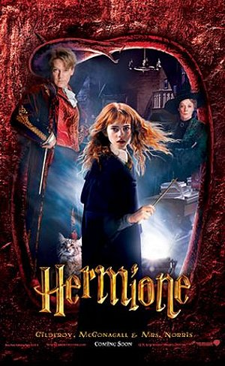
Seven Harry Potter Books
Harry Potter and the Philosopher's Stone
Harry Potter and the Chamber of Secrets (1999)
HarryPotter and the Prisoner of Azkaban (1999)
Harry Potter and the Goblet of Fire(2000)
Harry Potter and the Order of the Phoenix (2003)
Harry Potter and the Half-Blood Prince (2005)
Harry Potter and the Deathly Hallows (2007)

Slide 6
Harry Potter
Potter is a student wizard at Hogwarts School of Witchcraftand Wizardry, where he belongs to the house of Gryffindor, plays the oddbroom-riding sport of quidditch and battles the villain Lord Voldemort. The HarryPotter novels have the genre of fantasy literature; however, in many respects they are also bildungsromans (роман воспитания), or coming of age novels with mystery, adventure, thriller and romance.

Slide 7
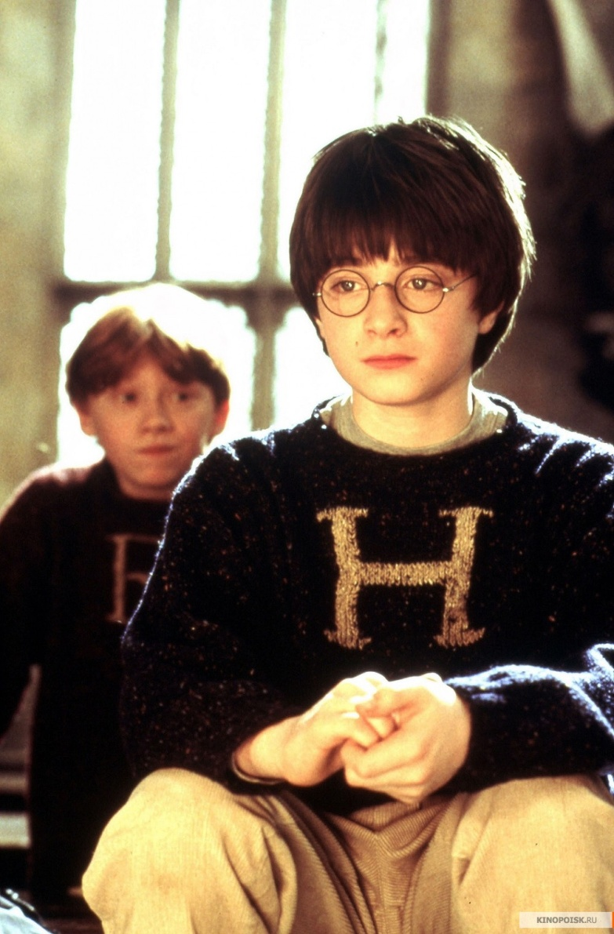
Daniel Radcliffe is the actor
Daniel Radcliffe is the actor who starred as boy wizard Harry Potter in the 2001 film Harry Potter and the Philosopher's Stone and its sequels: Harry Potter and the Chamber of Secrets (2002).

Slide 8
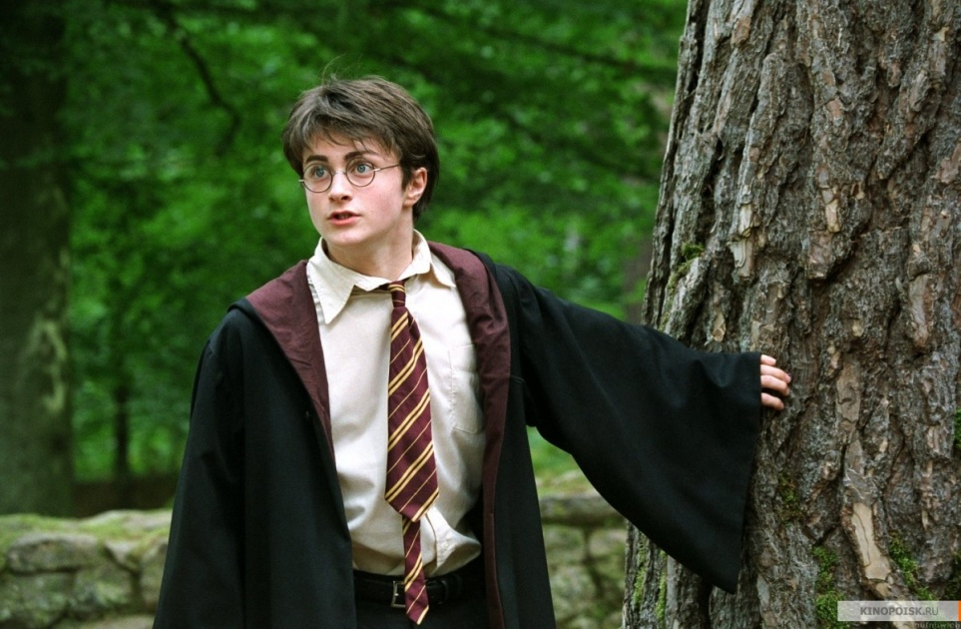
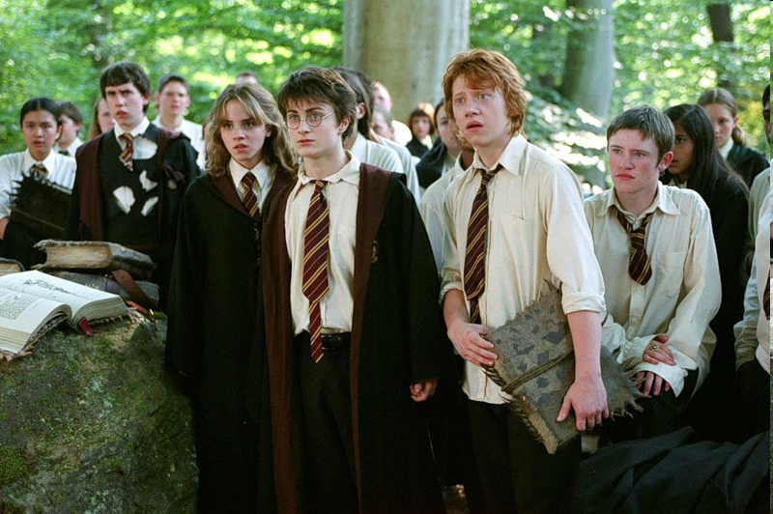
Harry Potter and the Prisoner of Azkaban (2004).

Slide 9
Harry Potter and the Goblet of Fire (2005, Harry Potter and the Order of the Phoenix (2007).

Slide 10
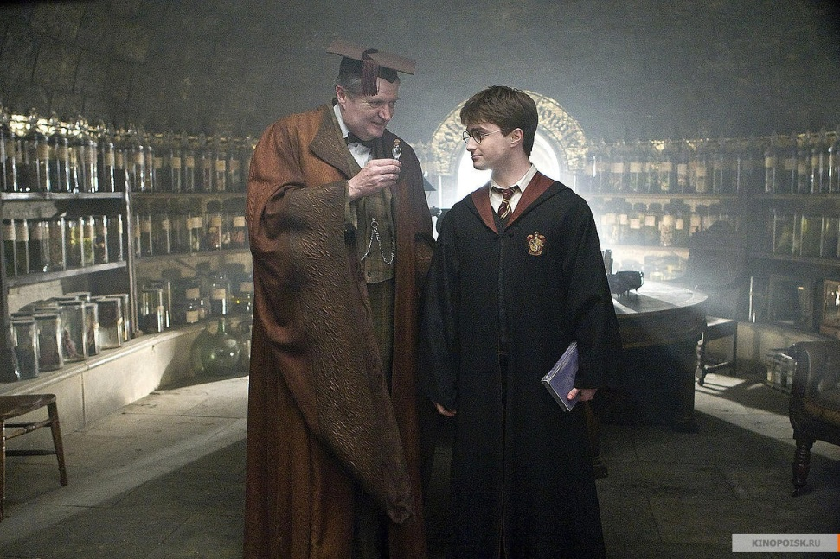
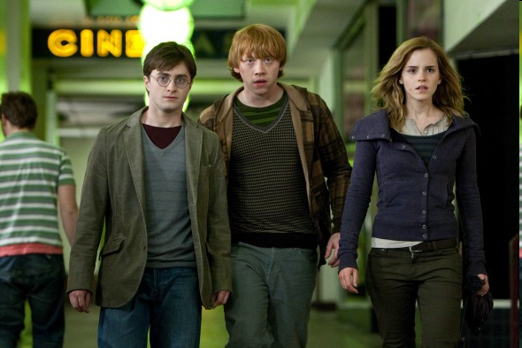
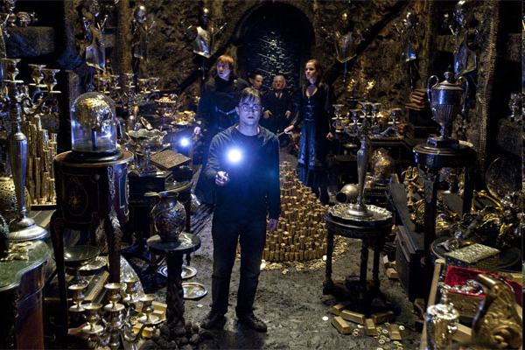
Harry Potter and the Half-Blood Prince (2009), Harry Potter and the Deathly Hallows: Part 1 (2010), and Harry Potter and the Deathly Hallows: Part 2 (2011).

Slide 11
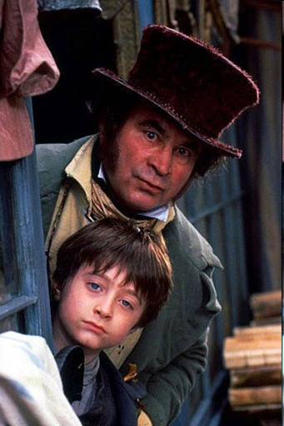
The films were based on the popular series of novels by British author J.K. Rowling. Radcliffe's first big film appearance was in the title role of the BBC TV adaptation of David Copperfield (1999). He has also appeared in the films The Tailor of Panama (2001, starring Pierce Brosnan), December Boys (2006) and My Boy Jack (2007). Radcliffe starred in a major London revival of the play Equus in 2007, appearing nude in one much-discussed scene.

Slide 12
Classmates’ opinion

Slide 13
Conclusion
J.K.Rowling and Daniel Radcliffe have became famous thanks to Harry Potter.
J.K.Rowling has wanted to become a writer since childhood.
Daniel Radcliffe has wanted to be an actor since childhood too.
They are creative, independent, hard working and intelligent.
They are a good example to follow.

Slide 14
Links
http://www.who2.com/harrypotter.html
http://content7.flixster.com/photo/30/83/66/3083665_gal.jpg
http://www.kinopoisk.ru/picture/1559995/#1471965
http://www.world-art.ru/cinema/cinema_photos.php?id=23655&screenshot_number=445
http://www.kinopoisk.ru/picture/1273904/#1273904
http://www.kinopoisk.ru/picture/1271166/
http://www.kinopoisk.ru/picture/1558485/
http://www.kinopoisk.ru/picture/505487/
http://www.kinopoisk.ru/picture/29013/
http://www.kinopoisk.ru/picture/1558468/
http://www.filmschoolrejects.com/images/harry-potter-deathly-hallows-1-590x393.jpg
http://www.world-art.ru/cinema/cinema_photos.php?id=6614&screenshot_number=408
http://www.world-art.ru/cinema/cinema_photos.php?id=6614&screenshot_number=367
http://kinoportal.net/stills_sep.php?picture=Harry_Potter_and_the_Order_of_the_Phoenix&still=3
http://www.kinopoisk.ru/picture/574627/
http://www.kinopoisk.ru/picture/774801/
http://upload.wikimedia.org/wikipedia/commons/5/5d/J._K._Rowling_2010.jpg

