Slide 1
Tradition of English tea.

Slide 2
CONTENTS
What is tea
Discovery of tee
A new era - an era of black tea
Origin of tea drinking
Varieties of tea
Afternoon tea
Loose tea
High tea
Tea drinking nowadays
Facts About Tea
Process of tea making
Make traditional English tea
Add tea to milk or milk to tea?
British Tea Council
Webliography
About the author

Slide 3
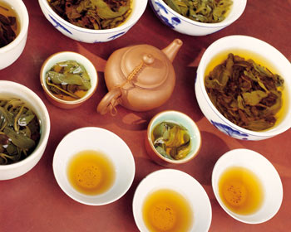
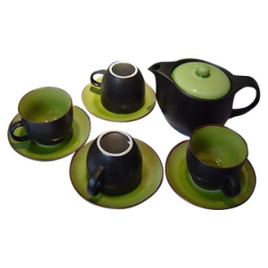
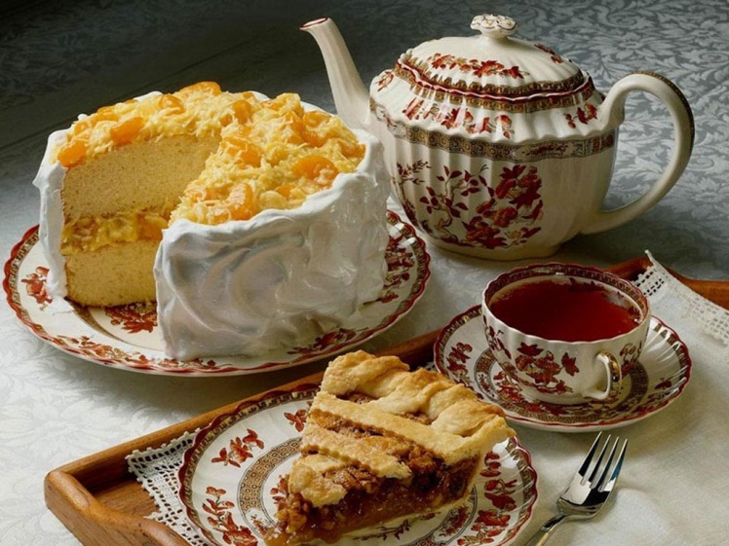
WHAT IS TEA
Tea can refer to any of several different meals or mealtimes, depending on a country's customs and its history of drinking tea

Slide 4
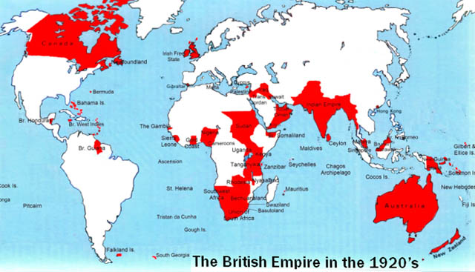
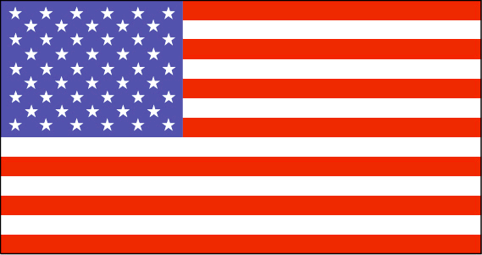
WHAT IS TEA
In those countries where the term's use is common, the influences are generally those of the former British Empire.

Slide 5
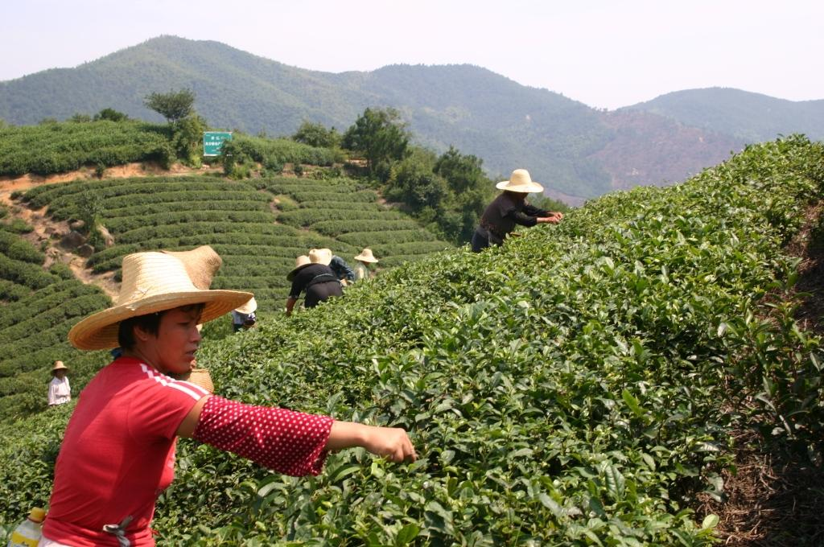
DISCOVERY OF TEA
Tea was "discovered“ by the Chinese about 5000 years ago, it took a long time before the moment when it became popular in Britain.

Slide 6
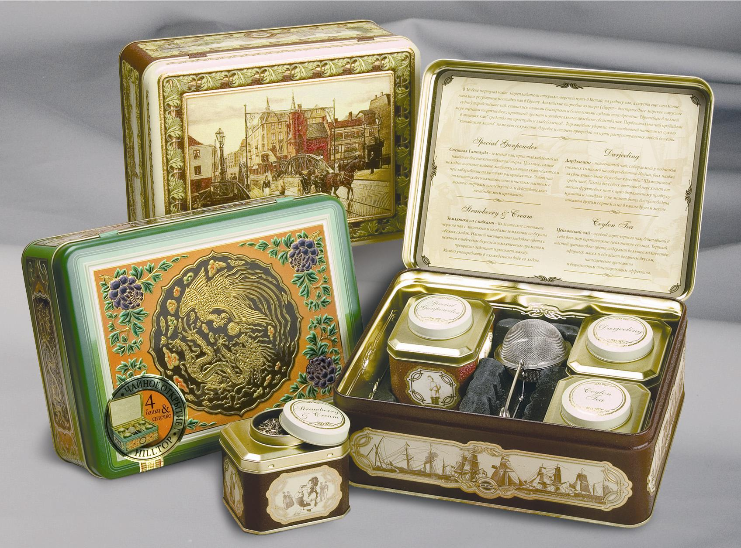
A new era - an era of black tea
Once in England came a ship with tea leaves, which are under the influence of heat and moisture got a bright color and strong flavor.
Unusual taste, deep color and flavor brewed from
the leaves of these drinks hit the British. So there was a black tea.

Slide 7
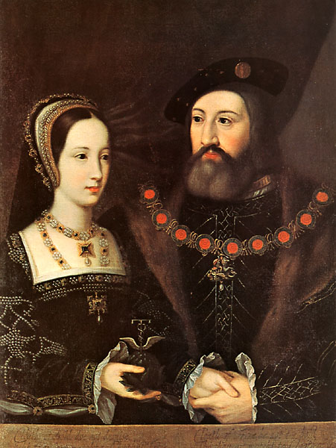
ORIGIN OF Tea drinking
The custom of drinking tea
originated in England when
Catherine of Bragança married
Charles II in 1661 and brought
the practice of drinking tea
in the afternoon with her
from Portugal.

Slide 8
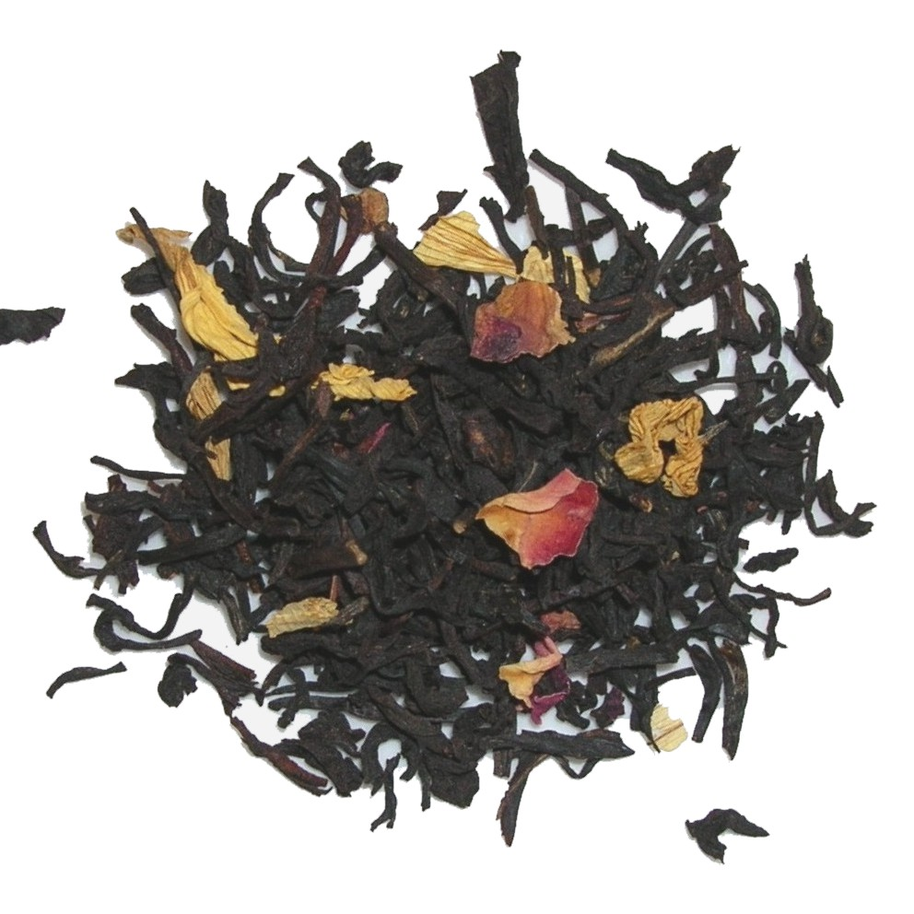
VARIETIES OF TEA
Exotic Mango

Slide 9
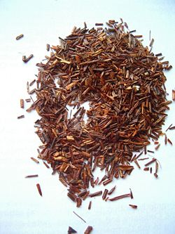
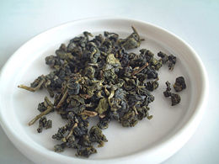
Rooibush
green tea

Slide 10
Afternoon tea

Slide 11
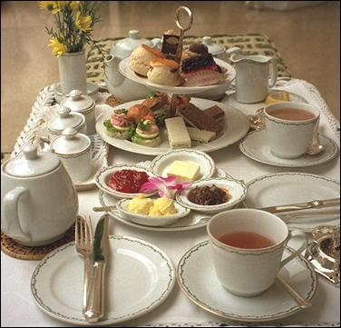
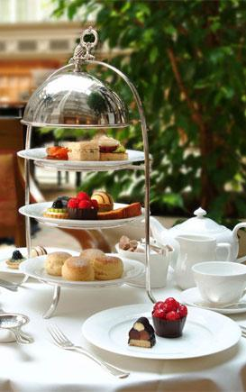
Afternoon tea
It is a light meal typically eaten between 3pm and 5pm.

Slide 12
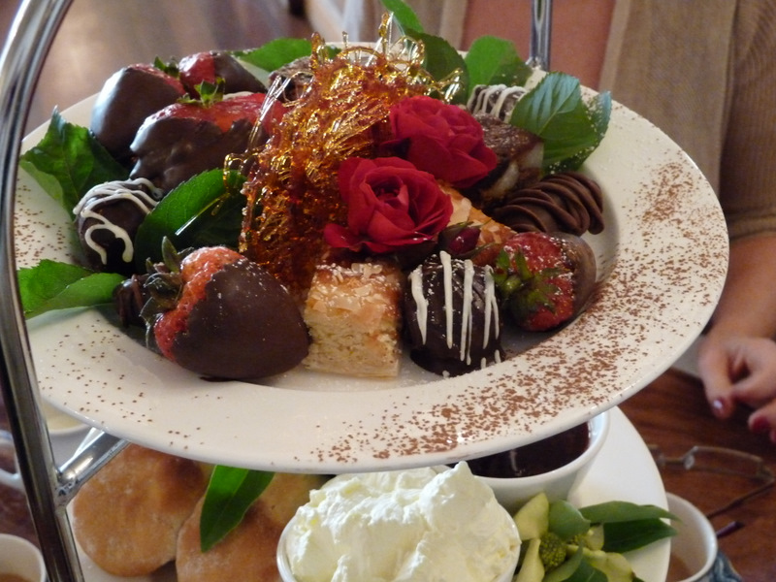
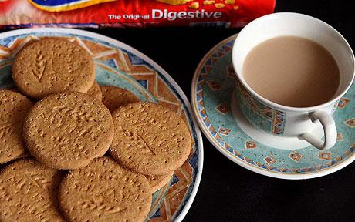
Afternoon tea
A formal afternoon tea
is, nowadays, usually
taken as a treat in hotels,
cafés or tea shops.
In everyday life, many British take a much simpler refreshment consisting of tea and biscuits at teatime.

Slide 13
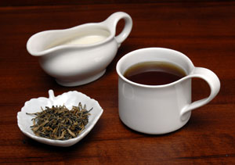
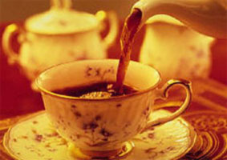
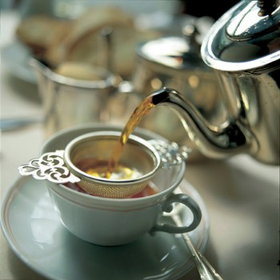
LOOSE TEA
Traditionally, loose tea is brewed in a teapot and served in teacups with milk and sugar.

Slide 14
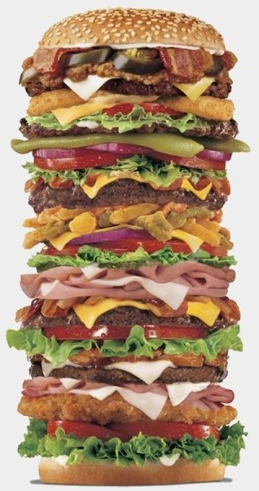
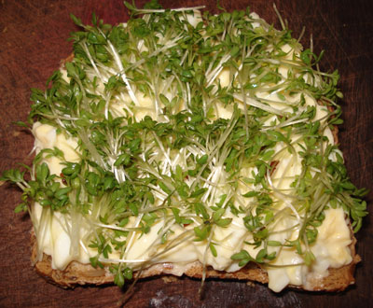
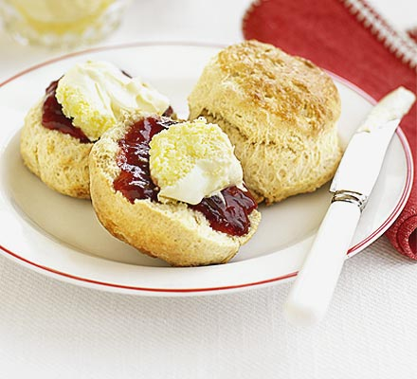
LOOSE TEA
It is accompanied by sandwiches
(customarily cucumber, egg and cress,
fish paste, ham, and smoked salmon)
and scones (with clotted cream and jam)
and usually cakes.
egg and cress
scones
sandwich

Slide 15
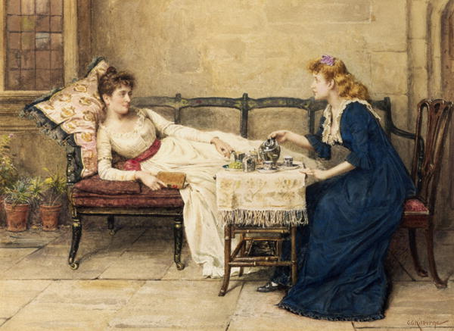
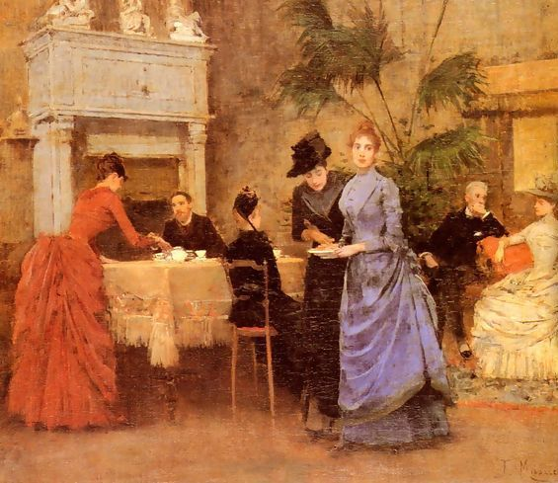
High tea

Slide 16
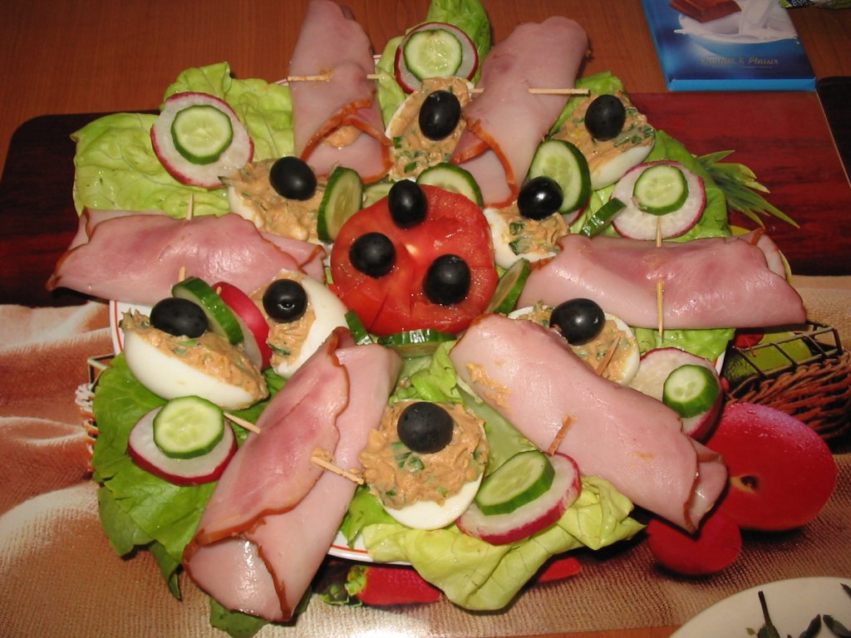
High tea (also known as meat tea) is an early evening meal, typically eaten between 5 pm and 6 pm. It is now largely followed by a later lighter evening meal.
High tea would
usually consist of
cold meats,
eggs or fish, cakes
and sandwiches.
High Tea

Slide 17
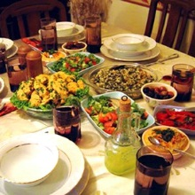
High Tea
On farms or other working class environments, high tea would be the traditional, substantial meal eaten by the workers immediately after nightfall, and would combine afternoon tea with the main evening meal.

Slide 18
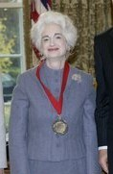
High Tea
The term “High Tea” is American, and it is not recognized in Britain.
This usage is not liked by etiquette
advisors, such as Miss Manners
(Judith Martin), who is an American
journalist, author, and etiquette
authority.

Slide 19
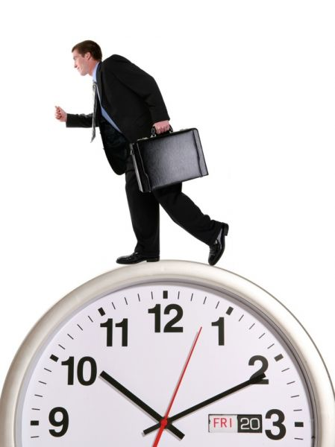
TEA DRINKNIG NOWADAYS
Changes in social customs
and working hours mean
that most Britons will
rarely take afternoon tea,
if at all.
NO TIME
FOR TEA

Slide 20
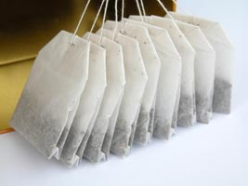
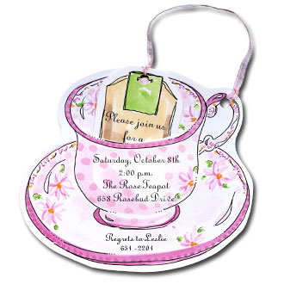
Facts About Tea
British daily drink 165 million cups of tea, which represents almost three cups per person, including infants.
Up to 90% of tea drunk
by the British - tea in bags.
Quarter of the total
consumption of milk
is consumed with tea.

Slide 21
Facts About Tea
98% of Britons drink tea with milk, but only 30% of added sugar in your tea.
Tea accounts for 40% of the liquid drunk in Britain.
Of the total consumption of tea is consumed at home 86% and 14% - outside the home.

Slide 22
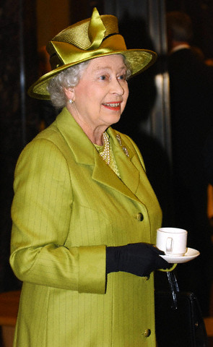
TEA AS A SYMBOL
OF BRITAIN
Queen Elizabeth II
Beatles

Slide 23
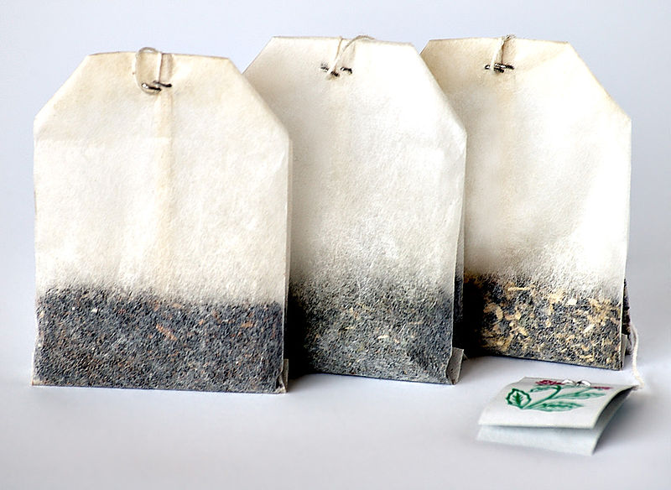
Tea bags

Slide 24
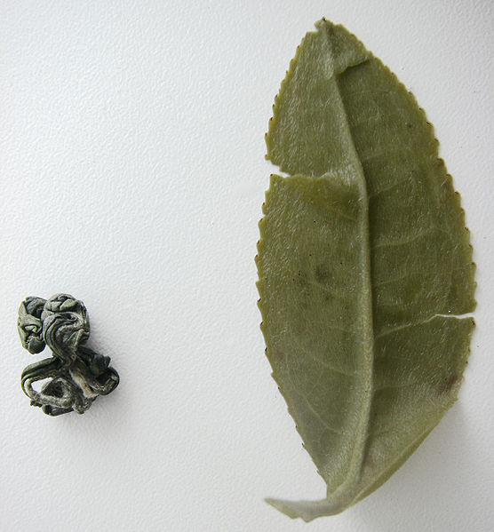
after
TEA LEAF
TEA SEED
before

Slide 25
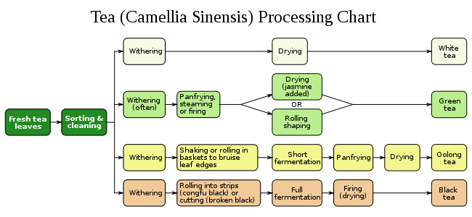
Process of tea making

Slide 26
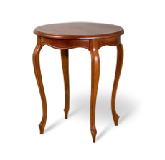
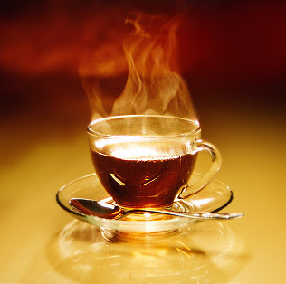
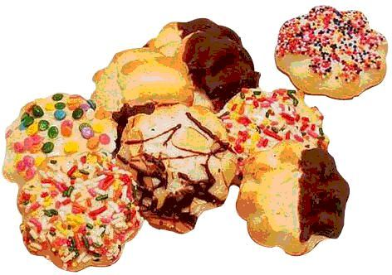
Make traditional English tea
A tea table is required, tea and snacks.

Slide 27
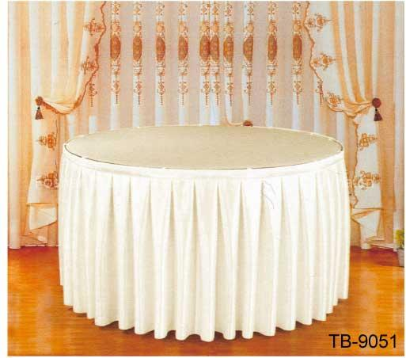
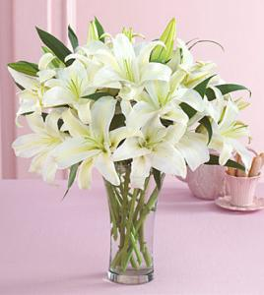
Make traditional English tea
The table must be covered with a cloth, preferably white, can be blue hues. On the table have to be a small vase of fresh flowers, preferably white.

Slide 28
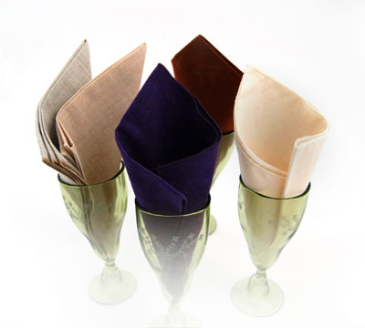
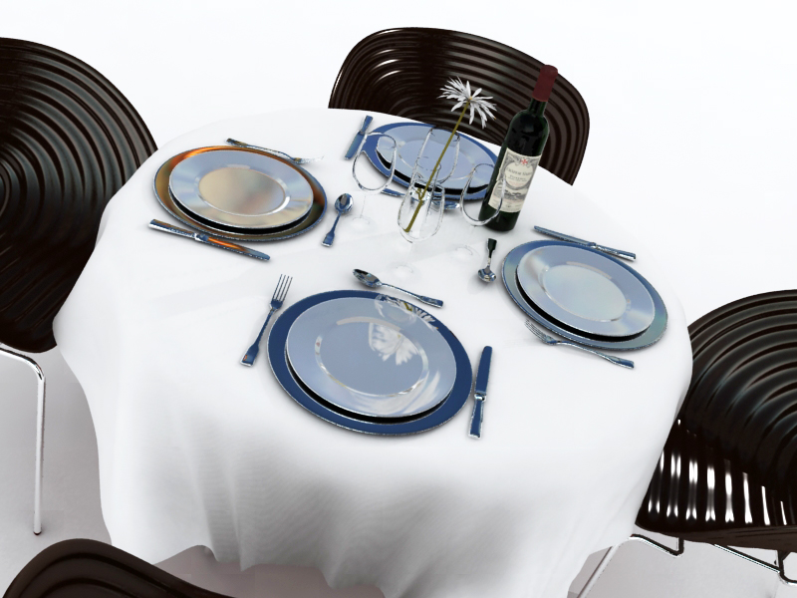
Make traditional English tea
Napkins, cloth or paper towels to match. Cookware set includes a pair of tea, dessert plates, tea spoon, fork and knife for each participant

Slide 29
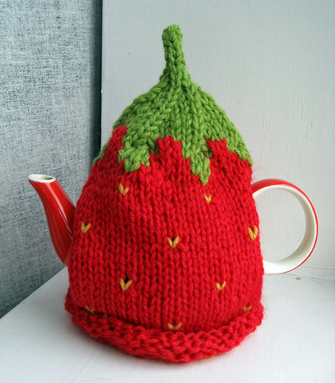
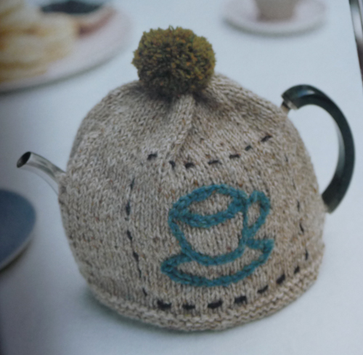
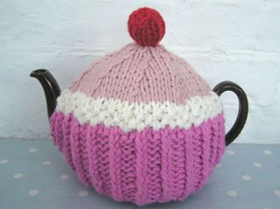
Make traditional English tea
A fabric cover on the kettle is very important (TEA-COSY)

Slide 30
Make traditional English tea
A choice of several varieties is offered to the guests. Different kinds of tea include Earl Grey, Lapsang Souchong, Assam, Darjeeling. May be offered different mixtures. Prestige for the host is to offer guests their own mix.

Slide 31
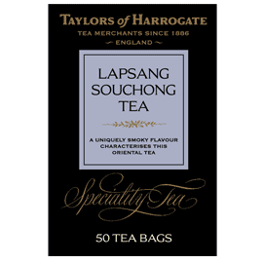
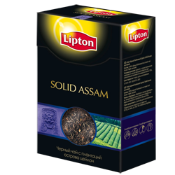
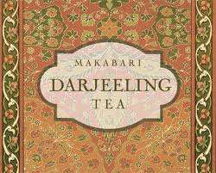

Slide 32
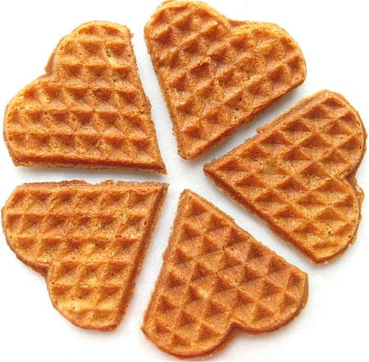
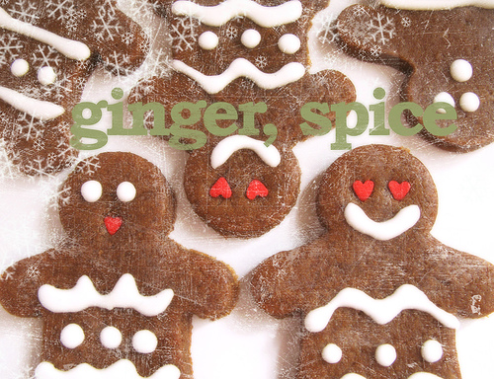
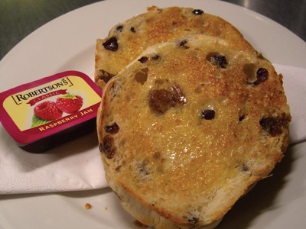
British snacks for tea
coarse waffles
gingerbread
cookies
tikeyki (fried buns with raisins)

Slide 33
Add tea to milk or milk to tea?
There is no consensus on whether to add milk to tea or tea into the milk, but it is believed that this is in some way affect the taste of the drink.
George Orwell in an essay "A cup of excellent tea" at first recommended to pour tea, not milk.

Slide 34
Add tea to milk or milk to tea?
According to another view you should first pour a cup of milk.
It is explained by the fact that in former times china could not withstand the sudden temperature change, and sometimes cracked, if you poured tea at first.

Slide 35
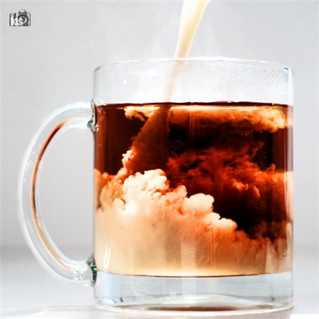
tea with milk

Slide 36
British Tea Council
British Tea Council represents the interests of the British tea industry, one of the most advanced and powerful in the world.
The main objective of the organization to disseminate as much accurate information about the case, to teach English to distinguish high-quality product from bad, to store tea, brewing, to maintain the tradition of a truly English tea, to talk about the variety of tea.

Slide 37
Webliography
http://ahmadtea.ru read about the history of Ahmad tea
http://www.english-tea.ru/ infromation about English tea, its history and development
http://www.tea.co.uk/ UK Tea Counsil http://en.wikipedia.org/ full information about tea, its kinds and countries where tea is grown
http://www.tea.ru/ interesting facts about tee in Russian
http://www.ftea.ru/node/638 general information about tea and tea plantations
http://www.revolutiontea.com/ read more about Revolution teas, various discounts and special offers
http://www.adagio.com/ online-shop of various teas
http://www.britainexpress.com/History/tea-in-britain.htm history of tea in Britain
http://www.panix.com/~kendra/tea/tea_to_england.html Hostory Of English tea
http://www.panix.com/~kendra/tea/afternoon_tea.html read about afternoon tea

Slide 38
Webliography
11. http://www.afternoontea.co.uk/ afternoon tea guide
12.http://www.entertaining.about.com/ read about hosting afternoon party
13. http://www.espemporium.com/ information on loose tea
14. www.bostontea.com/index.cfm/category/full-leaf-tea.html Boston tea company
15.http://coffeetea.about.com/cs/culture/a/aftervshigh.htm Read about these two distinctly different social events
16. http://www.victorialodging.com/attraction/victoria-high-tea Victoria high tea
17. http://www.theritzlondon.com/tea/ Luxurious afternoon tea
18.http://www.instructables.com/id/Delicious-sweet-milk-tea/ a recipe for milk tea
19. http://allrecipes.com//Recipes/drinks/tea/Main.aspx full collection of tea recepies
20. http://www.teausa.com/ The US tea counsil

Slide 39
About the author
I am Viktoriya Lavrentieva,
a 16-year-old pupil. I am interested
in England and its history.
My interests are not limited by
the English language only. I
like taking photos, and I
have a vast collection of old post
cards.
I’ve chosen the topic Tea Drinking for my presentation as I think that little attention is paid to this topic at school. This theme maybe interesting to everybody who wants to know more about English culture.
This presentation may be used at the lessons of English.

