Slide 1
The best place in the world!
Made:
Nuriev Rashid
6th form
Sharanga
2012

Slide 2
Sharanga
Sharanga is an administrative center of Nizhniy Novgorod region. Its area is about 160 thousand kilometers. There are more than 15 thousand population in it. Sharanga is rich in forests and fields.
First mention about this village was in 1747.

Slide 3
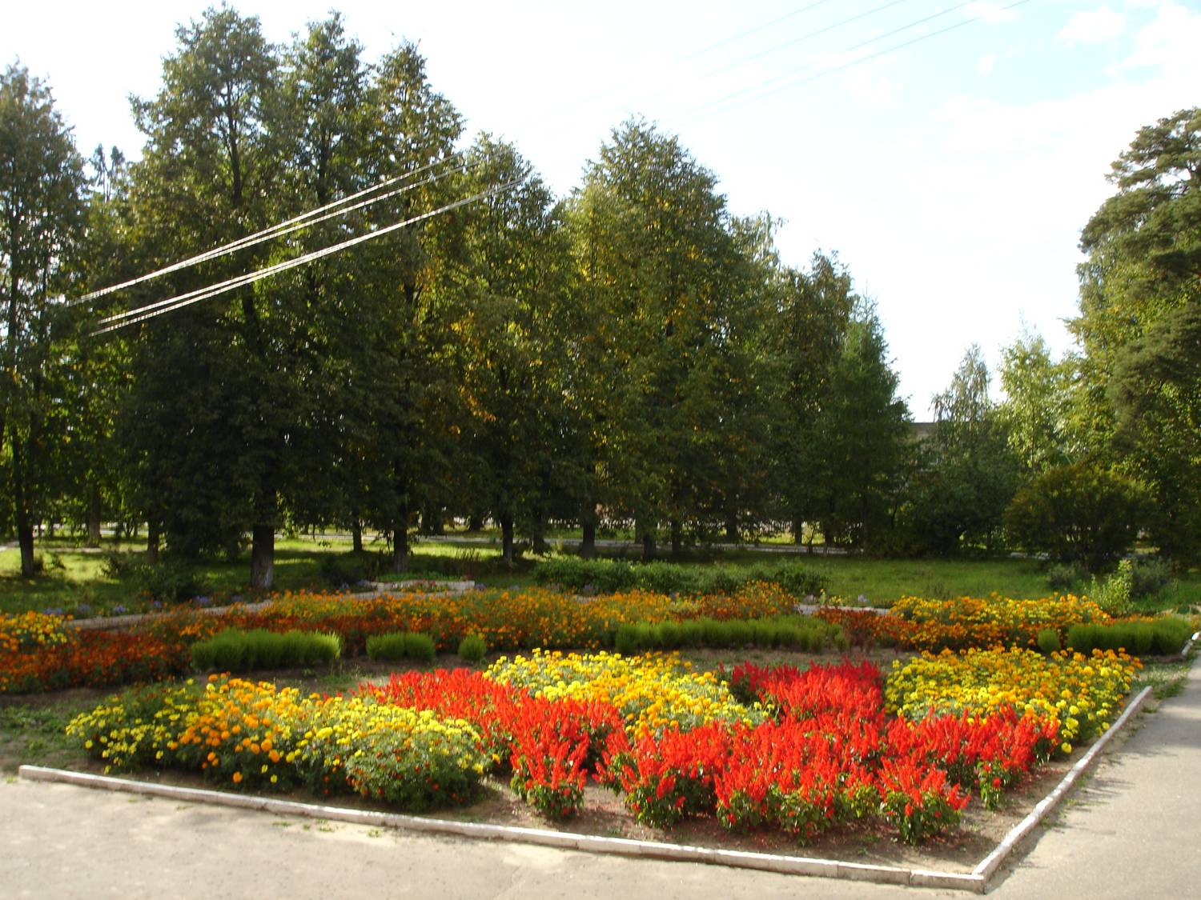
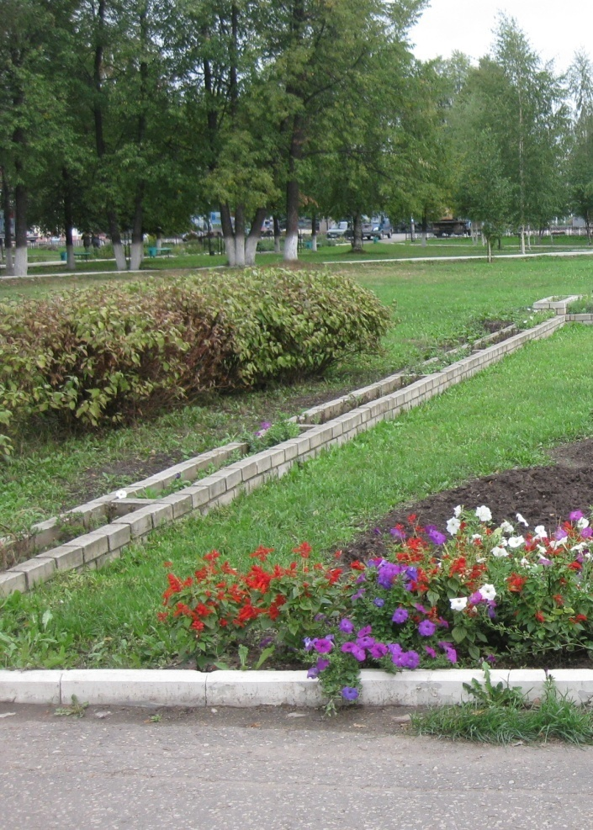
1904 - Sharanga became a center of Kirov region.
1960 - Sharanga was included in Nizhny Novgorod region.
1972 - Sharanga became a town.

Slide 4
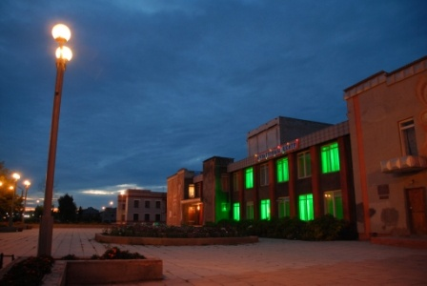
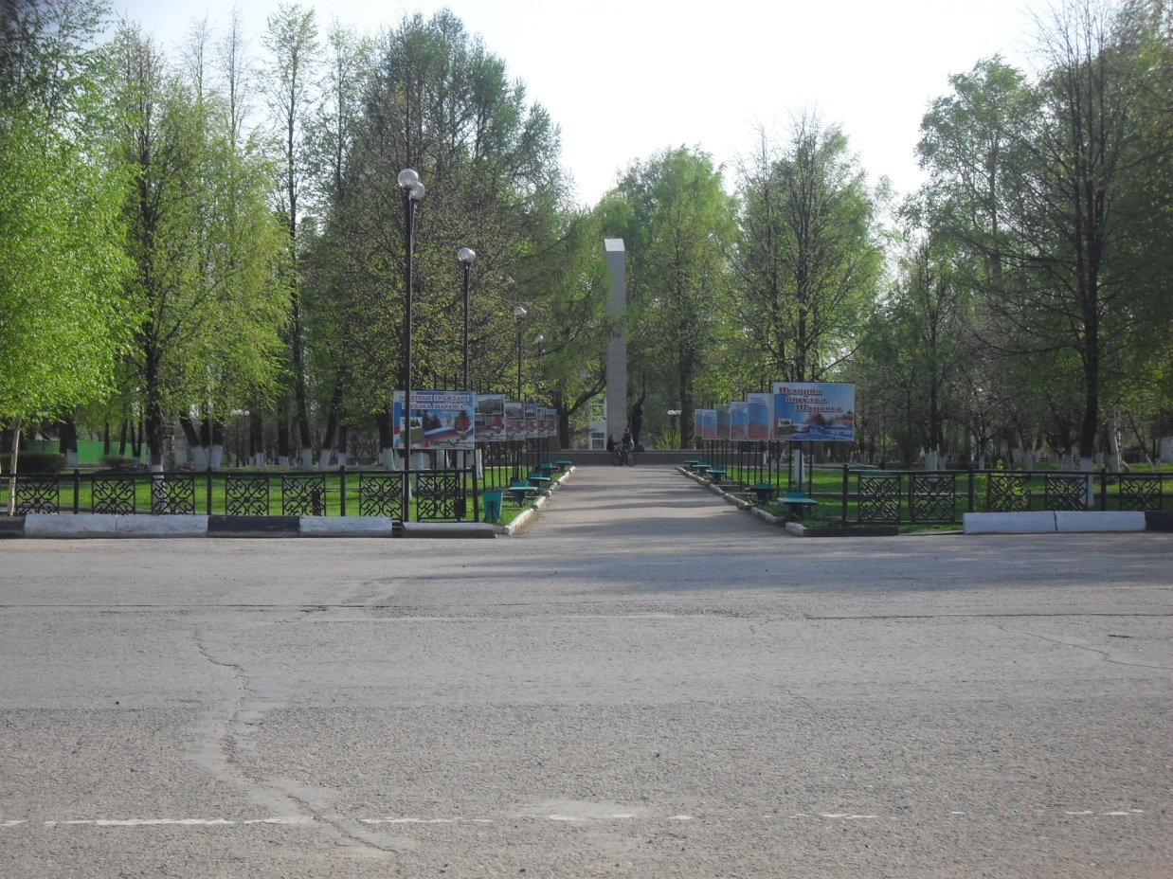
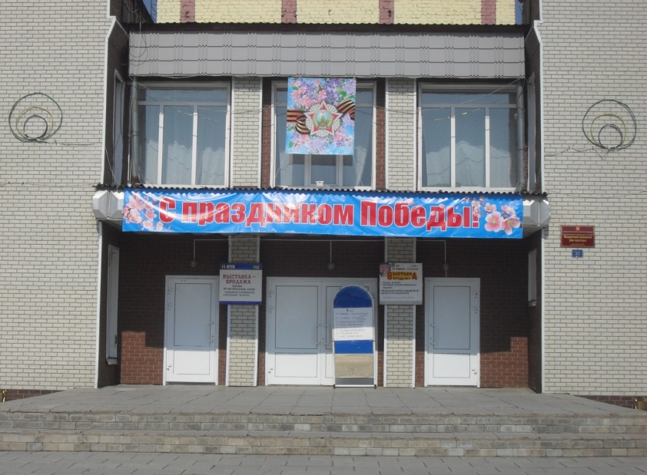
My native town is not large but it is very beautiful! There are fountains, a stadium, a market, the Church, the House of Culture, avenues, the school where I study and others. There are a lot of shops, beautiful parks in our town.

Slide 5
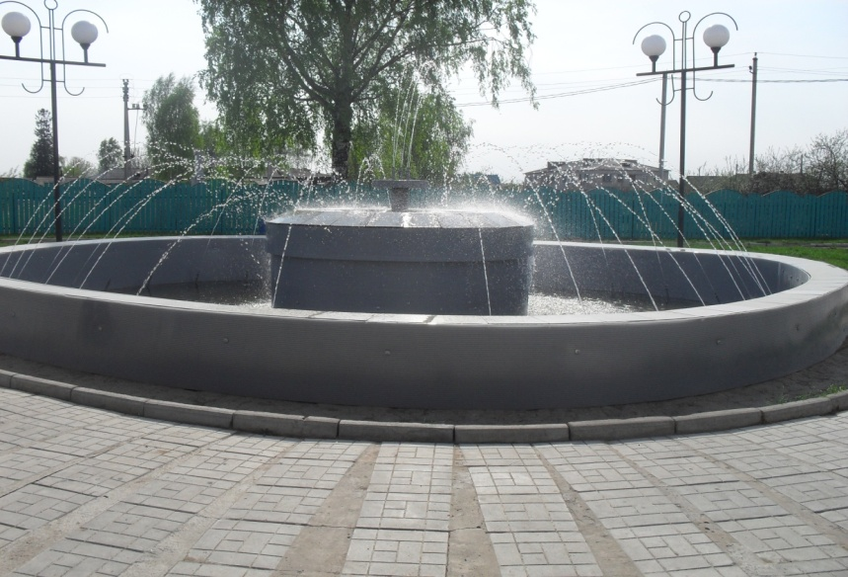
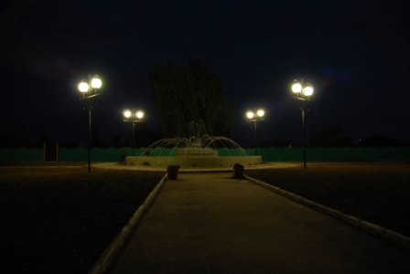
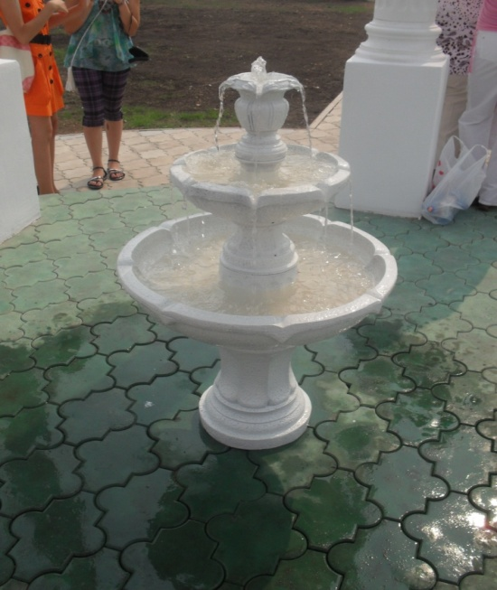
People like to spend their time near the fountains especially in summer.

Slide 6
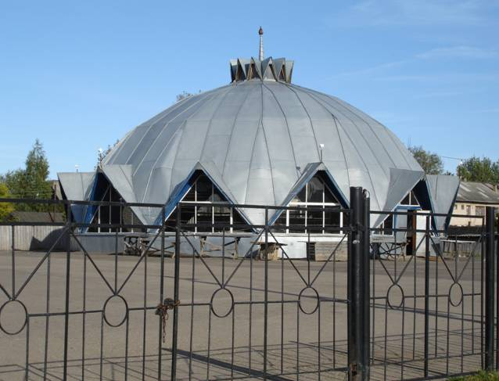
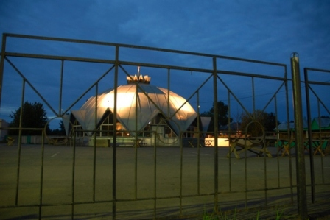
A market

Slide 7
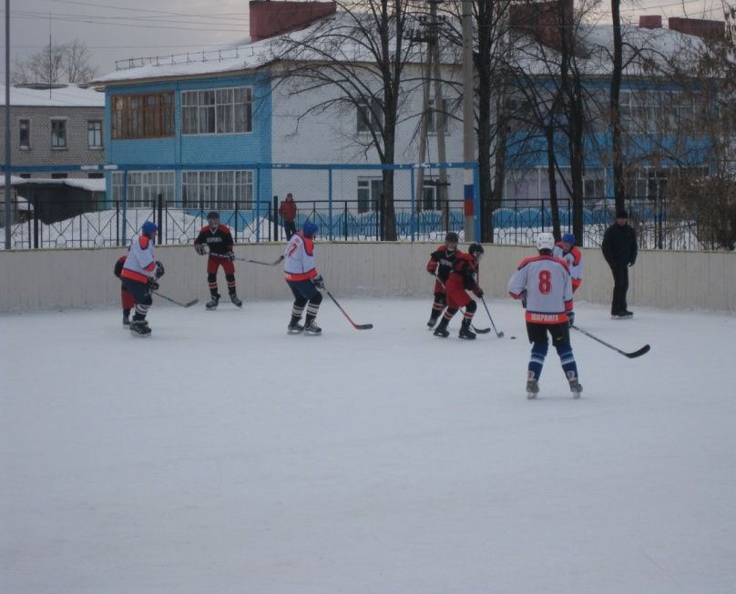
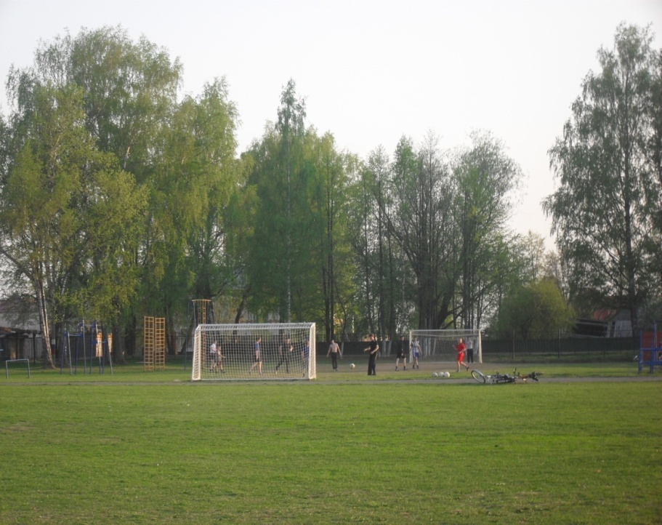
People in Sharanga like sport.

Slide 8
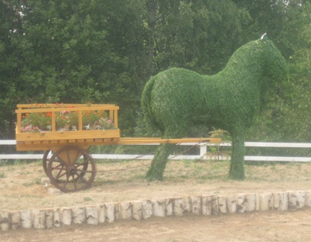
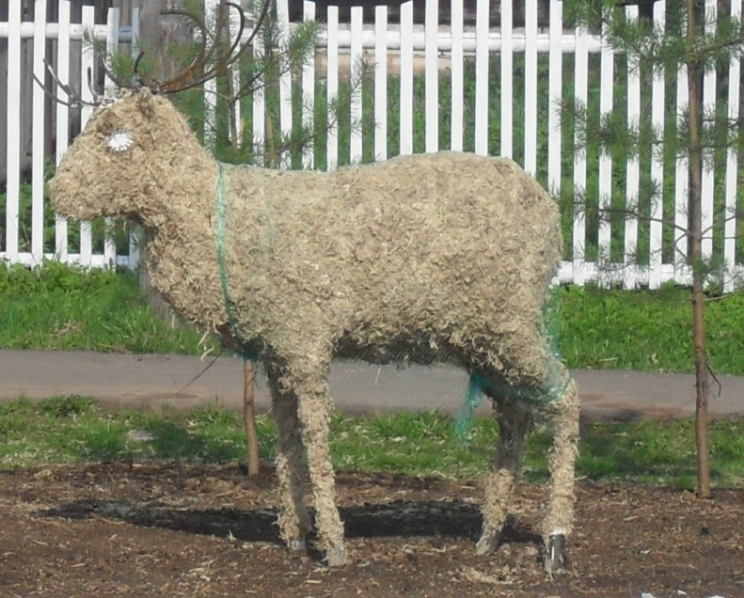
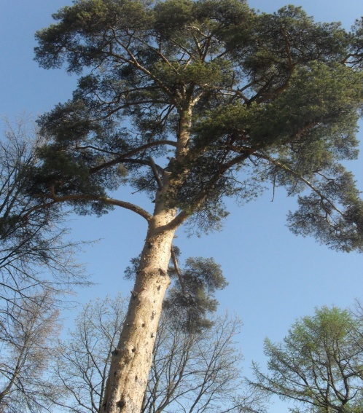
My town is really beautiful and all people do their best to make it cleaner , greener and tidier.

Slide 9
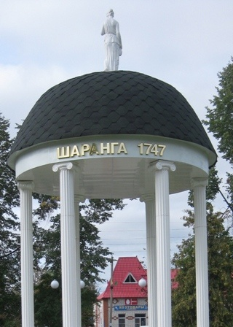
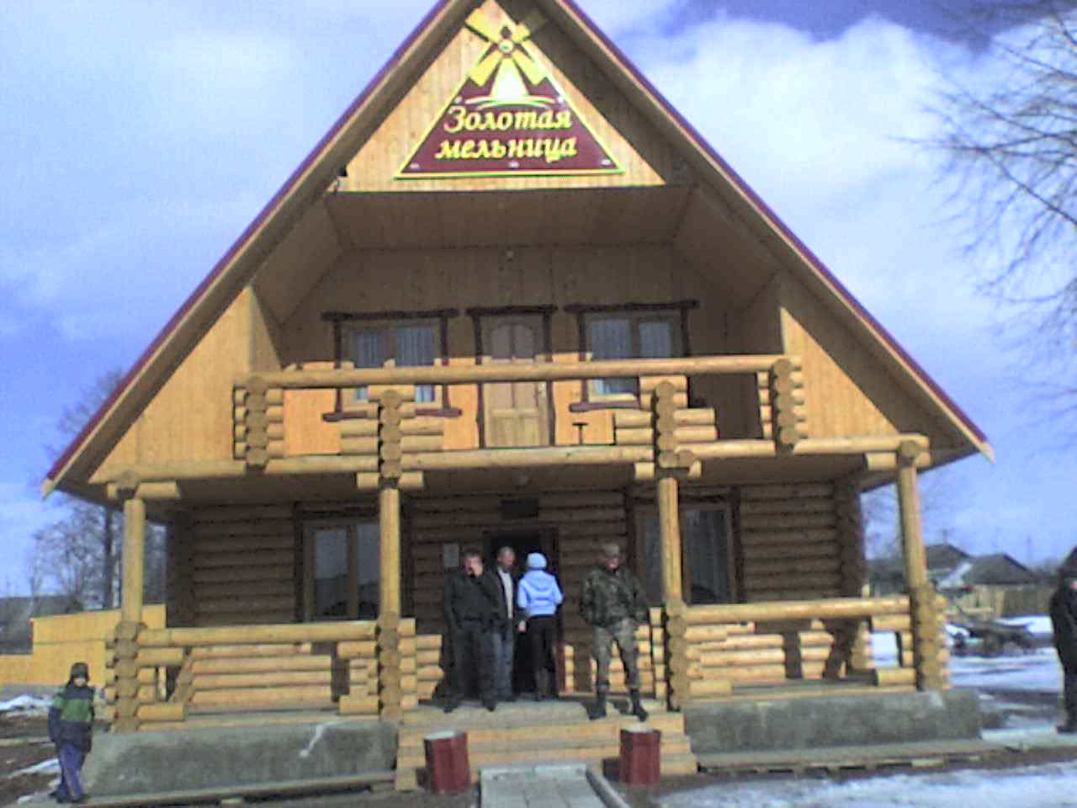
There are monuments and modern buildings and beautiful houses. Also there are many flowers ,green trees in our town. The nature is fine, the air is fresh. You can have a good time here.

Slide 10
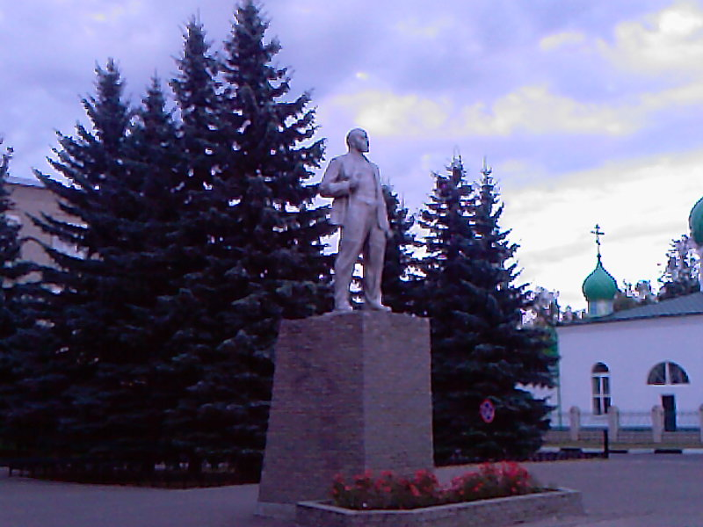
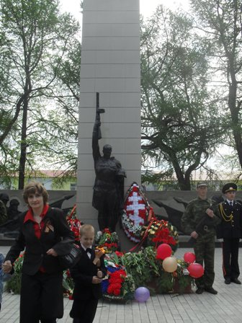
There are about 10 monuments in Sharanga.

Slide 11
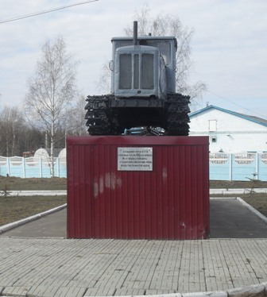
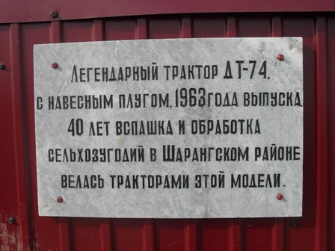

Slide 12
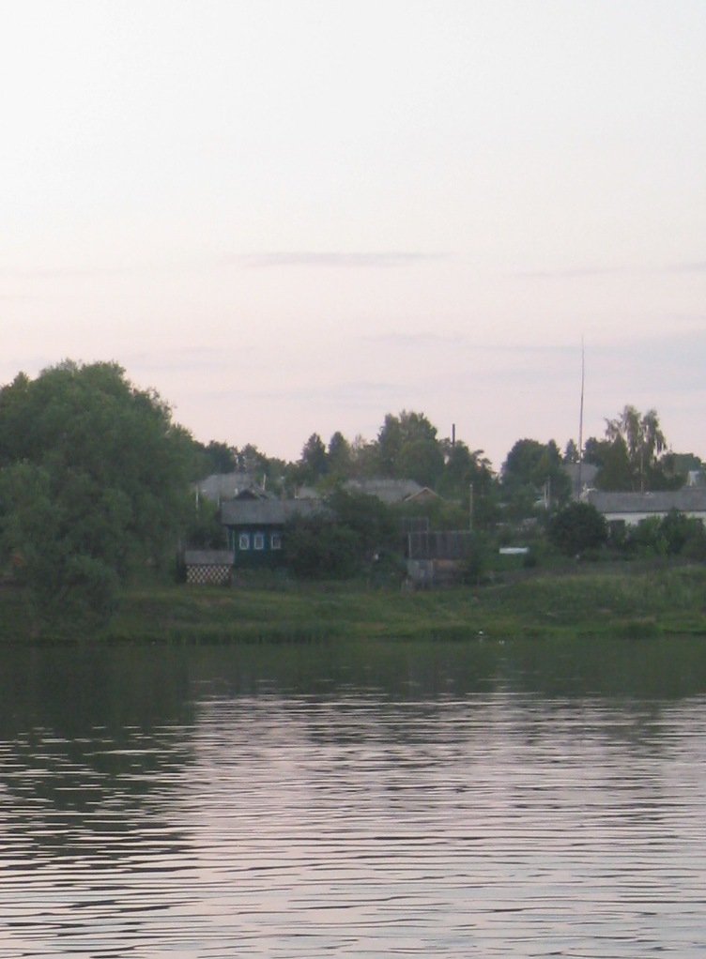
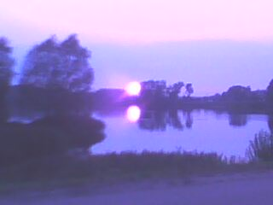
In my village there is the Sharanga river where you can swim and fish.

Slide 13
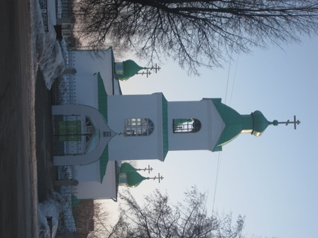
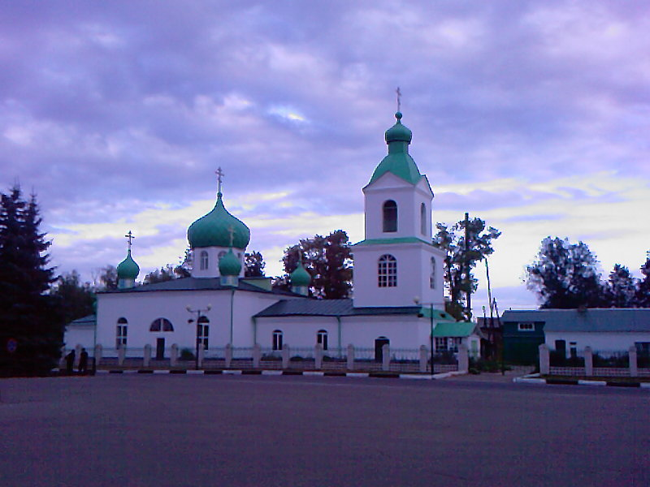
In the centre of Sharanga there is a church of saint trinity. It is one of the main sights in our town. There are always many flowers around it.

Slide 14
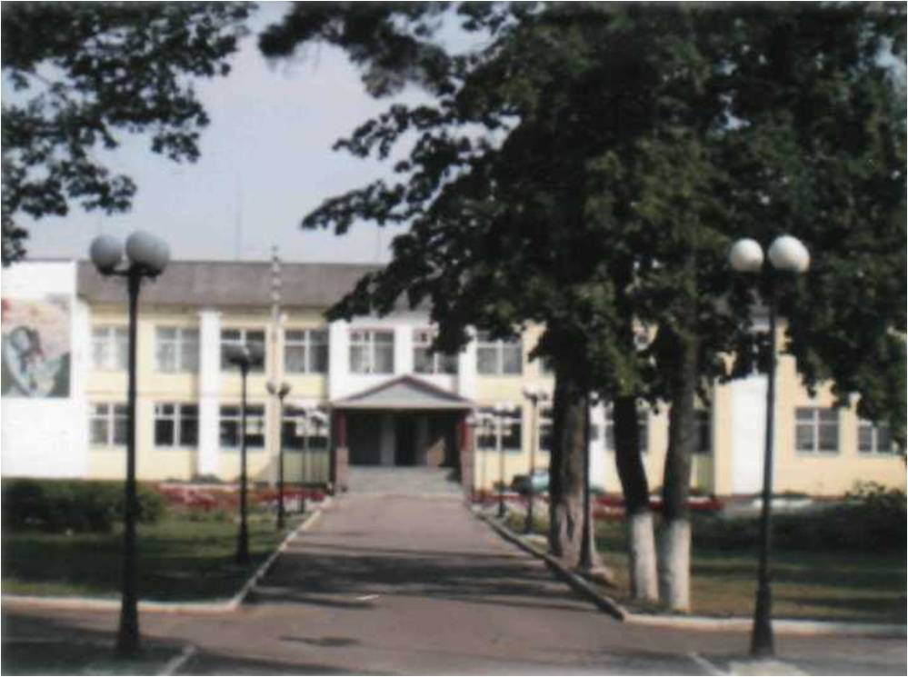
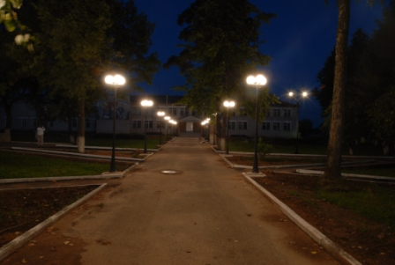
This is a school, where I study.

Slide 15
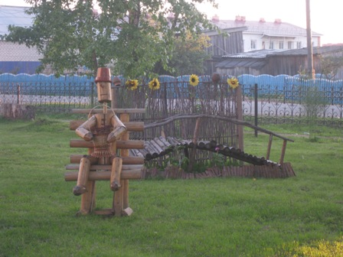
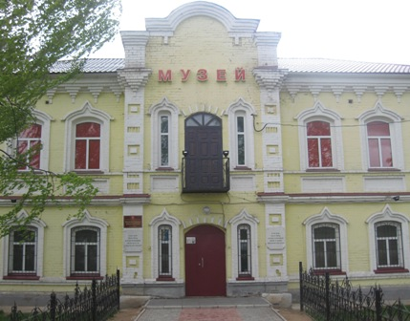
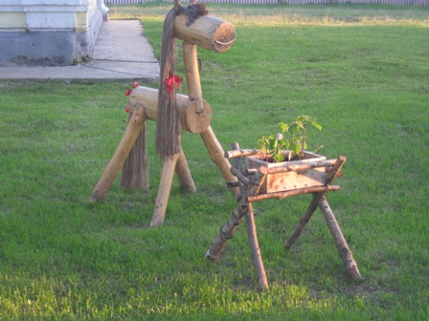
A Museum

Slide 16
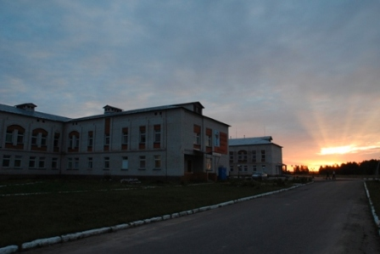
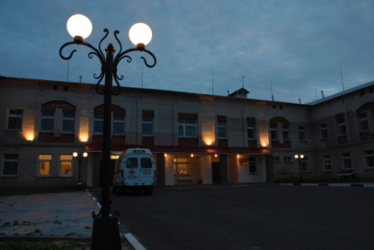
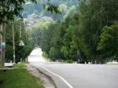
A hospital

Slide 17
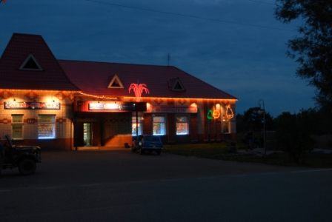
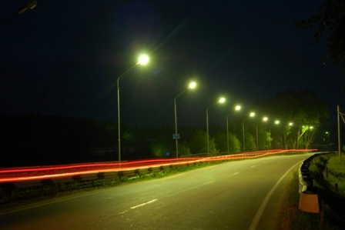
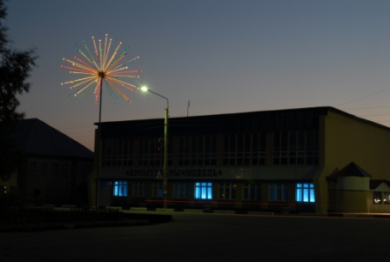
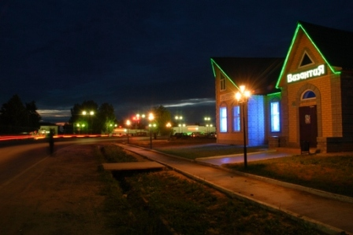
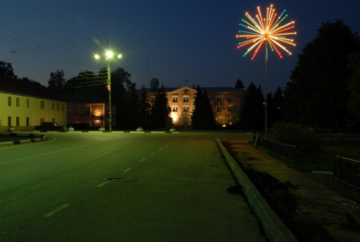
Sharanga is very far from Nizhniy Novgorod. They say that it is a "bearland". But it is nice and beautiful.

Slide 18
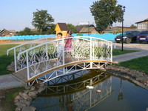
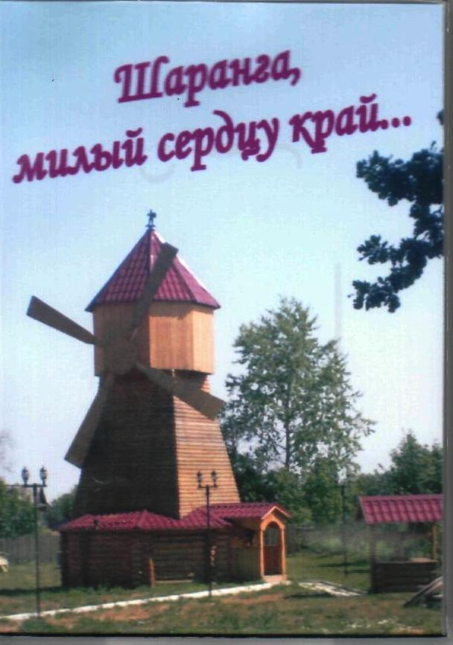
Every year many guests come to visit Sharanga and have a good rest here. They admire its cleanness and beauty.

Slide 19
Wellcome to Sharanga
I like my town very much! I can not imagine my life without my motherland.

