Slide 1
Day of Astronautics
Klad Kristina 7B
teacher:
Zemlyakova I.V

Slide 2
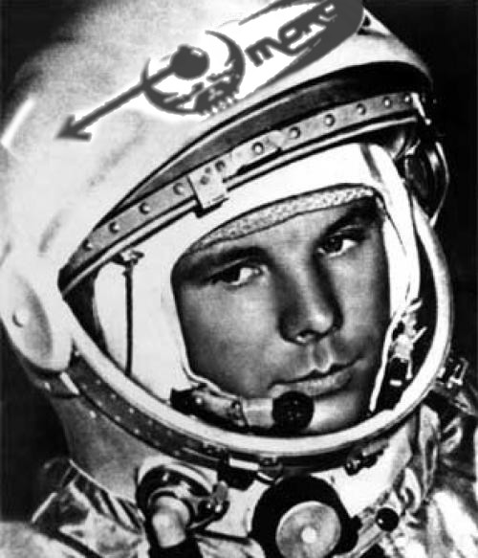
Preparation for flight
50 years ago Yury Gagarin made
The first-ever space flight
By spaceship "East".

Slide 3
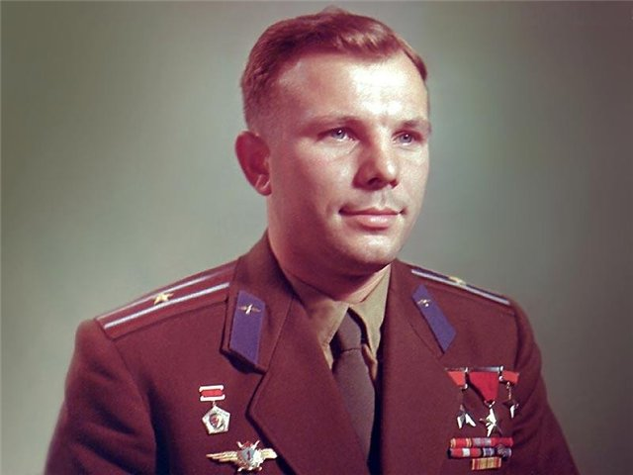
Yury's childhood has passed in village Klushino. On September, 1st, 1941 the boy has gone to school, but on October, 12th village Germans have occupied, and its study has interrupted. Almost one and a half year the village Klushino has been occupied by German armies. Once younger brother Yury, Boris Gagarin, the German has hung up on a scarf and has started to photograph. Yury has had time to call mother, and it was possible to that, having pushed away the German, to remove the son from a scarf. After that case Boris within a month could not go. [6] on April, 9th, 1943 the village was released by Red army, and study at school has renewed.

Slide 4
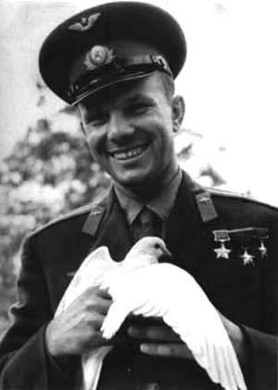
Transfer
On December, 9th, 1959 Gagarin has written the application with the request to enlist it in group of candidates in cosmonauts. In its week have caused to Moscow for passage of all-round medical examination to the Central research aviation hospital. In the beginning of next year one more special medical board which recognised the senior lieutenant Gagarin suitable for space flights has followed. On March, 3rd, 1960 by the order of the Commander-in-chief of the Air Forces of Konstantin Andreevicha Vershinin it is enlisted in group of candidates in cosmonauts, and on March, 11th Gagarin together with a family has left to a new place of work. Since March, 25th regular employment under the program of preparation of cosmonauts have begun.

Slide 5
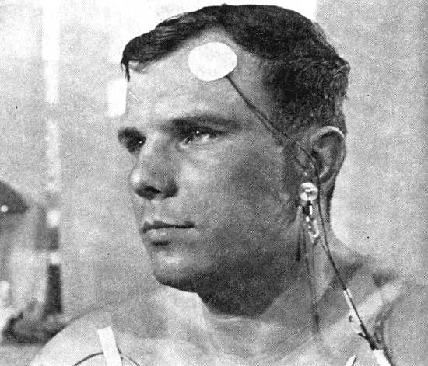
Preparation
After four months of the Moscow period of preparation which has begun in March, 1960, the Center of preparation of cosmonauts all cash structure has got over on a constant place of the basing — in Star. There by this time it was possible to create initially the most unpretentious conditions for work. Nearby, near station Chkalovsky, the first available housing — apartments for placing of families of listeners-cosmonauts and a part of families of an administrative board of the Center of preparation of cosmonauts has been received.

Slide 6
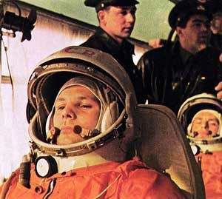
Requirements for flight
Candidates were typed among fighter pilots under the decision the Queen, considering that such pilots already have experience of overloads, stressful situations and pressure differences. Selection was spent to the first group of cosmonauts on the basis of medical, psychological and of some other parametres: age of 25-30 years, growth no more than 170 sm, weight no more than 70-72 kg, ability to high-rise and stratospheric adaptation, speed of reaction, physical endurance, mental steadiness.

Slide 7
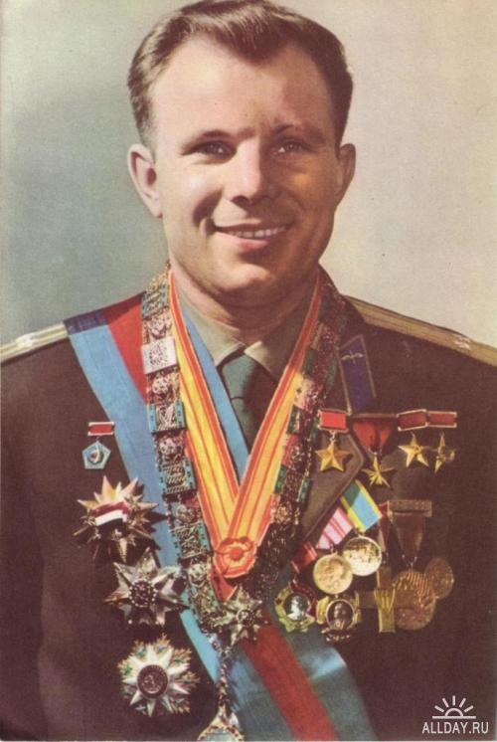
Difficult selection
From twenty applicants have selected a six, Queens very much hurried up, as there was data that on April, 20th, 1961 the person in space will be sent by Americans. And consequently start it was planned to appoint between April, 11th and 17, 1961. The one who will depart to space, steels Gagarin and its doubler Herman Titov have defined at the last minute, at session ГК, them. It has been prepared three messages of TASS on Gagarin's flight in space. The first — "Successful", the second in case it will fall to territories of other country or at world ocean — «the Reference to the governments of other countries», with the request of the help in search, and the third — "Tragical" if Gagarin does not return the live.

Slide 8
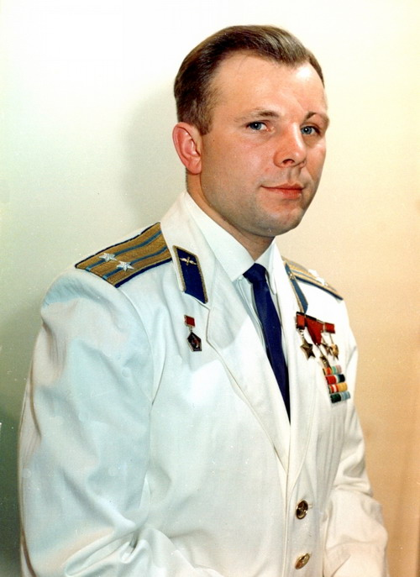
Space race
Participation of the USSR in space race has led to that at creation of the ship the East has been chosen a number not optimum, but simple and quickly realizable decisions. Some components to create in time were not in time, as a result it was necessary to refuse from: 1) systems of emergency rescue on start, 2) systems of soft landing of the ship. Besides, from a design of the under construction ship Vostok-1 duplicating brake installation has been cleaned. Last decision has been proved by that at ship start into a low 180—200 kilometre orbit, it anyway within 10 days would descend from it owing to natural braking about an upper atmosphere and would return on the earth. The same 10 days life-support systems paid off also.

Slide 9
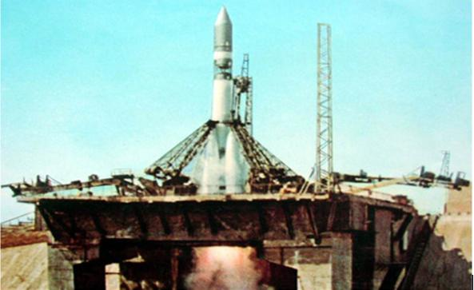
Start
Start of the ship "Vostok-1" has been made on April, 12th, 1961 at 09:07 Moscow time from the cosmodrome Baikonur; Gagarin's call sign was "Cedar". The Carrier rocket has worked the East without remarks, but at the closing stage the system of radio management which should switch off engines of 3rd step has not worked. Engine deenergizing has occurred only after operation of the duplicating mechanism (timer), but the ship has already risen into an orbit which highest point (apogee) has appeared on 100 km above settlement. The descent from such orbit with the help of "aerodynamic braking» could occupy by different estimations from 20 till 50 days.

Slide 10
Dangers
When the ship has entered into more dense beds of atmosphere connecting cables have fused, and the command on division of compartments has arrived already from temperature-sensitive elements so the lander at last has separated from a priborno-impellent compartment. Descent occurred on баллистистической trajectories (as well as at other spaceships of series the East and Rising), that is from 8-10 multiple overloads to which Gagarin was ready. It was more difficult to endure psychological loadings — after a capsule input in atmosphere the ship covering (the temperature outside at descent reaches 3-5 thousand degrees) has lighted up, on glasses of windows streams of liquid metal have begun to flow, and the cabin has started to crackle.

Slide 11
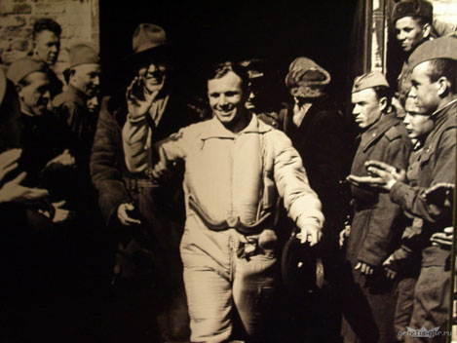
Landing to the Earth
The wife of the forester Anna Akimovna Tahtarova and its six-year grand daughter Rita have appeared the first people who have met the cosmonaut after flight. Soon to a place of events there have arrived military men from a battalion and local collective farmers. One group of military men took the lander under protection, and another has carried Gagarin in a part arrangement. Therefrom Gagarin by phone has reported to the commander of a division of air defence: «I Ask to transfer to the commander-in-chief of the Air Forces: a problem has executed, has landed in preset area, I feel well, bruises and breakages are not present.

Slide 12
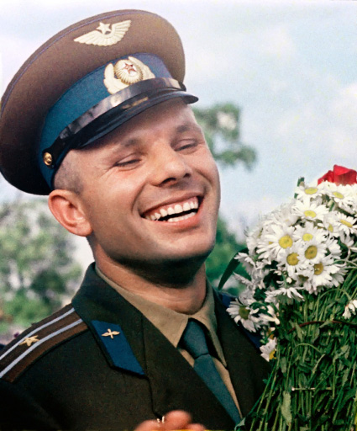
Meeting
In airdrome in Engels for Gagarin already waited, the helicopter gangway had all management of base. To it have handed over the congratulatory telegramme of the Soviet government. On Gagarin's "Victory" have carried in control office, and then in a base staff, for communication with Moscow.

Slide 13
The report on successful flight
By noon on airdrome Engels from Baikonur profits two planes: Silt-18 and An-10 on whom have arrived the vice-commander of the Air Forces lieutenant general Agaltsov and group of journalists. Within three hours while established connection with Moscow, Gagarin gave interview and was photographed. With the advent of communication he has personally reported on Khruschev (1 secretary of the Central Committee of the CPSU) and Brezhnev (the Chairman of Presidium of the Supreme body of the USSR) on flight performance. After the report Gagarin has sat down aboard the plane Silt-14 and has departed to Kuibyshev (now Samara). The decision in order to avoid a sensation to sit down somewhere far away from a city was accepted.

Slide 14
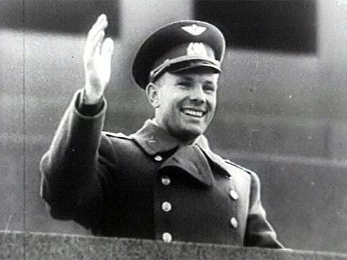
Meeting in Moscow
Originally nobody planned Gagarin's grandiose meeting in Moscow. All were solved at the last minute by Nikita Sergeevich Khruschev. According to his son — Sergey Khruschev [25]: «It has begun that has called the Minister of Defence to marshal Malinovsky and has told:„ It at you the senior lieutenant. It is necessary to raise urgently it in a rank “. Malinovsky has told, reluctantly enough, that will give to Gagarin a rank of the captain. On what Nikita Sergeevich has become angry:„ What captain? You to it though the major give “. Malinovsky long disagreed, but Khruschev has insisted on the, and the same day Gagarin became the major». Then Khruschev has called to the Kremlin and has demanded, that to Gagarin have prepared a worthy meeting.

Slide 15
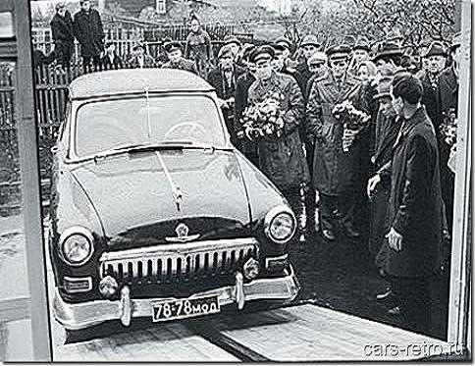
The report on flight
— A companion the First secretary of the Central Committee of Communist party of Soviet Union, Chairman of the council Ministrov of the USSR! Is glad to report on you that the task of the Central Committee of Communist party and the Soviet government is executed …

