Slide 1
Do you know
Great Britain?
Автор работы:
Бурыкина Елена Александровна
учитель английского языка
МОБУСОШ № 4
г. Новокубанск
Краснодарский край

Slide 2
4
Book
Potato
1
5
London
2
English
Dollar
3
Бурыкина Е.А., МОБУ СОШ №4, г. Новокубанск

Slide 3
4
Autumn
Pen
1
5
Russia
2
Door
Cat
3
Бурыкина Е.А., МОБУ СОШ №4, г. Новокубанск

Slide 4
4
Black
Elista
1
5
Fish
2
Dog
Clock
3
Бурыкина Е.А., МОБУ СОШ №4, г. Новокубанск

Slide 5
4
Chair
Train
1
5
Orange
2
Mark
Dog
3
Бурыкина Е.А., МОБУ СОШ №4, г. Новокубанск

Slide 6
The 1st tour
Бурыкина Е.А., МОБУ СОШ №4, г. Новокубанск

Slide 7
1. What is the official name of the country whose language you study?
the United Kingdom of Great Britain and Northern Ireland
Great Britain
England
Scotland
Бурыкина Е.А., МОБУ СОШ №4, г. Новокубанск

Slide 8
2. How many countries does the United Kingdom consist of?
One
Two
Three
Four
Бурыкина Е.А., МОБУ СОШ №4, г. Новокубанск

Slide 9
3. What is the capital of the United Kingdom?
Cardiff
Dublin
London
Belfast
Бурыкина Е.А., МОБУ СОШ №4, г. Новокубанск

Slide 10
4. What is the symbol of England?
Bald eagle
Britannia
Rose
Thistle
Бурыкина Е.А., МОБУ СОШ №4, г. Новокубанск

Slide 11
5. Piccadilly Circus is the meeting point of …
four streets
five streets
six streets
seven streets
Бурыкина Е.А., МОБУ СОШ №4, г. Новокубанск

Slide 12
6. The name of the Palace where the Queen lives is …
the Tower of London
the White House
the Windsor Palace
the Buckingham Palace
Бурыкина Е.А., МОБУ СОШ №4, г. Новокубанск

Slide 13
7. England is in …
Europe
Africa
America
Asia
Бурыкина Е.А., МОБУ СОШ №4, г. Новокубанск

Slide 14
8. The symbol of this country is a thistle; its patron saint is St. Andrew.
England
Wales
Scotland
Northern Ireland
Бурыкина Е.А., МОБУ СОШ №4, г. Новокубанск

Slide 15
9. What is the capital of Wales?
London
Cardiff
Belfast
Edinburgh
Бурыкина Е.А., МОБУ СОШ №4, г. Новокубанск

Slide 16
10. What is the largest part of the UK?
England
Scotland
Wales
Northern Ireland
Бурыкина Е.А., МОБУ СОШ №4, г. Новокубанск

Slide 17
The sights of London
Бурыкина Е.А., МОБУ СОШ №4, г. Новокубанск

Slide 18
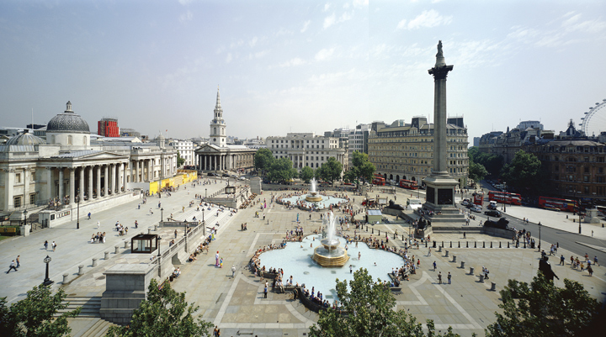
Trafalgar Square
Trafalgar Square was built in 1830 and is used to be home to thousands of pigeons. There is the statue of Admiral Lord Nelson there.
Бурыкина Е.А., МОБУ СОШ №4, г. Новокубанск

Slide 19
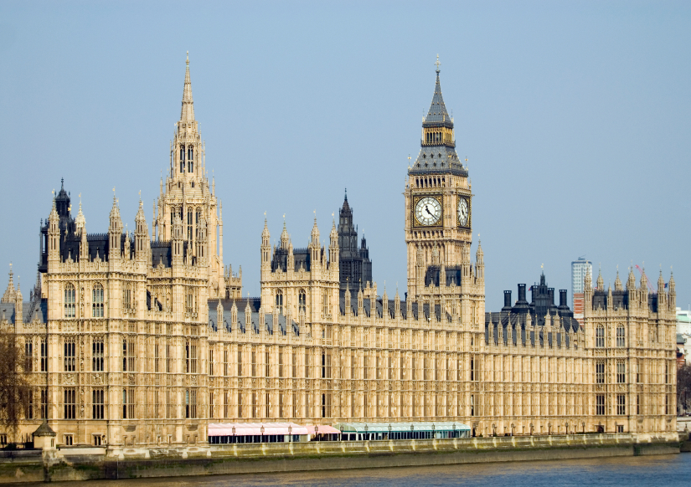
The Houses of Parliament with Big Ben
The Houses of Parliament was built in 1840. It is the seat of the British government. The Houses of Parliament contain the bell Big Ben. Big Ben is the biggest clock in Britain.
Бурыкина Е.А., МОБУ СОШ №4, г. Новокубанск

Slide 20
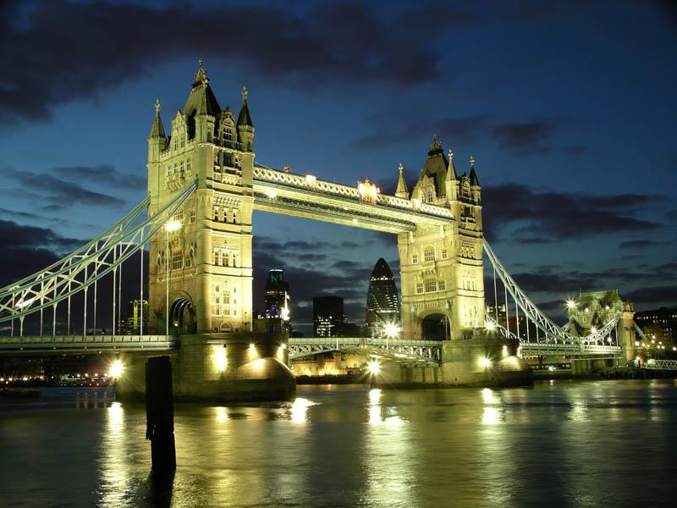
Tower Bridge
The Tower Bridge, named after its two impressive towers, is one of London's best known landmarks. This Victorian Bridge is now more than 100 years old.
Бурыкина Е.А., МОБУ СОШ №4, г. Новокубанск

Slide 21
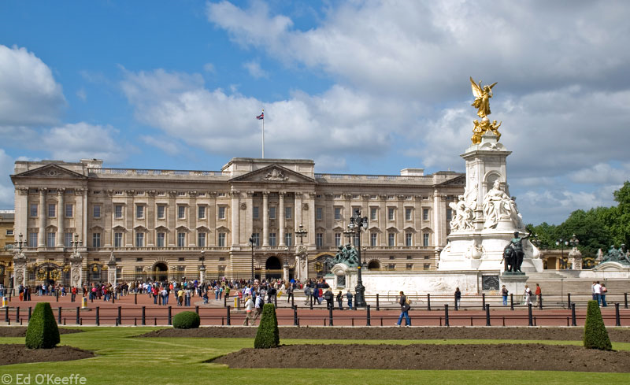
Buckingham Palace
Buckingham Palace was built in 1702 by the Duke of Buckingham as his London home. Now it is the London home of the Queen.
Бурыкина Е.А., МОБУ СОШ №4, г. Новокубанск

Slide 22
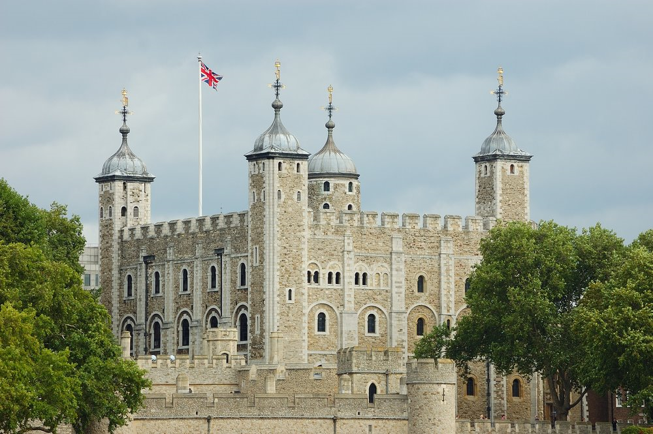
The Tower of London
For a long time the Tower of London was a fortress, a prison and a royal palace. Now it is a museum.
Бурыкина Е.А., МОБУ СОШ №4, г. Новокубанск

Slide 23
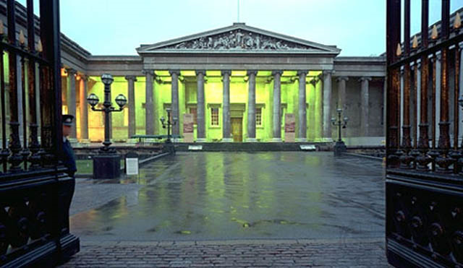
The British Museum
The British Museum was founded in 1753. Now it is the national museum of antiquities.
Бурыкина Е.А., МОБУ СОШ №4, г. Новокубанск

Slide 24
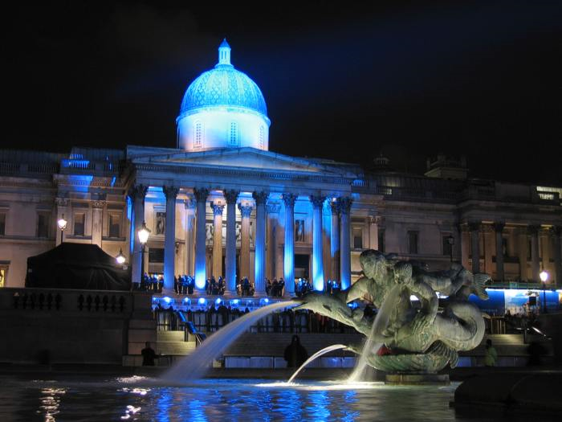
National Gallery
National Gallery, one of the principal art galleries in Britain, is located in Trafalgar Square. The gallery was built in 1834.
Бурыкина Е.А., МОБУ СОШ №4, г. Новокубанск

Slide 25
Horizontal line
1. The biggest and the most famous clock in Britain.
3. The capital of Great Britain.
5. Where is a Column of Nelson?
2
1
Vertical line
1. The Royal Palace in London.
2. The fortress, royal palace, prison, and now a museum.
4. One of the principal art galleries in Britain.
3
4
5
Бурыкина Е.А., МОБУ СОШ №4, г. Новокубанск

Slide 26
The 2nd tour
Бурыкина Е.А., МОБУ СОШ №4, г. Новокубанск

Slide 27
1. What is the Tower of London now?
prison
museum
house
fortress
Бурыкина Е.А., МОБУ СОШ №4, г. Новокубанск

Slide 28
2. What can you see in Trafalgar Square?
Nelson statue
King memorial
Queen memorial
M. Gorbachev memorial
Бурыкина Е.А., МОБУ СОШ №4, г. Новокубанск

Slide 29
3. The legend says that without them the Tower will fall. They are …
the pigeons
the cats
the squirrels
the ravens
Бурыкина Е.А., МОБУ СОШ №4, г. Новокубанск

Slide 30
4. When can you see the flag over the Queen’s Palace?
when she is out
when she is abroad
when she has a party
when she is at home
Бурыкина Е.А., МОБУ СОШ №4, г. Новокубанск

Slide 31
5. Where is London’s zoo?
Regent’s park
Hyde park
St. James’ park
Central Park
Бурыкина Е.А., МОБУ СОШ №4, г. Новокубанск

Slide 32
6. Sir Christopher Wren built …
St. Paul’s Cathedral
the Tower of London
Westminster Abbey
the Parliament
Бурыкина Е.А., МОБУ СОШ №4, г. Новокубанск

Slide 33
7. Where are the tombs of many British kings and queens and other famous people?
in the Tower of London
on the Cemetry
on the river bank
in Westminster Abbey
Бурыкина Е.А., МОБУ СОШ №4, г. Новокубанск

Slide 34
8. Covent Garden is now …
a cinema
a fruit and vegetable garden
a theatre
a tourist shopping centre
Бурыкина Е.А., МОБУ СОШ №4, г. Новокубанск

Slide 35
9. The Princess Diana was the wife of …
Prince John
Prince Robert
Prince Charles
Prince Wilgelm
Бурыкина Е.А., МОБУ СОШ №4, г. Новокубанск

Slide 36
10. How many members are there in the House of Commons?
350
450
550
650
Бурыкина Е.А., МОБУ СОШ №4, г. Новокубанск

Slide 37
The 3rd tour
Бурыкина Е.А., МОБУ СОШ №4, г. Новокубанск

Slide 38
PERSONALITY
Бурыкина Е.А., МОБУ СОШ №4, г. Новокубанск

Slide 39
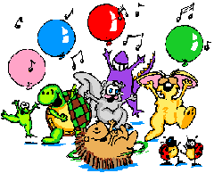
Thank you
for your attention!
Бурыкина Е.А., МОБУ СОШ №4, г. Новокубанск

Slide 40
Источники
http://v-n-zb.livejournal.com/2922947.html
http://weekend-tour.my1.ru/publ/ehkskursii/velikobritanija/velikobritanija/22-1-0-73
http://www.luchmir.com/History/RusskayaZima05.htm
http://www.gothereguide.com/Houses-of-parliament+london-place
http://www.mota.ru/wallpapers/get/id/22305/resolution/1366x768
http://elitethings.com/elits/gostinicy/
http://virtune.ru/page/5/
Бурыкина Е.А., МОБУ СОШ №4, г. Новокубанск

