Slide 1
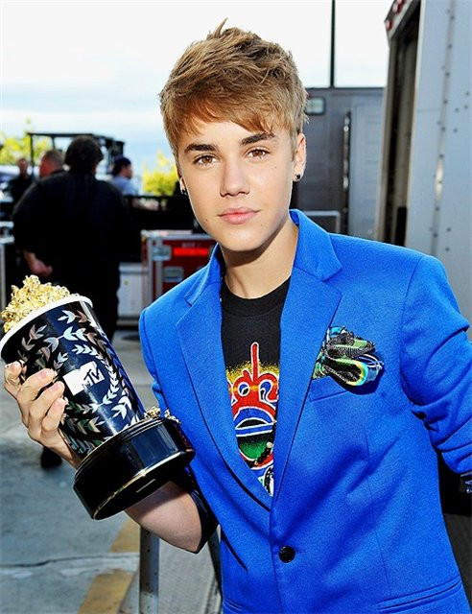
Подготовили: 1. Испирян Теймине 2. Испирян Кристина 3. Матвеева Милана 4. Маркелов Никита 5. Шемекеева Нина Учитель английского языка: Дубинина Лариса Витальевна
МБОУ «Средняя общеобразовательная школа№6 г.Канаш Чувашская республика
Justin Bieber
2012г.

Slide 2
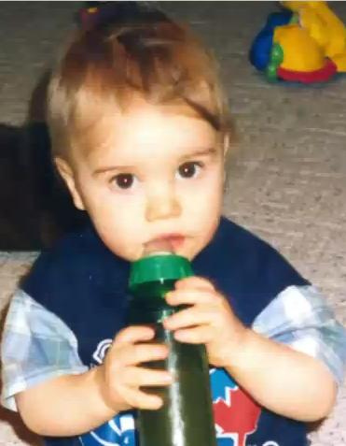
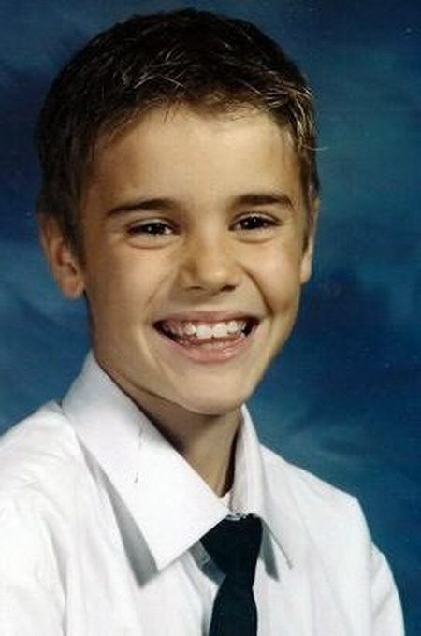
Justin Bieber was born on March 1, 1994. He was born in the city Stratford in the Canadian province of Ontario. His mother, Pattie Mellette met Jeremy Bieber at the very young age of 18 and gave birth to Justin.
Biography

Slide 3
Justin's mother bought him a drum set at the age of 4, and then he quickly progressed in learning to play the piano at age 7 and the guitar at age 10. When Justin went to the middle school, he learned to play the trumpet. It was no secret that Justin had an aptitude for playing musical instruments, but Justin amazed everyone with his singing voice at his hometown singing contest called the Stratford Star. Justin Bieber's proud parents posted videos of the singing competition on YouTube where the video became a viral hit. It was so much of a hit that music industry executives, including the former child hip hop singer phenomena. Usher signed a lucrative record contract with Justin Bieber .
glory

Slide 4
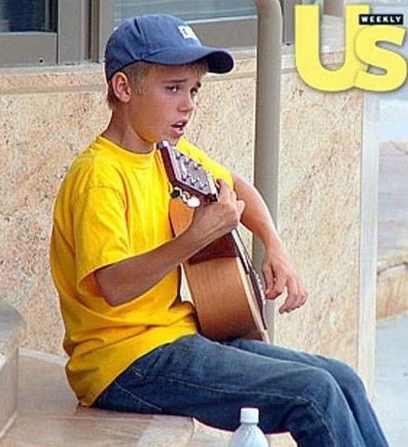
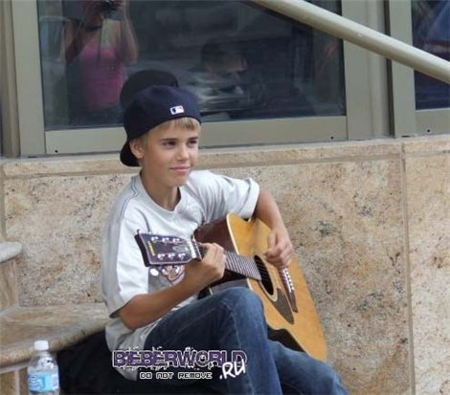
When the boy was 13 he helped the mother to pay accounts. The Us Magazine published the unknown boy Biber's pictures, on them he tried to earn money by the talent at a cinema. As it is known from the biography and the film about the life of the star boy, he was not always a star. The Canadian teenager had to help his mother who brought her children up without the father. Biber played the guitar and sang at an entrance of a cinema. Justin told that his earnings at a cinema were 3000 dollars that is certainly incomparable with its today's income. So the career of the well-known teenager began.
The career of the teenager

Slide 5
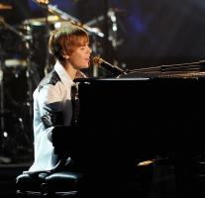
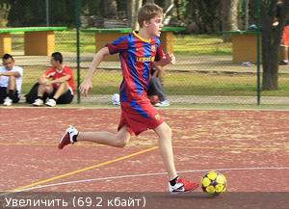
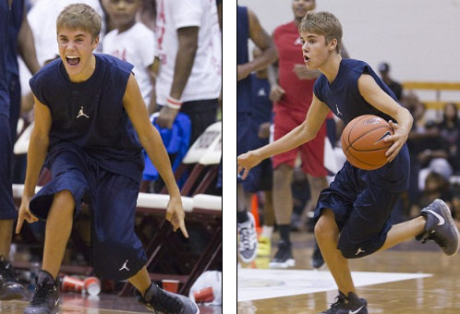
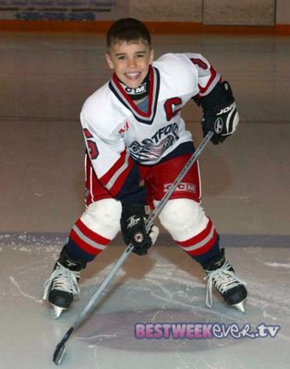
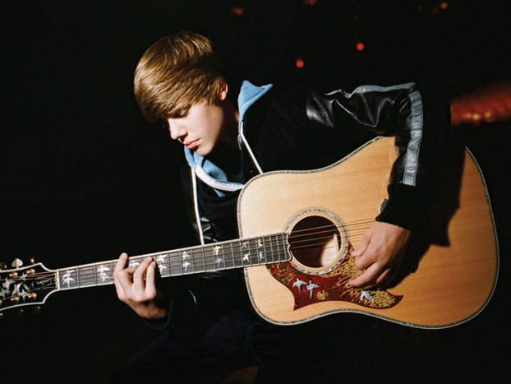
Justin is an actor and a singer. Bieber is also a self-taught musician who plays the drums, guitar, piano and trumpet. In addition to the music Justin is fond of sports. They are hockey, basketball, football, golf.
Hobby

Slide 6
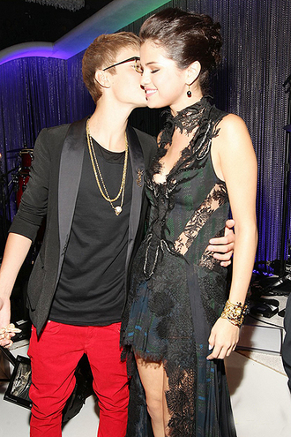
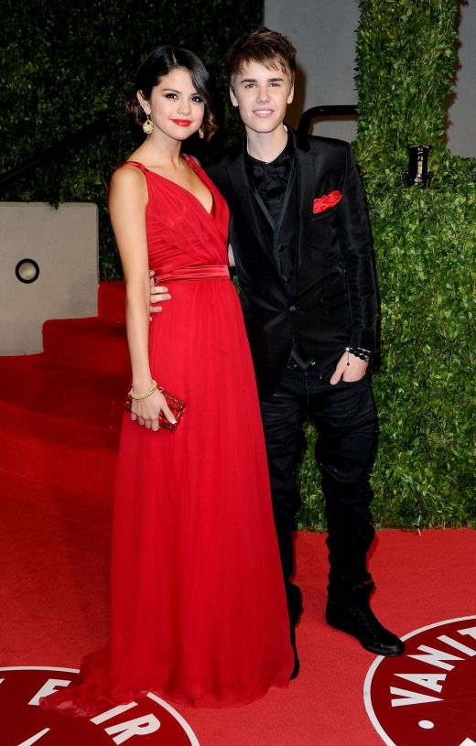
In 2010 Justin met the actress and singer Selena Gomez. They spend a lot of time together. They try to give to each other the days off. They love each other, respect interests of each other, like to make pleasant gifts, to surprise each other. They are a good pair.
Private life

Slide 7
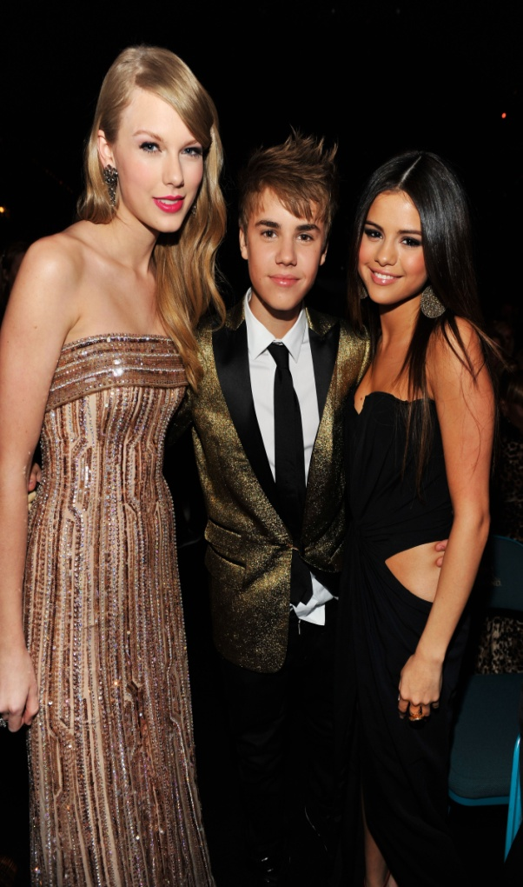
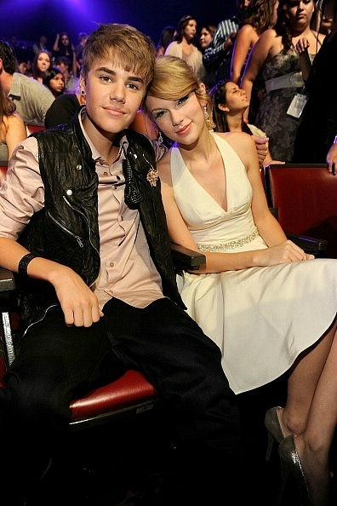
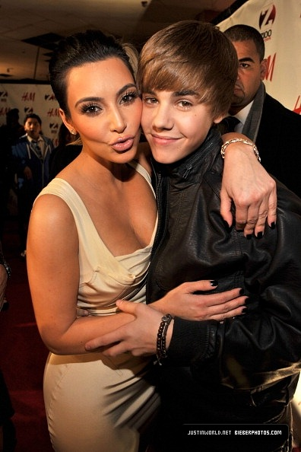
For Justin friends have great value. He appreciates them very much, respects, and will never betray. Justin has many friends from celebrities. They are Jaden Smith, Kim Karadashian, Taylor Swift, Mayli Cyrus, Selena Gomez and others.
Friends

Slide 8
2010 American Music Awards Actor of the year 1 Actor the year 2 the Best Pop/Rock performer The best debut Favourite Rock album 2010 BET Awards The best new actor 2010 Juno Awards Album of the Year Pop Album of the Year New actor of year 2010 Meus Prêmios Nick Awards The best world artist 2010 MTV Brazil Music Awards The best world artist 2010 MTV Europe Music Awards The best new performer The best boy 2010 MTV Video Music Awards The best new actor
awards
2011 Brit Awards The best debut 2011 awards "Grammy" The best new actor The best vocal Album 2011 Juno Awards The best album The best artist The best actor International Album of theYear 2011 Kids Choice Awards the Favourite singer the Favourite songs ("Baby") 2011 Billboard New actor Social actor Photocopy actor Digital artist of Media The best album Streaming (video) Favourite of the crowd 2011 CMT The best video of the year 2011 MTV Music Awards The best video of the year 2011 MTV Video Awards The best man's video
2010 Much Music Video Awards New Artist Canadian video The international videos of the year in Canada 2010 Myx Music Awards The best world artist 2010 Teen Choice Awards Man's performer Man's artist Summer musical star Fanatic Fans Pop album 2010 TRL Awards The best actor 2010 World Music Awards The best singer The best new actor 2010 Young Hollywood Awards The best Beginner of the year
2011 People's Choice Awards Favourite artist Favourite clips

Slide 9
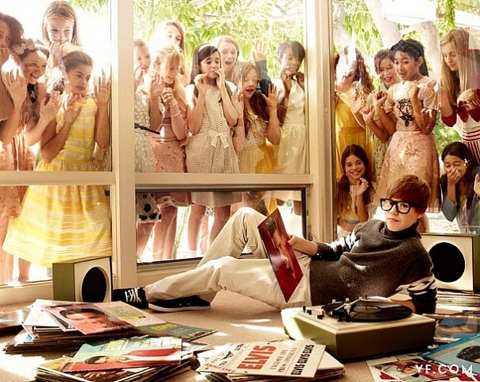
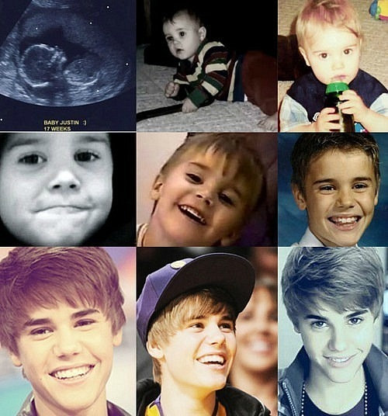
http://ru.wikipedia.org/wiki/%C1%E8%E1%E5%F0,_%C4%E6%E0%F1%F2%E8%ED http://www.bieberworld.ru/ http://www.bieberworld.ru/photo http://ilovejustinbieber.ru/biografiya-justina-bibera.html http://www.justinbiebermusic.com/ http://www.myspace.com/justinbieber http://www.facebook.com/JustinBieber http://lichnosti.net/people_1521-art_2057.html
resource

Slide 10
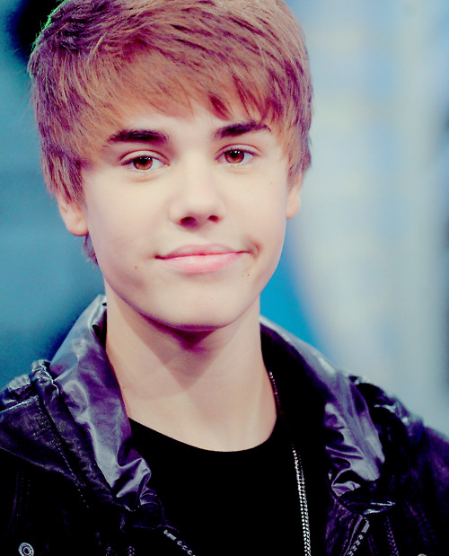
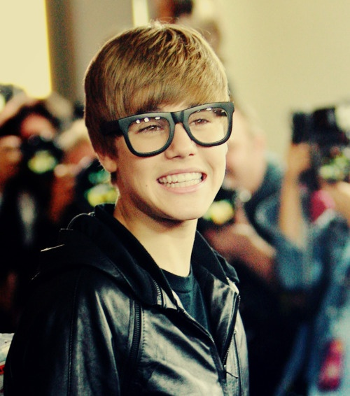
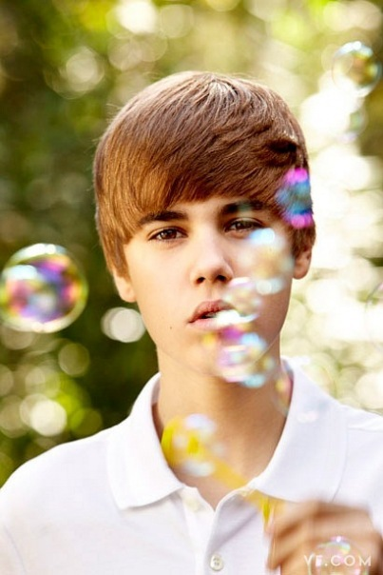
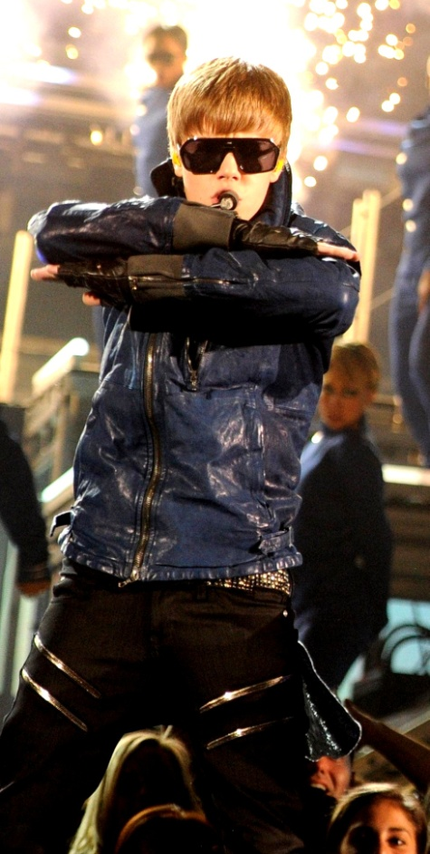
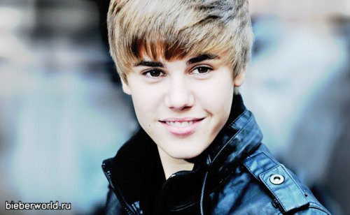
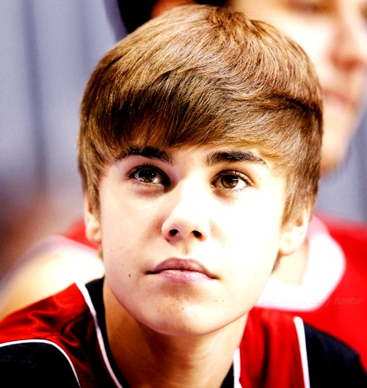
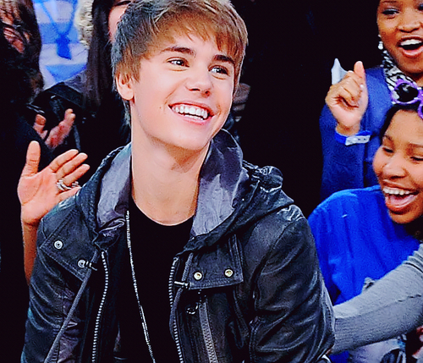

Slide 11
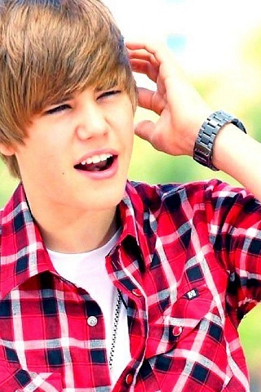
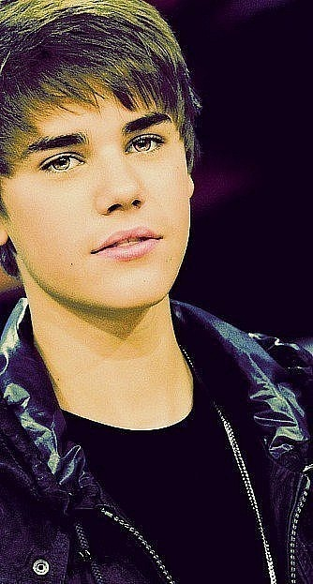
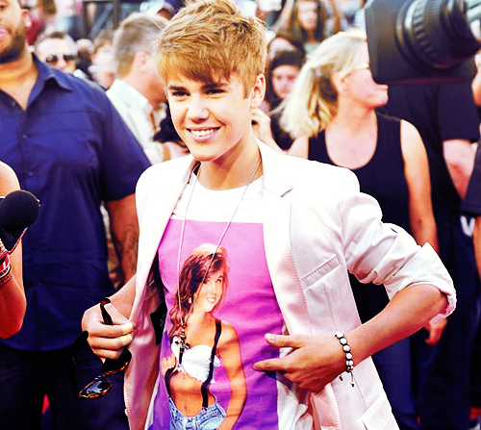
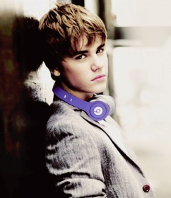
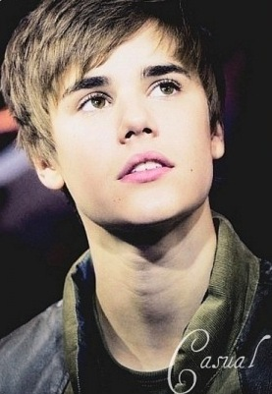
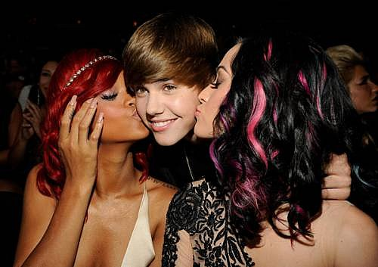
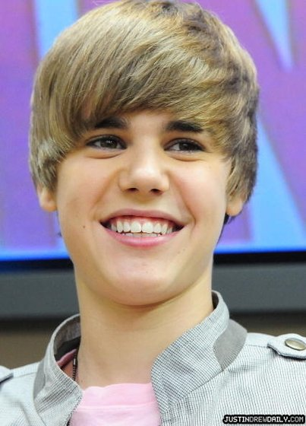
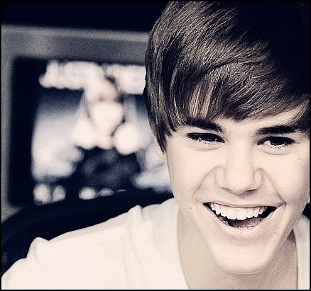
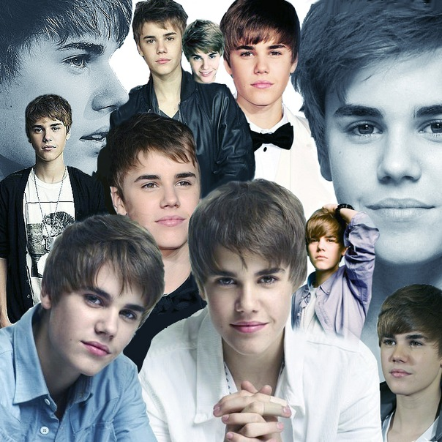
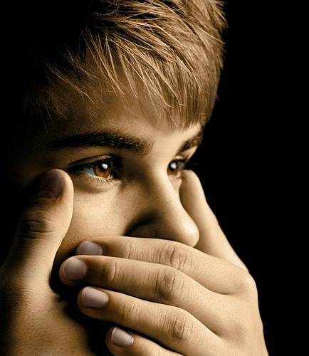

Slide 12
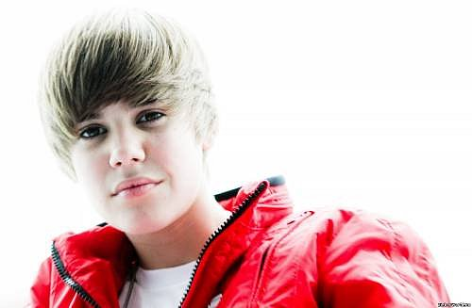
Thank you!!!

