Slide 1
Project 7 Wonders of the World
creator: Semenets P. form 7 «B» school years 2010-2011

Slide 2
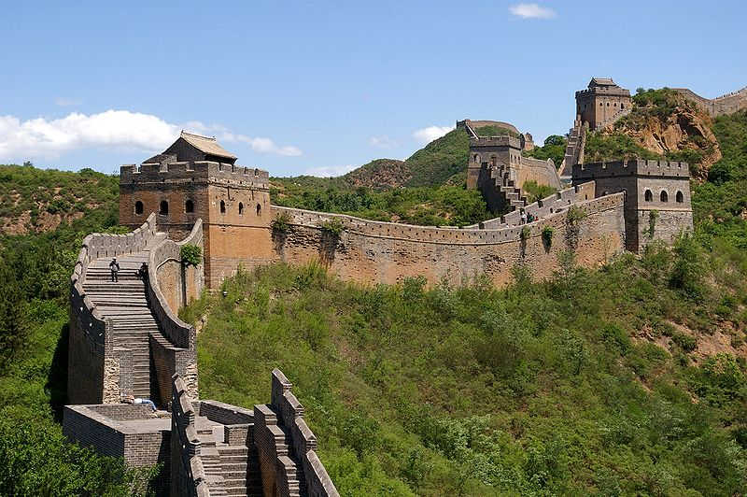
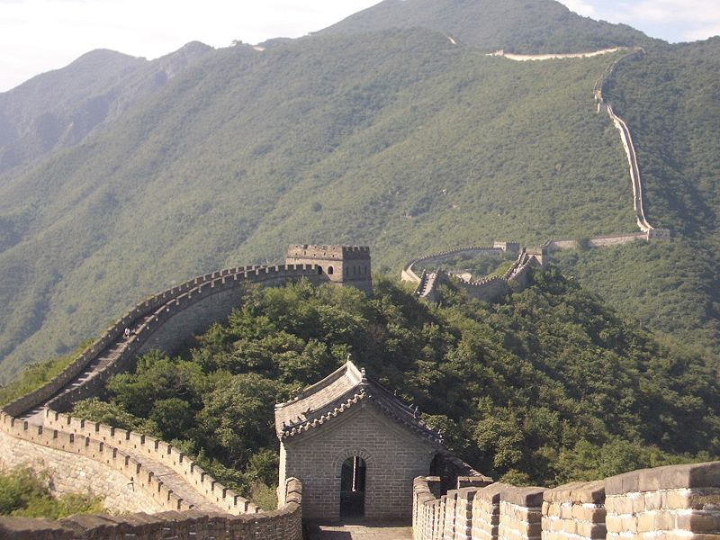
Great Wall of China
Construction of the first wall began in the III century BC. er. during the reign of Emperor Qin Shi Huangdi, (Qin Dynasty), in the Warring States period (475-221 years. BC. er.) to protect the state from the raids of the nomadic Xiongnu people. Participated in the construction of a fifth of the then population, about one million people. The length of the wall is 8,000 851 km and 800 meters.
The wall was supposed to serve at the northern line of a possible expansion of the Chinese themselves, it was to protect the citizens "Middle Kingdom" of the transition to a semi-nomadic way of life, from the confluence with the barbarians.

Slide 3
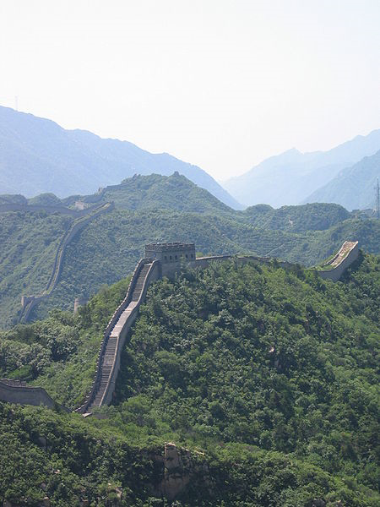
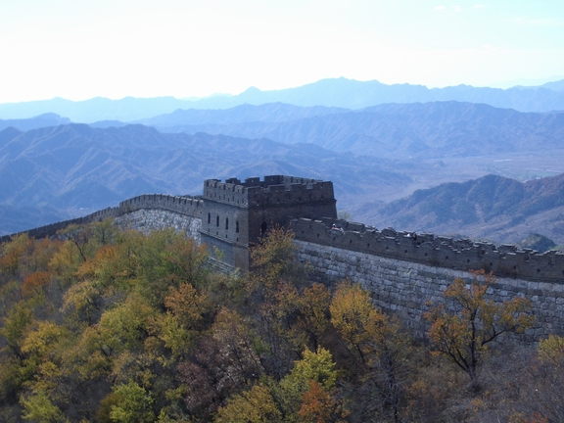
The wall was supposed to clearly indicate the boundaries of Chinese civilization, to promote the consolidation of a unified empire, had just drawn from a number of conquered kingdoms. During the Han Dynasty (206 BC. - 220 n.) Wall was extended west to Dunhuang. Also, the line was built watchtowers, goes deep into the desert to protect the trade caravans of nomads.
Those portions of the Great Wall, which survived until our times, were built mainly during the Ming Dynasty (1368-1644). In this era of major construction materials are brick and stone blocks, makes the design more robust. During the reign of the Ming wall stretched from east to west from Shanhaiguan outpost on the shores of Bohai Bay of the Yellow Sea to the gates Yuymenguan at the junction of the modern provinces of Gansu and the Xinjiang Uygur Autonomous Region.

Slide 4
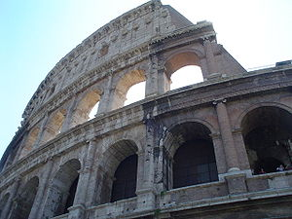
Colosseum in Rome
Coliseum - the largest of the ancient Roman amphitheater - one of the most famous ancient monuments of ancient Rome and one of the most remarkable facilities in the world. Located in Rome, in a hollow between Eskvilinskim, and Tselievskim Palatine hills, the place where the pond belongs to the Golden House of Nero.
The construction was over 8 years, 72-80 years. Mr. The Colosseum was a long time for the residents of Rome and visiting the main place of entertainment shows, such as gladiator fights, animal travli.Pri emperor Macrina, he suffered from a fire, but was restored by decree of Alexander Severus. In 248, Emperor Philip has celebrated it with great views of the millennium of the existence of Rome.

Slide 5
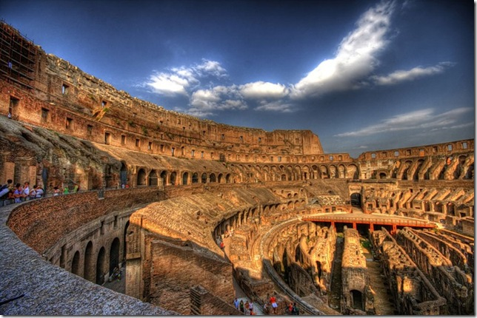
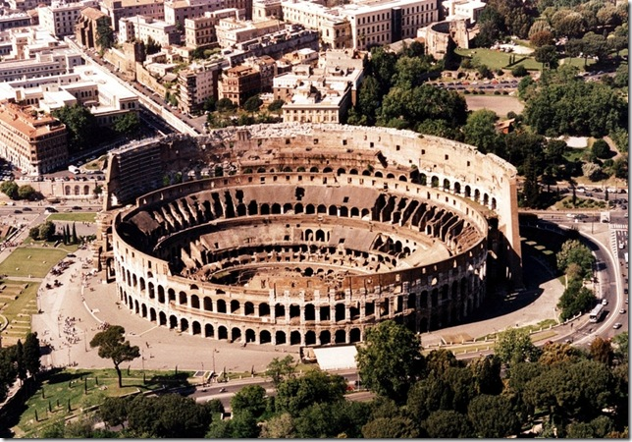
After the invasion of barbarians, the Flavian Amphitheatre desolation came and began to disintegrate. Since 11 century to 1132 Amphitheatre was a fortress for the wealthy Roman birth, who tried to challenge the influence and power over the Roman citizens. In 1332 the aristocrats suit here bullfights, but from that time began the permanent destruction of the Coliseum.
Now the stones were the Coliseum to build new facilities. At 15 and 16 centuries P. Paul II took from him the stones for the construction of the Venetian palace, the palace of Cardinal Riario for the office, and Paul III for the palace of the Farnese. With all of this has escaped most of the amphitheater, but the building as a whole remains disfigured.

Slide 6
Machu Pikchu
City of ancient America, located in present-day Peru. Also, Machu Picchu, often referred to as the "city in the sky"or "city amongst the clouds, sometimes called" the lost city of the Incas. "
Some archaeologists believe that this city was established as a sacred mountain shelter the great Inca ruler Pachacutec a century before the conquest of his empire, that is, approximately in 1440 and functioned until 1532, when the Spaniards invaded the Inca empire. In 1532 all of its inhabitants mysteriously disappeared. Similar to the Machu Picchu mountain town Chokekirao lasted much longer, up to 1570's. The city is situated on the territory of modern Peru at the top of a mountain ridge at an altitude of 2,450 meters above sea level, dominating the valley of the Urubamba River.

Slide 7
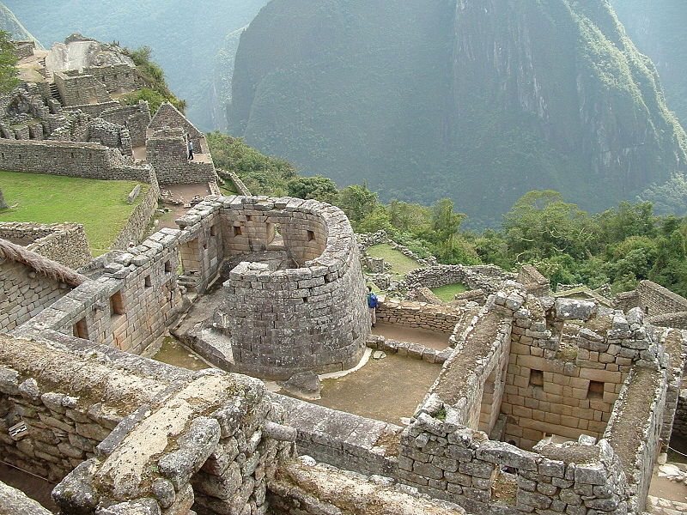
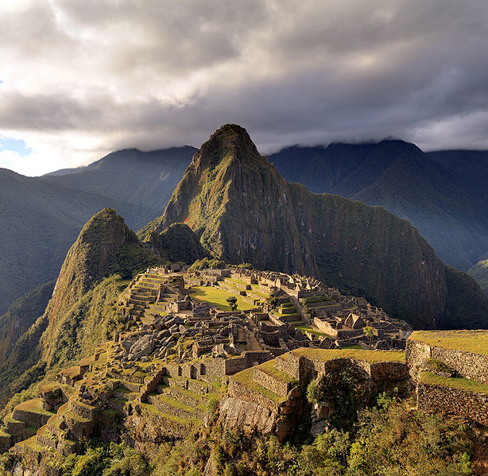
According to its modest size Machu Picchu can not claim to be a big city - it is not more than 200 buildings. This is mainly temples, residences, warehouses and other facilities for public use. For the most part they are composed of well-crafted stone, close-fitting panels to each other. It is believed that in and around it lived up to 1200 people, who worshiped the sun god Inti there and cultivated crops on the terraces.
More than 400 years the city was forgotten and remained in ruins. His discovered an American researcher from Yale University professor Hiram Bingham July 24, 1911. When he got here, accompanied by a dedicated government unit of Health and local boy, a conductor, he found the peasants living there.

Slide 8
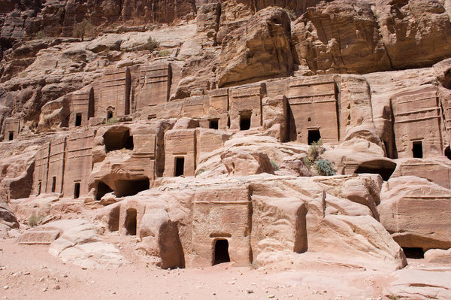
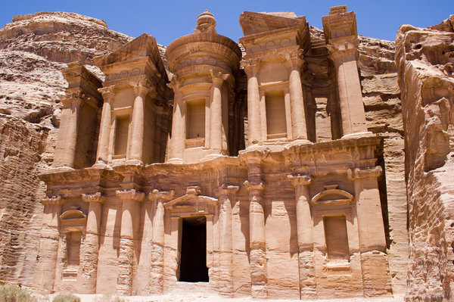
Petra
Peter was located at the crossroads of two major trade routes: one connected the Red Sea to Damascus, the other - the Persian Gulf with Gaza in the Mediterranean coast. Heading for the Persian Gulf caravans laden with precious spices, for weeks had to grin and bear the rigors of the Arabian desert until they reached the coolness of the narrow canyon Sik, leading to a long-awaited Peter.
There, travelers find food, shelter, and a cool life-giving water. Hundreds of years of trade brought great wealth of Petra. But when the Romans opened sea routes to the East, overland trade of spices came to naught, and Peter gradually deserted, lost in the sands. Many structures of Petra were erected at different times and under different masters of the city.

Slide 9
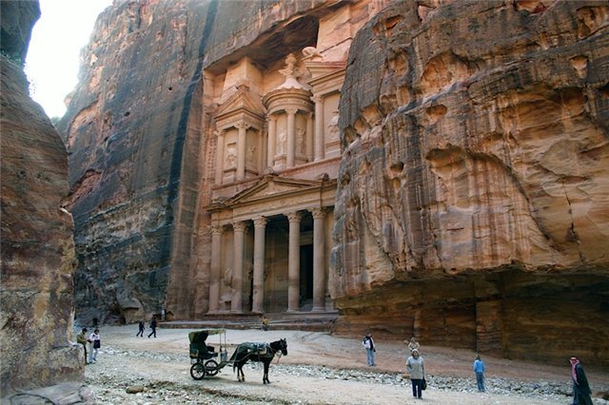
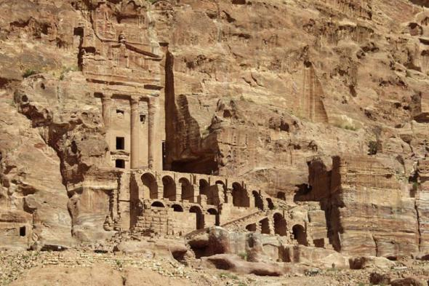
Having learned to expertly collect water, residents of Petra also mastered the art of working with stone. The name "Peter", which means "rock ", is associated with a stone. And Peter really was a city of stone, similar to her in the Roman Empire was not. Alarm, built a city, patiently carved houses, tombs and temples of stone blocks.
Peter is conveniently located among red sandstone, which are ideally suited for construction, and the first century AD in the heart of the desert rose a monumental city. With terracotta pipes architects Peters created a complex system of water and despite the arid climate, residents will never need water.

Slide 10
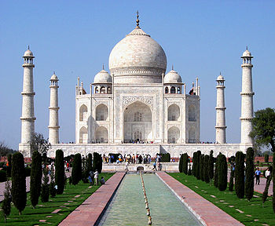
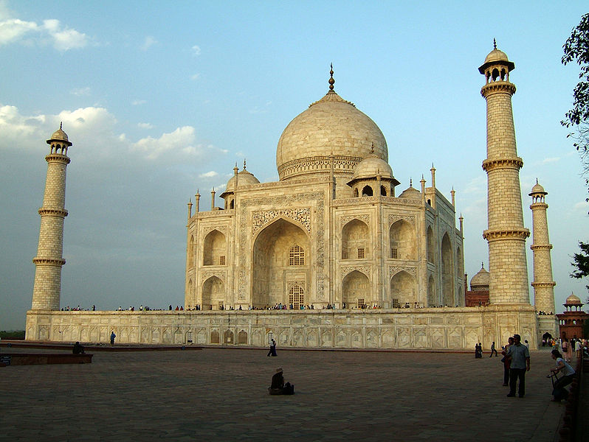
Taj Mahal
Mausoleum-Mosque, located in Agra, India, on the banks of the river Yamuna (architects, probably Ustad Isa and others). Built by the Mughal emperor Shah Jahan in memory of his wife Mumtaz Mahal, who died in childbirth (later there was buried himself Shah Jahan).
Taj Mahal (also "the Taj") is considered the best example of Mughal architecture style, which combines elements of Persian, Indian and Islamic architectural styles. Despite the fact that the white marble dome of the mausoleum is the most prominent component, the Taj Mahal - is structurally integrated complex.

Slide 11
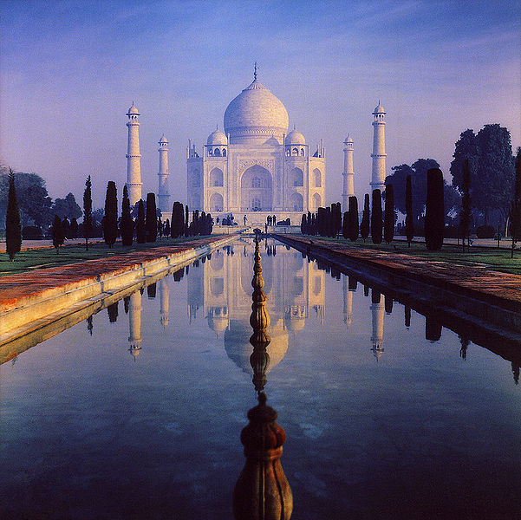
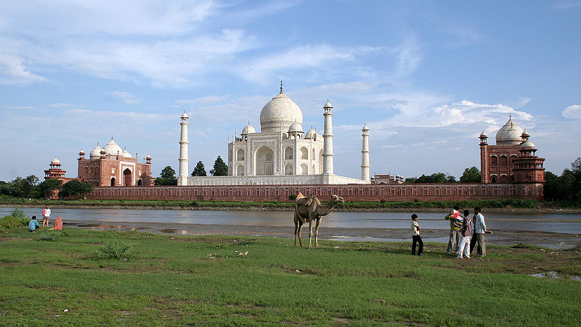
The building began to build around in 1632 and completed in 1653, employed thousands of artisans and craftsmen. Construction management of the Taj Mahal was entrusted to the Board of Architects under imperial control, including Deschênes Ana, Makramat Khan and Ustad Ahmad Lahauri. Chief designer is usually considered Lahauri.
Inside the mausoleum are two tombs - Shah and his wife. In fact, their place of burial is in the same place and the tomb, but under the ground. Construction time is approximately 1630-1652 years.

Slide 12
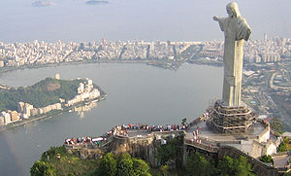
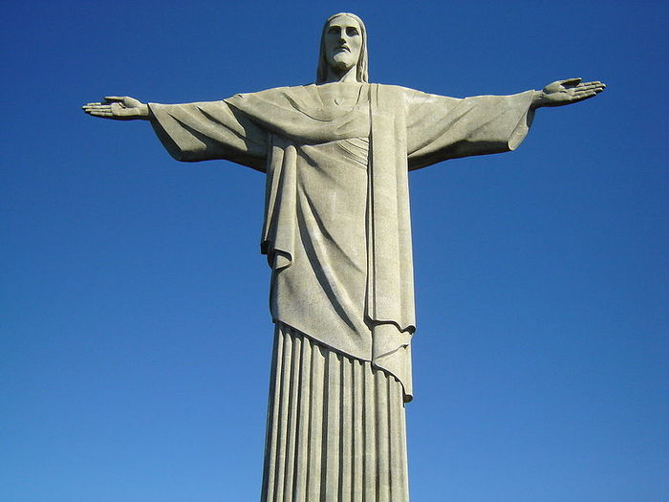
Christ the Redeemer
The exact dimensions of the statue of Christ the Redeemer are: height - 38 meters, including the pedestal - 8 m, weight - 1145 tons; span - 30 feet. Statue of Christ Redeemer in Rio de Janeiro - one of the most famous and popular in the world monuments.
In 1921 blizyaschayasya centenary of national independence of Brazil (1822) inspired the fathers of the city - Rio de Janeiro when it was the capital of Brazil - to create a monument to Christ the Redeemer. Magazine "O Cruzeiro announced fund-raising by subscription for the construction of the monument.

Slide 13
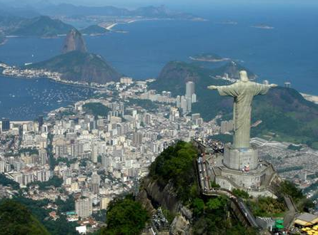
As a result, the campaign had collected 2.2 million flights. To raise funds and joined the church: the then Archbishop of Rio de Janeiro, Don Sebastian Leme took a large part in creating the monument.
In 1924 the French sculptor Paul Landowski (Paul Landowski) finished the modeling of the head (height 3.75 meters) and the hands of the statue. In the disassembled all the parts of the monument were brought to Brazil, and transported by rail to the top of Corcovado Mountain.

Slide 14
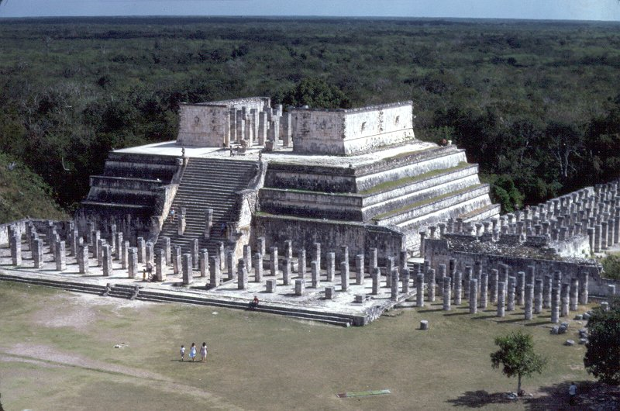
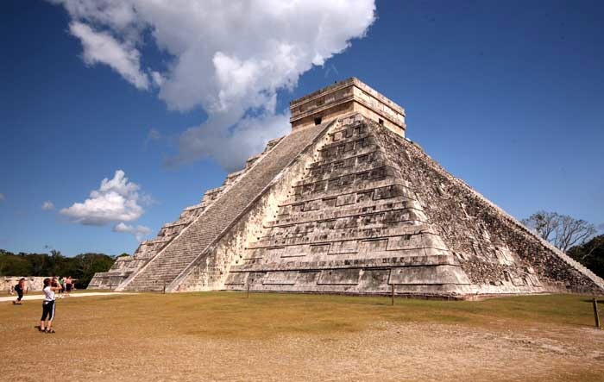
Chichen Itza
Chichen Itza (Mayan language "about the source of Itza") was probably founded around 450 AD Mayan tribes migrating from the south. Experts suggest that the site continued to occupy and at the end of the Mayan Classic Era (c. 900 AD), in contrast to central and southern areas of the Mayan (Campeche, Chiapas, Guatemala, Honduras), which until that time had a much greater significance.
New research suggests that the tribes of the Central Mexican mountain region were heading east, getting to this part of Yucatan in 7-8 centuries, mixing with the Aboriginal Maya. A century or two later, followed by a return migration, which explains the apparent Mayan items found in Thule.

Slide 15
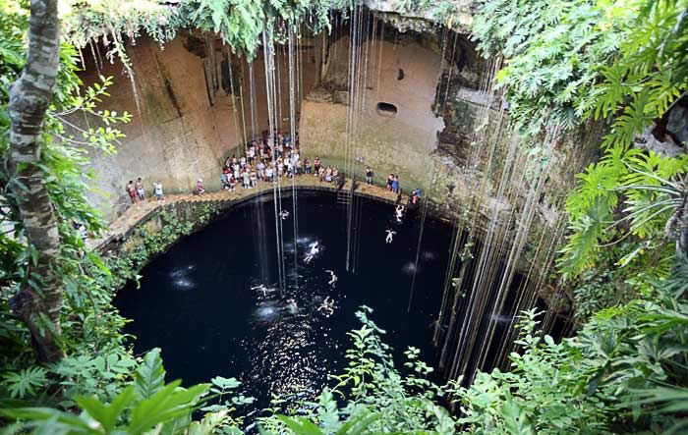
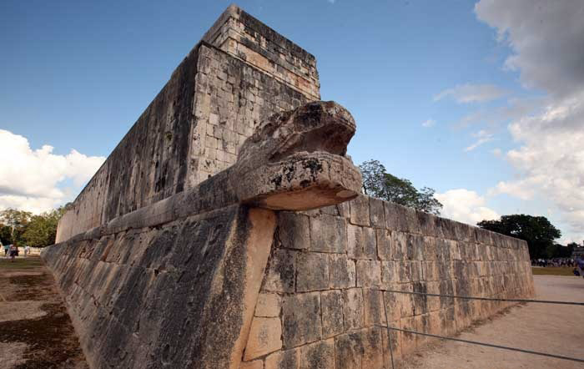
Previously, archaeologists believed that the Toltecs, first made a 1200-km journey from Tollan (Tula Modern) to the northern Yucatan around 1000 BC, when they established themselves at Chichen Itza (or Uukil-abnal, "seven bushes" in the language of the Maya as it was then called the settlement)
According to old chronicles the Nahua, the recent migrants were headed by the legendary prince Ke Akatl Topiltsin named, as well as several governors Toltec, Kuttsalkoatlem or Kukulkanom ("feathered serpent"). He was expelled from Tula to become more peaceful.

Slide 16
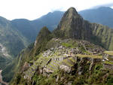
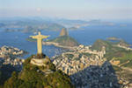
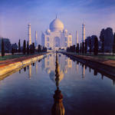
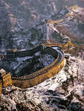
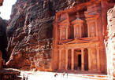
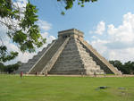
THE END

